Slide 1
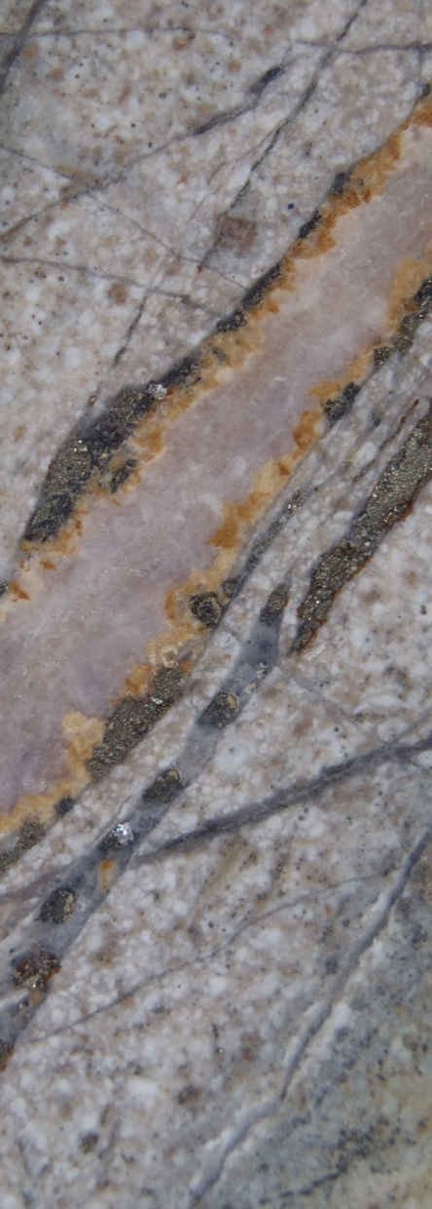
Making the most of multi-element geochemistry A work-flow for interpreting ICP assays
Scott Halley
Consulting Geochemist,
Mineral Mapping Pty Ltd,
Hawley Beach, Tasmania, 7307.
Email: minmap@westnet.com.au
Web: www.scotthalley.com.au
Notes:
Over the last 40 years, standard analytical methods have evolved from XRF and atomic absorption spectroscopy to Instrumental Neutron Activation Analysis to ICP atomic emission spectroscopy to ICP mass spectroscopy. Adjusted for inflation, commercial assay laboratories now deliver analyses for half of the periodic table with amazing precision and detection limits for the same price as half a dozen base metals by AAS 40 years ago.
A four acid digest with a combination of ICP AES and ICP MS is gradually becoming an industry standard. This is the best fit for purpose assay package for mining and exploration companies for routine analyses at an affordable price. It is not the best digest and analytical combination for every element, but it is the best technique for most metals and pathfinders. ICP MS is also a superb analytical method for trace elements and it is quite adequate for the major elements.
Even though vast amounts of data are being generated, most companies still just plot Cu, Au and a few pathfinders, and don’t really know what to do with the other 40-odd elements.
Mining companies and assay laboratories both have strict QAQC protocols for commercial metals. These procedures include inserting reference samples with known metal concentrations, running duplicate assays and round-robin surveys to compare laboratory performance with other laboratories. The same QAQC procedures are not applied to all of the elements reported in the four acid digest ICP AES and ICP MS packages. All laboratories add a disclaimer to the analyses by this method advising that some metals may not be completely dissolved with a 4 acid digest. The reality is that there is a significant difference reported by different laboratories for the same samples. All labs use the same ICP AES and MS instruments. The differences in results are due to different sample preparation procedures and especially different acid digest protocols. The sample preparation is critically important, because most of the metals being dissolved have very low solubility, therefore only a very small portion of powder can be utilized. It is vitally important to use crushing and grinding procedures that homogenize the sample as thoroughly as possible in order to get repeatable analyses.
We know that some metals are not totally dissolved in a 4 acid digest, and in some circumstances, some metals do not remain totally in solution. Zr is the most obvious one. In older rocks that have more radiation damage in the zircon crystals, the Zr analyses by 4 acid digest ICP-MS are usually quite close to the total Zr. However in young magmatic rocks it is common for 4 acid digest ICP-MS to report somewhere from 20% to 50% of the total Zr. Cr by 4 acid digest ICP-MS is commonly 50 to 75% of Cr reported by XRF. It is also common for Al by 4 acid digest ICP-MS to under-report by 5 to 10%. The degree to which many elements are incompletely dissolved is commonly related to alteration types. Refractory elements are more difficult to dissolve in rocks from acid alteration facies.
Most geologists are totally unaware of the differences between assay laboratories when it comes to ICP analyses, and just assume that all laboratories are the same. The point to emphasize here is that while all labs will be set up to report good quality data for chalcophile elements for example, there are very significant differences for the quality of analyses for more refractory elements. If we are trying to use these elements to characterize rock types, and map magmatic processes, the quality of the data is very dependent on the digestion protocols that the laboratories use. A few labs do this very well. Many do not do it well. The alternative is to use a Li-borate fusion, but this results in higher detection limits and lower precision. The best option is to find a laboratory that specializes in doing 4 acid digest ICP-MS well.
If you are interpreting geochem data, always where possible, go back to the drill core. There will be aspects of the interpretation that are ambiguous but easily resolved by looking at the rocks!

Slide 2
4 acid digest ICP-AES + MS assays
Use the major elements to map alteration trends.
Use immobile trace elements to map compositions and magma fertility
Map pathfinder footprints and zonation patterns.
Notes:
This presentation describes a number of geochemistry plots derived from 4 acid digest ICP-MS/AES assays that can be used to derive information about alteration mineralogy, compositions of rocks and fractionation processes in magmas, plus a few comments on pathfinder elements.

Slide 3
Rock Compositions
4 acid digest ICP analyses measure all the majors except SiO₂
Instead of Silica, plot elements against Scandium
Sc is highly correlated with the silicate-hosted component of Fe.
Rule of thumb;
Basalt >30ppm Sc
Andesite 20 to 30ppm
Dacite 10 to 20ppm
Rhyolite <10ppm Sc
Relationships are different in ultramafics and pyroxene cumulates.
Notes:
Geologists typically think about rock compositions initially in terms of SiO2 content, eg basalt, andesite, rhyolite, etc.
Si is not reported from a 4 acid digest ICP analysis because it forms a volatile SiF4 complex during the digestion.
Rather than plotting elements against Si to make a first-pass subdivision of compositions, Sc could be used instead. Sc is highly correlated with the silicate-hosted component of Fe. Sc is hosted in Fe-Mg minerals such as pyroxenes and amphibole. It always has a valency of 3+, and is very immobile in most environments.

Slide 4
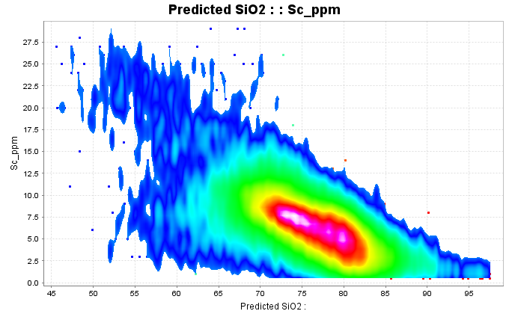
Rock Compositions
Rule of thumb;
Basalt >30ppm Sc
Andesite 20 to 30ppm
Dacite 10 to 20ppm
Rhyolite <10ppm Sc

Slide 5
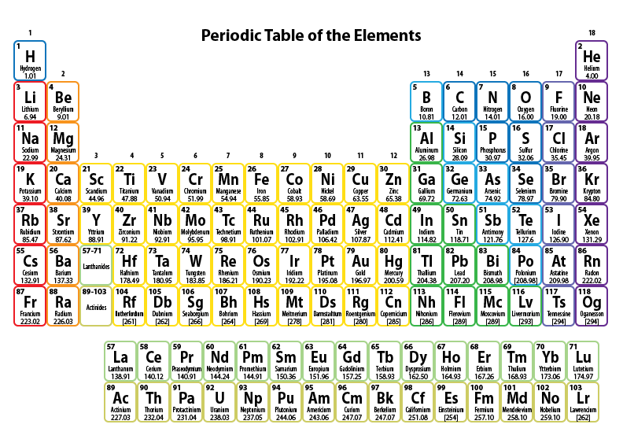
Rock Compositions
To pick compositional groups, plot the immobile trace elements.
Plot Sc versus Al, P, Ti, V, Cr, Y, Zr, Nb, La, Th
Add a point density contour overlay
Look for clusters on the data.
Notes:
The elements that are least-mobile in hydrothermal environments are those that have a valency of 3+ or 4+. Of the elements that are routinely analysed with a 4 acid digest ICP-MS/AES package, that includes Sc, Al, P, Ti, V, Cr, Y, Zr, Nb, La and Th.
Another interesting property that we will come back to later is the similarities in behavior of most of the first-row transition metals.
Sc, V, Mn, Fe, Co, Ni, Cu and Zn have very similar chemical properties, and in unaltered rocks are usually highly correlated. Sc is usually the least-mobile of these.
Some of these metals are redox sensitive. Some of these substitute into oxides as well as silicates. Some are acid-soluble, particularly at lower valencies. Some of these metals are sequestered by immiscible magmatic sulfides. Because of these properties, plotting each of these metals against Sc can provide proxies for mapping redox, tracking fractionation of opaque oxide minerals, tracking S saturation in melts, or mapping acid leaching of metals.

Slide 6
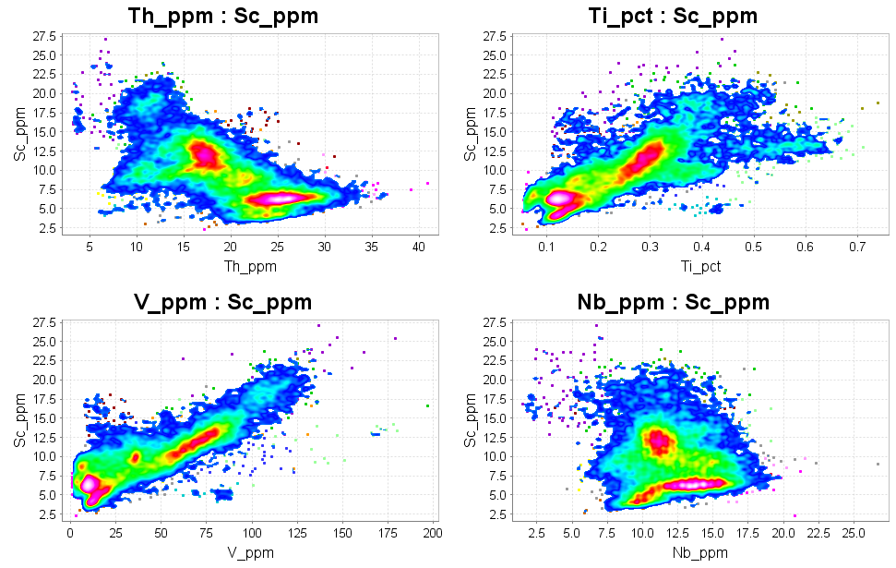
Rock Compositions
To pick compositional groups, plot the immobile trace elements.
Plot Sc versus Al, P, Ti, V, Cr, Y, Zr, Nb, La, Th
Add a point density contour overlay
Look for clusters on the data.
Notes:
In ioGAS, Plot Sc versus Nb, P, Th, Ti, V, Zr. In the ioGAS software, this makes an array of 2 x 3 scatterplots. At this scale it is detailed enough to see what is going on. Add a point density contour overlay to highlight the compositional groups in the data.
Also plot Sc against Al, Cr, Ce, Ga, La, Y.

Slide 7
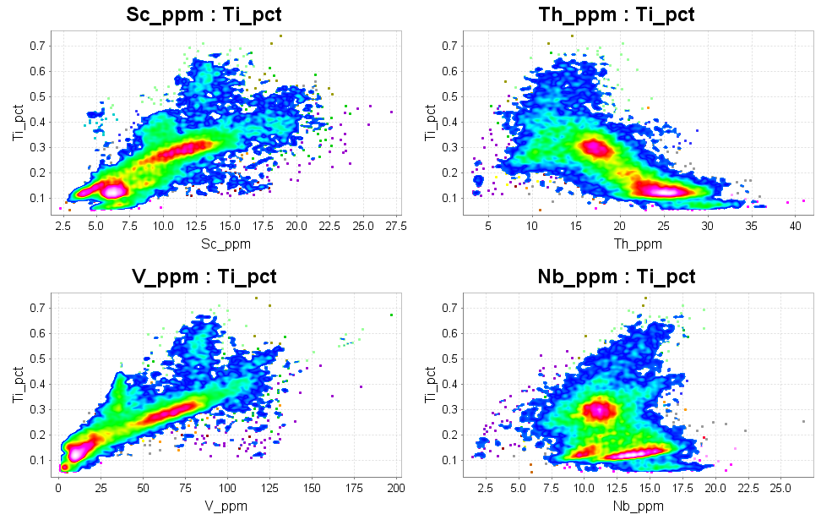
Rock Compositions
Next Step; use the same elements, but plot Ti first.
Plot Ti versus Al, P, Sc, V, Cr, Y, Zr, Nb, La, Th
Add a point density contour overlay
Look for clusters on the data.
Notes:
The next step is to use the same elements but to plot Ti first. Plot Ti versus Sc, Nb, P, Th, V, Zr.
Also plot Ti against Al, Cr, Ce, Ga, La, Y.

Slide 8
Rock Compositions
Individual plots to pick specific signatures;
V vs Sc; to pick signatures of high pressure melting of an amphibole-bearing source, or fractional crystallization of magnetite
Ti vs Nb; to characterize opaque oxide mineralogy
Ta vs Nb; to pick fractional crystallization of biotite
Hf vs Zr; to pick fractional crystallization of zircon
Sr vs Y; to pick high P melting of plagioclase in hydrous environment
Sc vs Ni; to pick sulfur saturated magmas

Slide 9
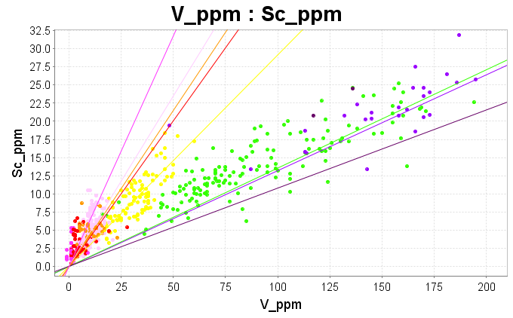
Fractional Crystallization of Magnetite
Commonly observed in fractionated magnetite-series granites.
Depletion of V at a given Sc content; V/Sc <7 (crustal average)
Notes:
In reduced magmas, V3+ has very similar behaviour to Sc3+. The V/Sc ratio is always around 7:1. Both substitute for Fe in amphibole, pyroxene and biotite.
In more oxidized magma, some of the V is 4+. V4+ has a very strong affinity for magnetite.
Fractional crystallization of magnetite causes a depletion of V relative to Sc. Declining V/Sc with increasing SiO2 (or with decreasing Sc) is a sure sign of fractional crystallization of magnetite. This is a very common signature in “magnetite-series” melts.

Slide 10
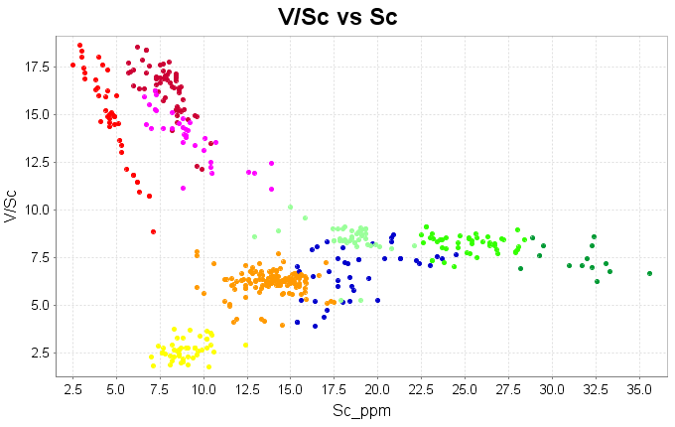
Fractional Crystallization of Magnetite
Fertile porphyry Cu field
Fractional crystallization of magnetite

Slide 11
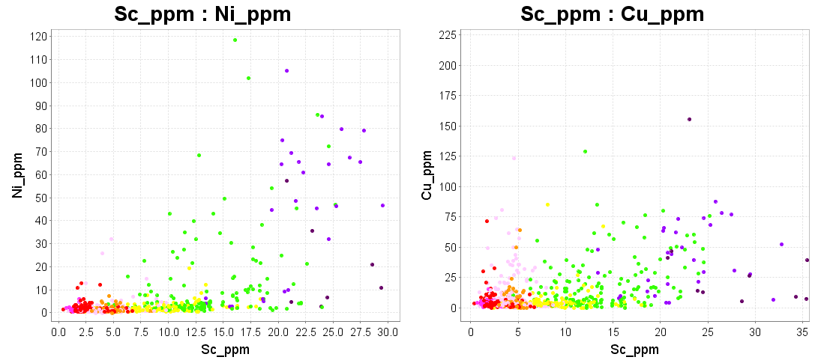
Sulfur Saturation
Most magmas have Ni/Sc between 1 and 2, Cu/Sc around 2.5
Magmas that fractionate magnetite become S-saturated.
Immiscible ISS first (Fe-Ni-Co-S),
MSS second (Fe-Cu-Au-S)
Notes:
In unaltered rocks Cu is highly correlated with Sc, with a ratio of about 2.5:1, and in igneous rocks that do not contain olivine or CPX, Ni is highly correlated with Sc with a ratio of about 1.5:1. However in melts that have become sulfur saturated, Ni and Co are sequestered by the sulfide droplets and the silicate melt is left depleted in Ni and Co. With further sulfur saturation, an immiscible Fe-Cu-S (Au) phase is formed. It is very common for melts that have undergone fractional crystallization of magnetite to show this signature of sulfur saturation, with depletion of Ni and Cu from the remaining silicate. This reduces the ore-forming potential of those magmas.

Slide 12
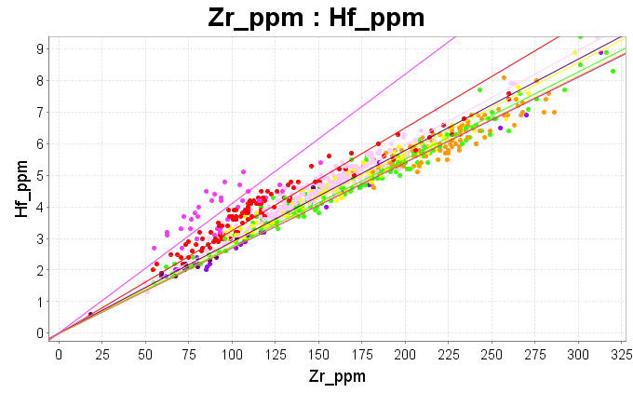
Fractional Crystallization of Zircons
Commonly observed in magmatic hydrothermal orebodies, eg Sn granite, Intrusion-related Au deposits.
Reduced total Zr content, but high Hf/Zr ratio.
Notes:
The only place where Hf resides in a rock is substituting for Zr in the mineral zircon. In the vast majority of data sets, Hf vs Zr plots with a remarkably linear correlation, with a ratio of 1:36. Hf is less compatible than Zr, so as zircons crystallize, the Hf/Zr ratio in the melt increases. The zircons eventually end up with rims with higher Hf/Zr. Zircons crystallize late within a crystallization sequence, and because of the viscosity of the magmas, there is little chance of fractional crystallization. However in very hydrous melts, and especially in fluorine rich melts, silicate chains are de-polymerized, viscosity decreases, and the solidus is lowered. In these circumstances, fractional crystallization of zircons can occur. Crystal settling of zircons in a magma chamber results in lower total Zr in the remaining melt, but fractionation leads to an increased Hf/Zr ratio. Reduced total Zr content, but high Hf/Zr ratio is a clear indicator of fractional crystallization of zircons. Melts that have this signature have a very high mineralization potential.

Slide 13
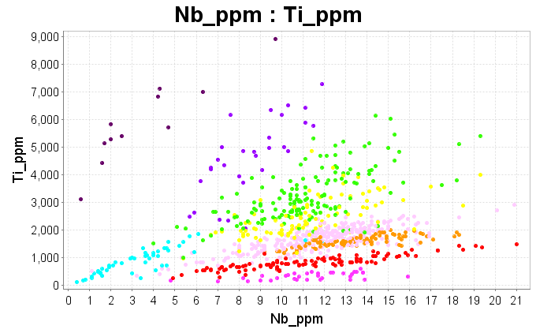
Ti vs Nb; to characterize opaque oxide mineralogy
Ti and Nb strongly correlated;
Biotite granites depleted in Ti, enriched in Nb
Magnetite granites depleted in Ti, constant Nb;
Porphyry Cu magmas not depleted or enriched in Ti and Nb.
Notes:
Titanium minerals crystallize early in a crystallization sequence. Nb has chemistry that is very much like Ti, but it has much lower compatibility. In any one batch of magma, Ti and Nb are highly correlated, but the way in which the Ti/Nb ratio changes with fractionation depends on which mineral phase is the main repository for Ti. The example shown in this plot has strong fractional crystallization of magnetite and lesser fractionation of biotite; Ti values drop to below 1000ppm, but Nb remains about the same. Where biotite is the main repository for Ti (as in a Sn-granite), the Ti values drop very rapidly and Nb increases strongly. In contrast, typical porphyry Cu magmas always have around 2000 to 4000ppm Ti and 2 to 4ppm Nb.

Slide 14
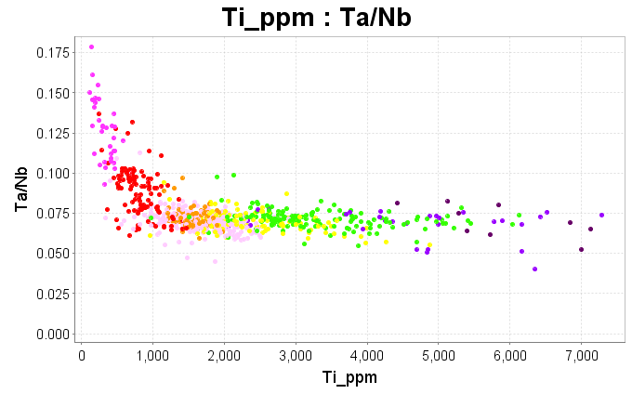
Fractional Crystallization of Biotite
Commonly observed in fractionated granites.
Strongly depleted Ti but increasing Ta/Nb ratio.
Notes:
Ti, Nb and Ta have similar chemical properties. Ti is compatible; Nb is less compatible; Ta is least compatible. Nb and Ta are least compatible in biotite, therefore granites that have the greatest amount of biotite fractionation have the largest amount of Nb and Ta enrichment. Increasing Ta/Nb with decreasing Ti is an indicator for fractional crystallization of biotite.

Slide 15
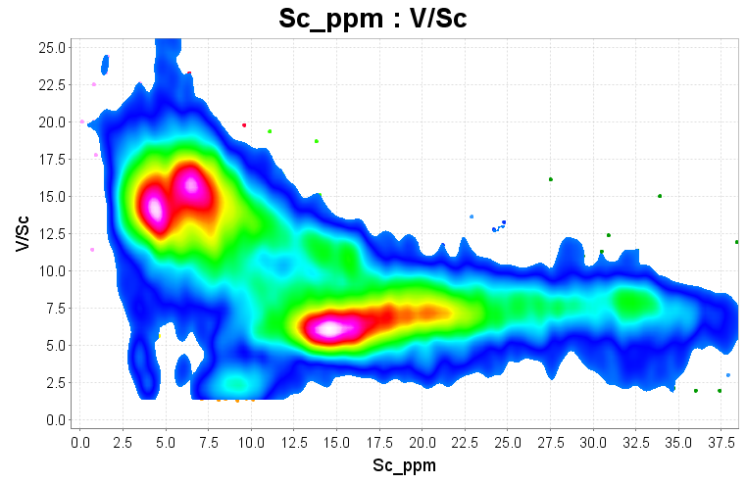
Porphyry Cu Fertility
Porphyry Cu magmas show increasing V/Sc with increasing SiO2 (Bob Loucks)
We don’t have SiO2, so plot V/Sc vs Sc
Favourable magma composition
Notes:
Bob Loucks identified that fertile porphyry Cu magmas showed a trend of increasing V/Sc with increasing SiO2. Partial melting of an amphibole-bearing source at high pressure leaves a pyroxene-garnet residue. Sc partitions into pyroxene slightly more than V3+. Pyroxenes are less preferred hosts for V4+ and V5+. Therefore high pressure melting of an amphibolite source, especially under oxidizing conditions, leads to increasing V/Sc. This is thought to be the reason for the trend identified by Loucks. Since 4 acid digest ICP-MS/AES does not report SiO2, We can plot V/Sc vs Sc as an alternative to the Loucks diagram. Porphyry Cu magmas typically have 3 to 8ppm Sc and V/Sc ratios of 10 to 15.

Slide 16
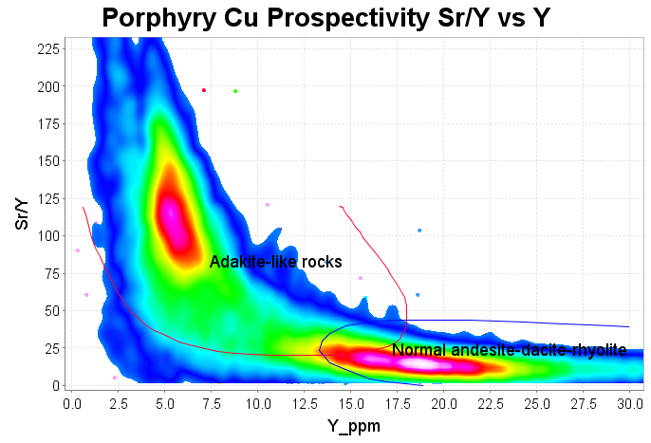
Porphyry Cu Fertility
Porphyry Cu magmas have high Sr due to hydrous melting of plagioclase, and low Y due to retention of HREE’s in garnet in the melt source region.
Notes:
High water contents in high pressure magmas leads to complete melting of plagioclase, and suppression of the plagioclase crystallization temperature. This generates magmas with a high Sr content. Low Y (<15 ppm) indicates garnet (or possibly hornblende) fractionation: garnet tells us the crust is thick (>20 km), hornblende that the melts are hydrous (>4% water). High Sr/Y and low total Y is a signature that is observed in porphyry Cu magmas and it is indicative of garnet fractionation and a lack of high temperature plagioclase crystallization.

Slide 17
Common alteration minerals include;
white mica,
chlorite,
carbonate,
feldspar,
pyrite,
sulfates.
Think of the mineral compositions, then design major element scatter plots to show the composition and abundance of these minerals.
Notes:
Consider the compositions of the common alteration minerals;
White mica KAl₃Si₃O₁₀(OH)₂
Chlorite (Fe,Mg)₅Al₂Si₃O₁₀(OH)₈
Carbonate Ca(Fe,Mg)(CO₃)₂
Albite NaAlSi₃O₈
KSpar KAlSi₃O₈
Pyrite FeS₂
Anhydrite CaSO₄
Create scatterplots of the major elements in these minerals

Slide 18
Common alteration minerals include;
This process can be captured as a standard workflow.
K/Al vs Na/Al molar ratio plot to map sericite alteration
Al-K-Mg ternary plot to map relative proportions of sericite vs chlorite
Ca vs Mg to map calcite vs dolomite
Ca-Fe-Mg ternary plot to pick carbonate compositions
Ca-K-Na to map feldspar compositions
Fe vs S to map the degree of sulfidation
Ca-Fe-S ternary plot to map anhydrite
Rb vs K to map alunite

Slide 19
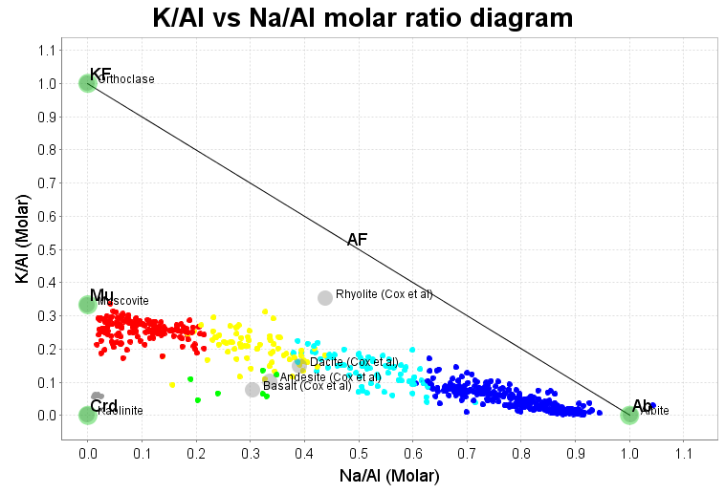
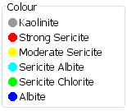
Sericite; K/Al vs Na/Al molar ratio plot
Acid alteration systems typically remove Na from the rocks.
See where samples plot relative to the Muscovite-Albite tie-line.
Notes:
A really useful way to characterize alteration in porphyry copper deposits is to plot K/Al versus Na/Al calculated on a molar basis. Consider a rock that is totally sericitized. The mineralogy of the rock might be muscovite-quartz-carbonate-pyrite. All of the K and Al in that rock will be within sericite. Muscovite has a composition of KAl₃Si₃O₁₀(OH)₂. Therefore the ratio of K:Al in the sericitized rock is 1:3. Similarly, a totally K feldspar (KAlSi₃O₈) altered rock will have a K:Al ratio of 1:1. In the same way, albitisation can also be tracked. Albite is NaAlSi₃O₈: Na:Al =1:1.
In quartz-sericite-pyrite-albite-chlorite-carbonate alteration systems, it is quite common to see altered rocks plotting on a tie line between muscovite and albite, as in this example. The relative proportions of sericite to albite are easily read from this diagram.

Slide 20
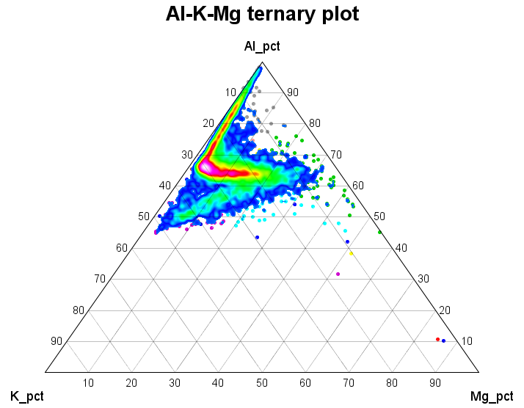
Chlorite; Al-K-Mg ternary plot
See where samples plot within the muscovite-orthoclase-chlorite triangle.
Advanced argillic alteration is depleted in Mg and Na.
Muscovite
Chlorite
KSpar
Notes:
Although the K/Al vs Na/Al molar ratio plot is really useful, it can be ambiguous, especially since it says nothing about the amount of chlorite. Mixtures of feldspar and chlorite can plot with the same K/Al ratio as sericite. The K/Al vs Na/Al plots should always be used in conjunction with an Al-K-Mg ternary plot.
The example shown here shows a trend of points between the projected compositions of muscovite and chlorite, a trend of points from muscovite to the Al-apex (kaolinite), and a trend of points from K feldspar to chlorite. Advanced argillic alteration assemblages are always depleted in Mg as well as Na.

Slide 21
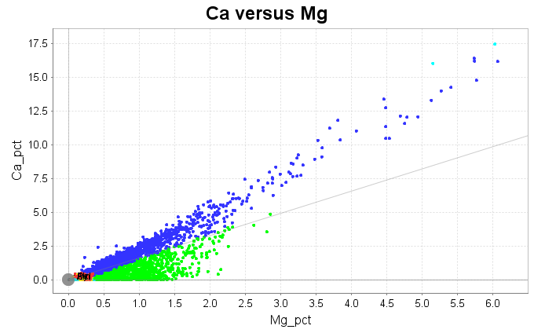
Carbonate; Ca vs Mg
This example shows a ferroan dolomite trend (blue) and alteration of dolomite to Mg-chlorite (green).
Dolomite Line
Notes:
The dolomite line shows a molar ratio of 1:1. Samples with pure dolomite (+/- quartz-illite-pyrite) would plot on this line.
The samples in blue show a strongly linear trend, strongly suggesting a carbonate control, but they plot above the dolomite line because it is a ferroan dolomite.

Slide 22
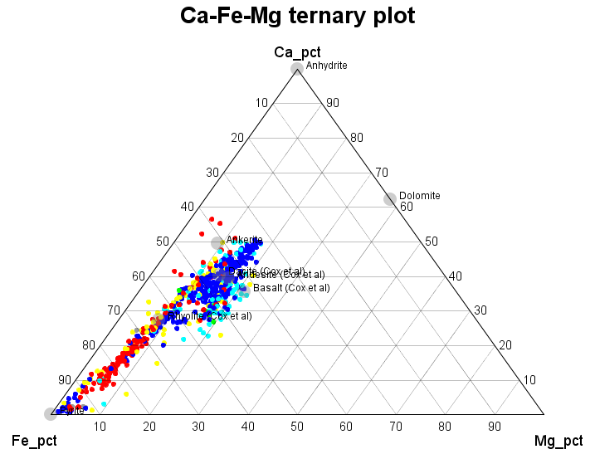
Carbonate; Ca-Fe-Mg ternary
In sericite-carbonate-pyrite systems, the composition of the carbonate can be determined. This is an magnesian ankerite.
Dolomite
Ankerite
Notes:
This is the same data from slide 5. The mineralogy in these rocks is quartz-sericite-carbonate-pyrite. All of the calcium, magnesium and iron in these rocks is in carbonate and pyrite. These data plot on a tight linear trend that runs from a point on the ankerite-dolomite tie line to the Fe-apex. This linear trend is controlled by mixture of magnesian ankerite and pyrite. From this, we can determine the solid solution composition of the carbonates. This would not work if there was another Fe-Mg mineral present, eg chlorite.

Slide 23
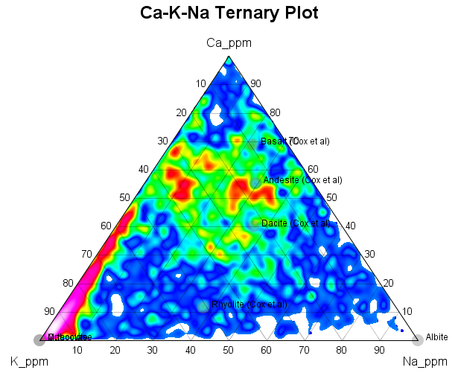
Feldspar Ca-K-Na ternary
Differentiate between (quartz) sericite-pyrite alteration and sericite-pyrite-carbonate.
Sericite-Carbonate
Sericite-Pyrite
Notes:
This is a data set of about 5000 assays from the stringer zone in the Hellyer VMS deposit. The least-altered samples would plot somewhere near the projected compositions of a standard dacite or andesite. A characteristic of alteration in VMS systems is depletion of Na. This plot shows that in many samples, Na is depleted, but Ca is retained (as carbonate). Depletion of Na but retention of Ca causes the data points to move directly away from the Na apex, on to the Ca-K edge of the triangle. With further alteration, the data points move away from the Ca apex until they reach the K apex. Spatially, this maps a zoning pattern from relict plagioclase to sericite carbonate to (quartz)-sericite-pyrite. The carbonate halo is not that easy to pick from visual logging; the problem is consistency in the logging. However it is easily mapped from the chemistry.

Slide 24
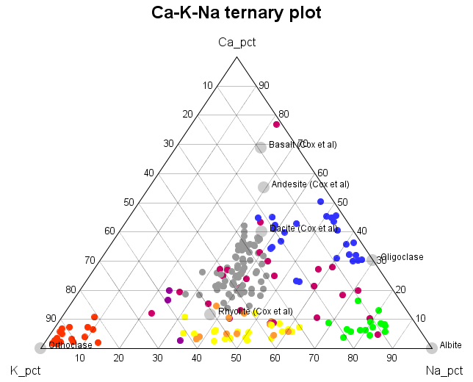
Ca-K-Na ternary
High salinity or alkaline fluids are more likely to form feldspar-rich alteration (rather than mica-rich).
Oligoclase
(sodic-calcic)
Least-altered rocks
K Feldspar
Albite
Alkali Feldspar
Notes:
This is a collection of surface rock chip samples from the Yerington porphyry Cu district. The ellipse in the center shows where the least-altered rocks plot. There is a range of hydrothermal feldspar compositions from Oligoclase to Albite to alkali feldspar to Orthoclase. These map out very distinct zones around the porphyry Cu environment.
Note: a plot that includes K/Al ratios is required to differentiate Orthoclase from sericite in the cluster of red points.

Slide 25
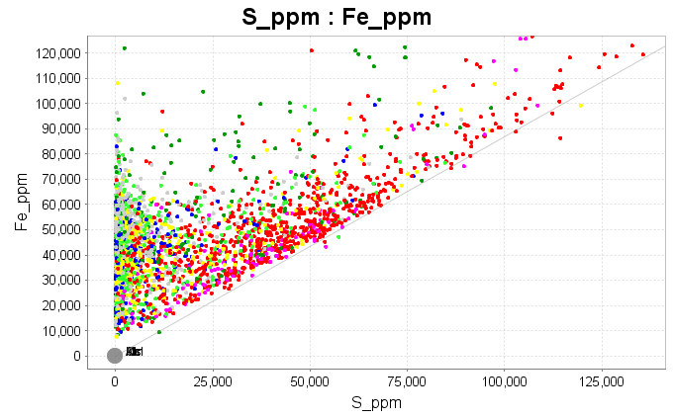
Fe versus S Plot
Pyrite
Veins
Map the degree of sulfidation.
Disseminated pyrite
Utilizing host-rock Fe
Notes:
Although Fe is quite mobile, in most hydrothermal systems involving low to moderate salinity fluids, a plot of Fe against S shows that pyrite is formed just by adding Sulfur and utilizing Fe that is already present in the rock. When all of the available Fe in a rock has reacted to form pyrite, samples will plot on the pyrite line, with a molar ratio of Fe:S = 1:2. Samples that plot further out on the pyrite line will be from material that has pyrite in veins as well as disseminated pyrite.

Slide 26
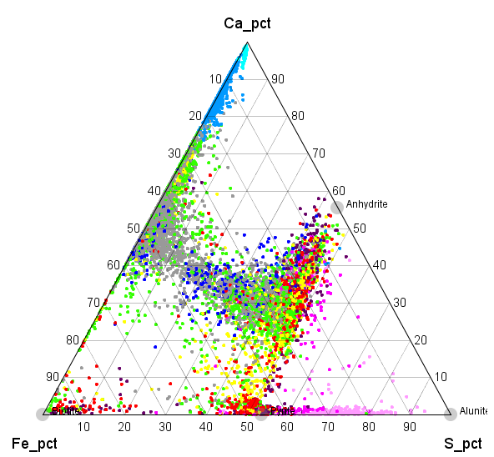
Anhydrite Ca-Fe-S ternary
Map pyrite versus anhydrite in porphyry Cu systems.
Amount of S addition is limited by Ca content, Fe content, or both.
Anhydrite
Least-altered rock
Addition of Sulfur
Pyrite
Notes:
A Ca-Fe-S ternary plot is a useful way to look at the relative importance of pyrite and anhydrite in porphyry Cu systems.
As sulfur is added to the rock, the data points move from the least-altered composition towards the S apex.
In some parts of the porphyry Cu environment, anhydrite is formed without sulfides, but feldspars (Na-K) remain stable. In that case, the amount of S that can be added is limited by the amount of Ca in the rocks. These samples plot on the tieline between anhydrite and the Fe-apex (biotite, magnetite).
In other parts of the porphyry Cu environment, pyrite is formed without anhydrite, and feldspars are destroyed. In this case, the amount of S that can be added is limited by the amount of Fe in the rock. These samples will plot along a trend from the projected position of the least-altered rock towards the Pyrite node on the Fe-S join.
In the example shown in this plot, the data points mostly plot along the join between anhydrite and pyrite. The amount of S that was added was limited by the amount of Ca + Fe in the rock.

Slide 27
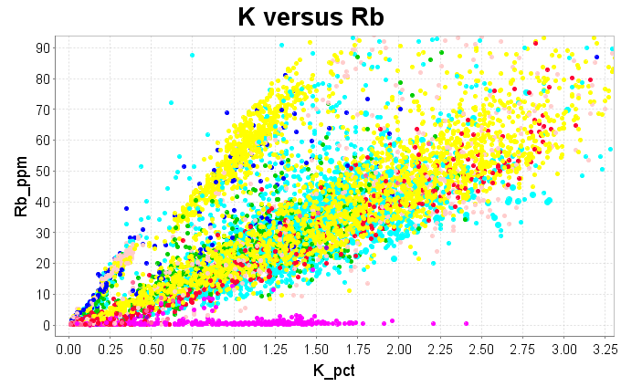
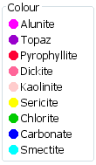
Alunite; K versus Rb
Rubidium substitutes for K into silicate minerals, but it does not substitute into sulfates.
The Rb-depleted samples in a Rb-K plot therefore highlight samples with alunite.
Notes:
Rubidium substitutes for K into silicate minerals, but it does not substitute into sulfates.
The Rb-depleted samples in a Rb-K plot therefore highlight samples with alunite.

Slide 28
Pathfinder chemistry
Plot pathfinder elements as a factor of average crustal abundance levels for each element. A coherent footprint (multi-point anomaly) of >10 x average crustal abundance is a significant anomaly!
Notes:
For reconnaissance geochemical surveys, a cluster of sample points with >10 times average crustal abundance defines a significant anomaly for that element.

Slide 29
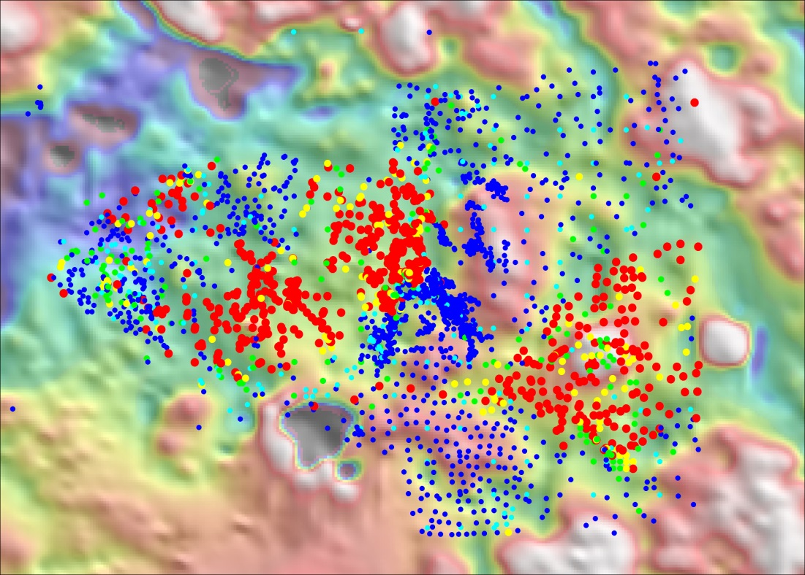
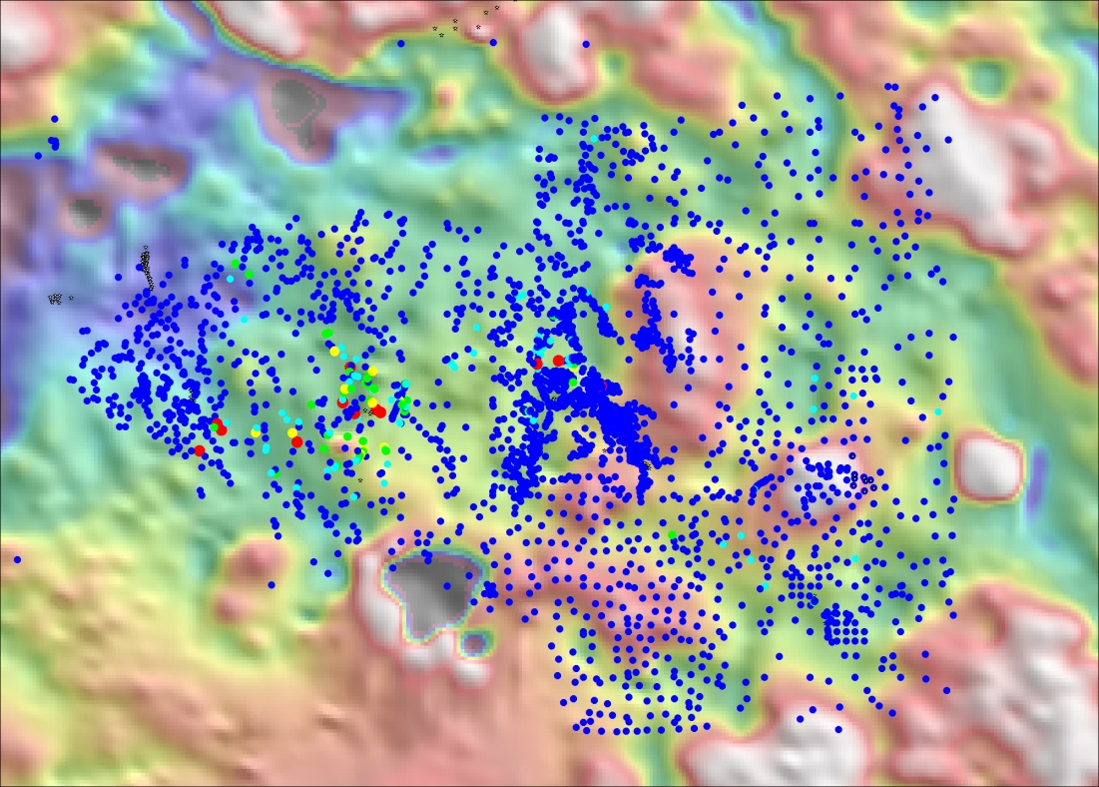
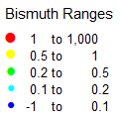
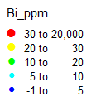
Pathfinder chemistry; importance of detection limits
Bismuth assays by ICP-MS, detection limit 0.01ppm
Bismuth assays by ICP-AES, detection limit 5ppm
Blind Porphyry Cu deposits
300m below surface
Outcropping Porphyry Cu deposit
Notes:
This figure illustrates the importance of detection limits in regional reconnaissance geochem.
The field of view here is about 8km by 5km. The survey covers an outcropping porphyry Cu and 2 blind porphyry Cu occurrences.
These are surface rock chip samples. When measured with ICP-MS, the detection limit for Bi is 0.01ppm. When measured with ICP-AES, the detection limit for Bi is likely to be reported at either 2 or 5ppm. In this case, ICP-MS clearly mapped the footprint of phyllic alteration around the porphyry deposits. However these anomalies would have been missed if the samples were analysed by ICP-AES.

Slide 30
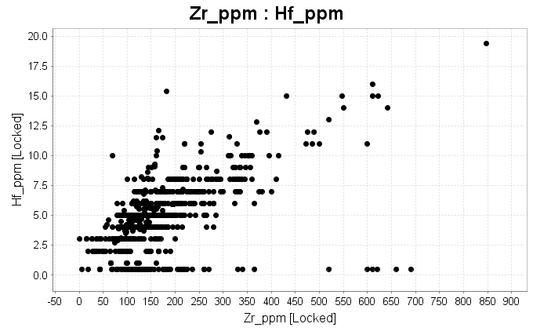
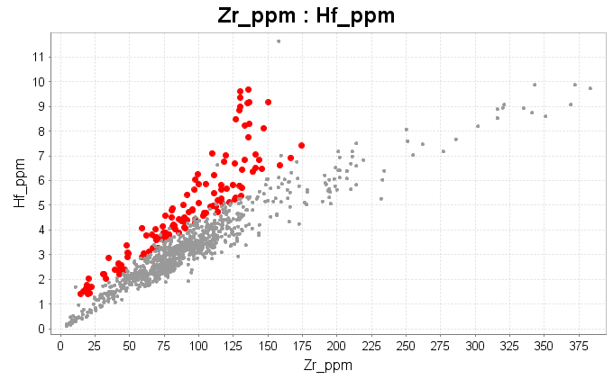
Examples; Mapping “Magma Fertility”
Geoscience Australia samples
Kennedy Province, NE QLD
State-of-the art assays, 1980’s
Same samples reassayed;
Conventional 4 acid ICP-MS
Suite of granites with fractional crystallization of zircons
High prospectivity for magmatic Au
Notes:
The quality of assays from commercial laboratories today far exceeds the quality from “Research Laboratory” assays from 30 years ago
It is possible to interpret magmatic processes from routine exploration data that could not have been measured by any analytical method 20 to 30 years ago.
There is a very good case for going back to all of the sample pulp collections at Geoscience Australia and the State geological surveys and re-assaying them with modern ICP-MS using a consistent digest and assay method.
GeoScience Australia OzChem database contains ~60,000 assays. At about $50/assay, that would not be a prohibitive cost.

Slide 31
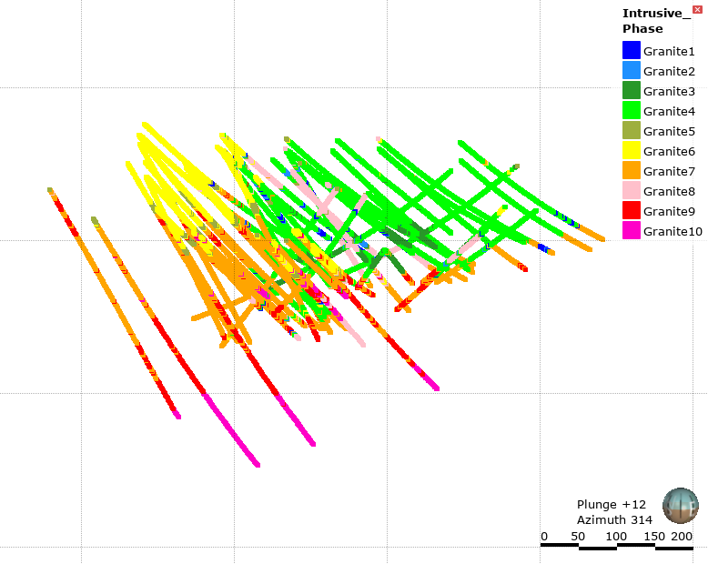
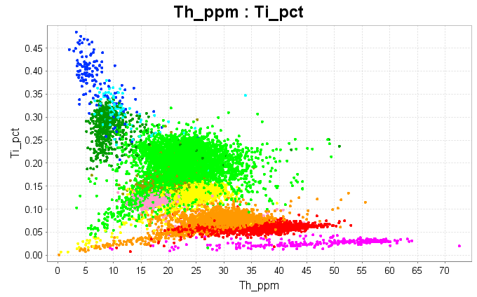
Example; Lithology model from assays
Notes:
This is an example from the Horn Island gold deposit where the owner, Alice Queen, has used a 4 acid digest ICP-MS/AES assay method for all drill samples. The assays show that there are 10 different phases of intrusions. There are 6 different phases of granite, 3 compositions of mafic dykes, and one felsic dyke. The granite phases are related to each other via fractionation processes, but the data shows that fractionation did not occur in-situ. These melts were fractionated in a staging chamber, and then emplaced in pulses. The mineralized veins occur as vein arrays along intrusive contacts. This is a good example of how the assays help not just with the logging, but also provide information about processes within the system.

Slide 32
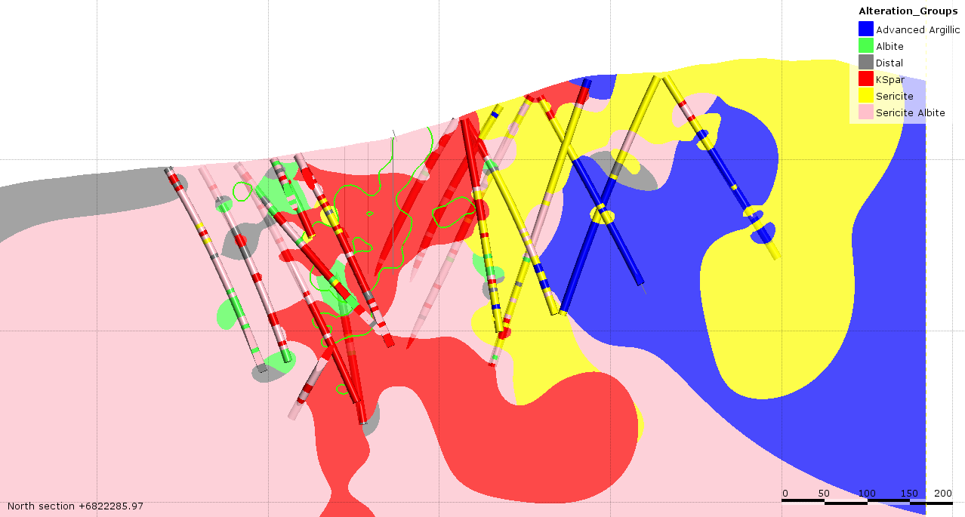
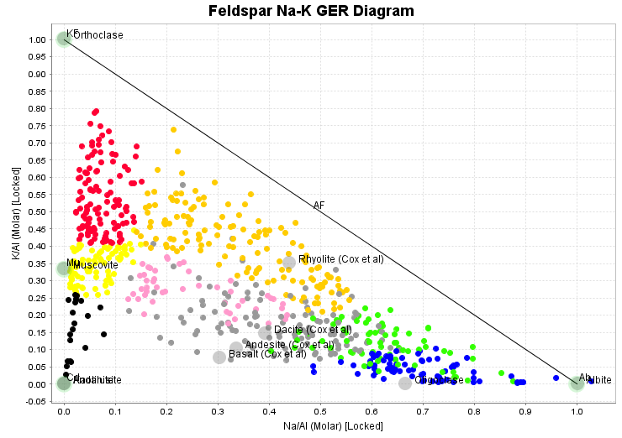
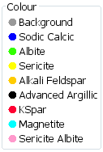
Example; Alteration model from assays
Notes:
This is an example from the Productora deposit in Chile. This is a Cu-Mo deposit hosted in a series of tourmaline breccias. Every sample was assayed with a 4 acid digest ICP-AES method. In total there are about 190,000 assays. The alteration is very feldspar-rich. Hydrothermal feldspars range from orthoclase to alkali feldspar to albite to oligoclase. These are all grey to cream-coloured, hard, microcrystalline rocks. The feldspar compositions cannot be mapped visually. With such a large amount of data, the leapfrog modelling tools can convert this into quite coherent models of gangue mineralogy domains. The copper mineralization is intimately associated with a K feldspar halo.

Slide 33
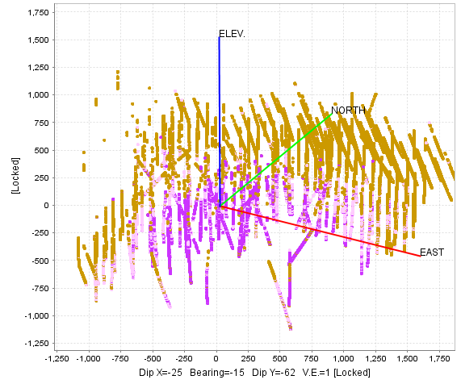
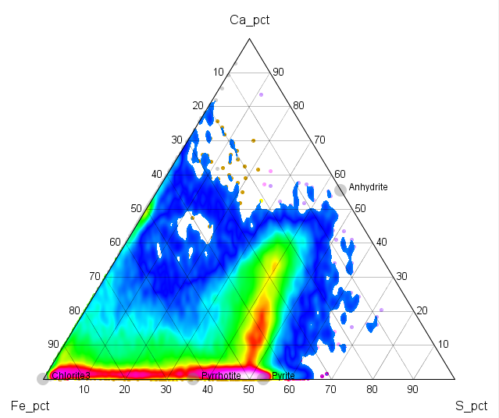
Example; Alteration model from assays
Anhydrite
Anhydrite>Pyrite
Anhydrite<Pyrite
Pyrite
Notes:
This is an example from a porphyry Cu system, where all samples were assayed with a 4 acid digest ICP-AES method. On a Ca-Fe-S ternary plot, the mineralized samples plot close to the tie line between anhydrite and pyrite. From this we could measure anhydrite/pyrite ratios. Most of the copper mineralization occurs in the transition from anhydrite to pyrite. Metallurgically, it is important to quantify how much pyrite is in each ore block, as this determines what capacity is needed in the flotation citcuit, and has a significant effect on copper recoveries.

Slide 34
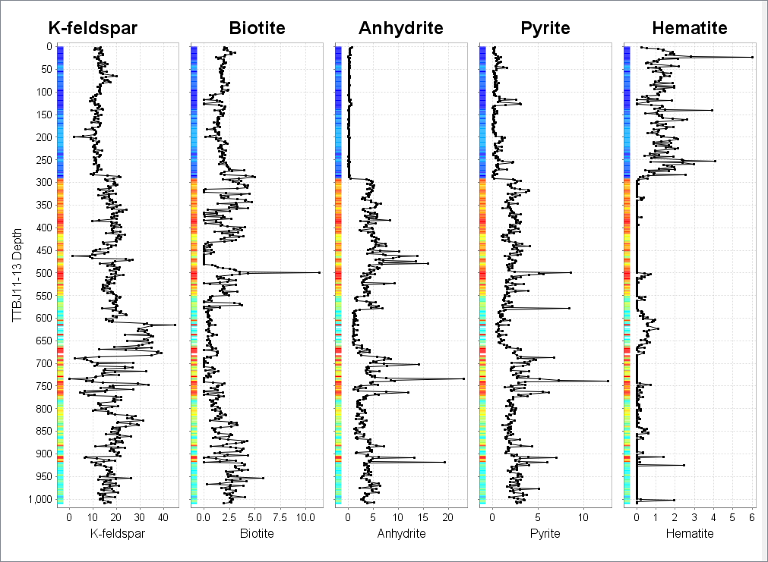
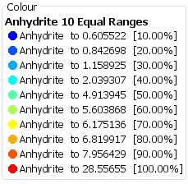
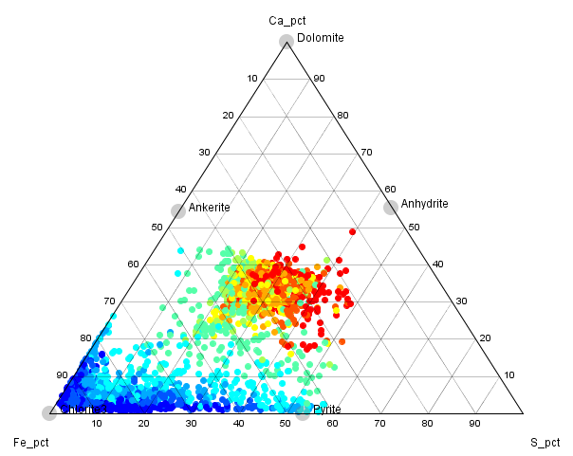
Example; Calculated Mineralogy
Predicted mineral percentages from mass-balance calculations on 4A-ICP assays
Down hole traces of calc. mineral %, colored by Cu grade
Notes:
In the coming years, the next evolution in interpretation of multielement geochemistry will be quantitative mineral estimations from assay data. This is non-trivial, since an ICP analysis does not include SiO2, H2O or CO2. At best it will be an estimation. If the mineral assemblage in any given sample is well constrained, then the predicted mineral proportions should be quite reliable. This will give us the ability to make much better 3D mineralogy models.

Slide 35
Conclusions
4 acid digest ICP MS/AES should be the assay method of choice
Quantitative measurements, independent of geologist’s opinions and bias.
Data can be reduced to a simple classification and set of numeric fields; ideal for modeling.
Look for common patterns in the data that are governed by magma types and mineralogy.
There is no substitute for good quality data.

