Slide 1
Measuring Orebody Variability from Geochemical Analyses
Scott Halley
Master of Economic Geology Short Course: Geometallurgy
November 4 – 15, 2019

Slide 2
Ore type Characterization
Orebodies are never homogenous.
Variability in
Host rock
Gangue mineralogy
Sulfide mineralogy
Need to define the variability so that
End-member ore types are selectively tested for metallurgical performance
Spatial distribution of ore types is included in the Resource model.

Slide 3
Objectives
Ore body knowledge can be improved can be improved by better characterization and spatial definition of lithology and mineralogy.
Visual logging is commonly subjective and inconsistent.
Many companies now routinely collect 4 acid digest ICP assay data. This is quantitative data, independent of observer bias. Assay data provides proxies for lithology, gangue mineralogy and sulfide mineralogy.
Potential to provide robust 3D characterization of ore types.

Slide 4
Classifying Rock Compositions from Immobile Trace Elements
Master of Economic Geology Short Course: Geometallurgy
November 4 – 15, 2019

Slide 5
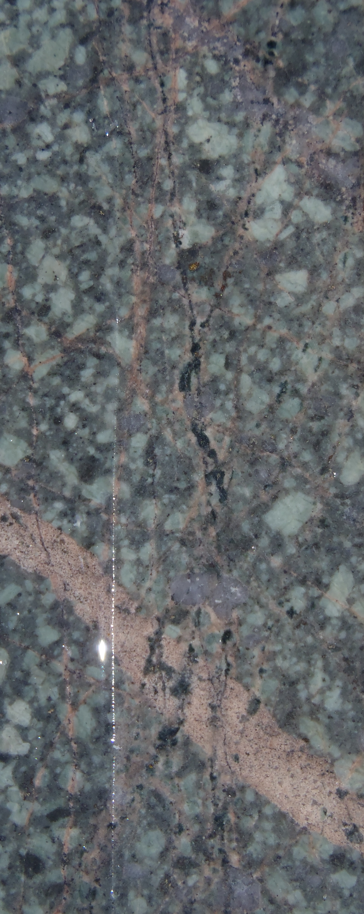
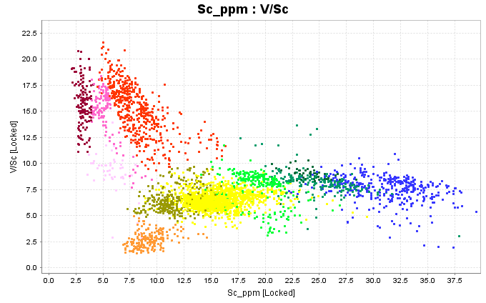
Classifying Rock Compositions from Immobile Trace Elements

Slide 6
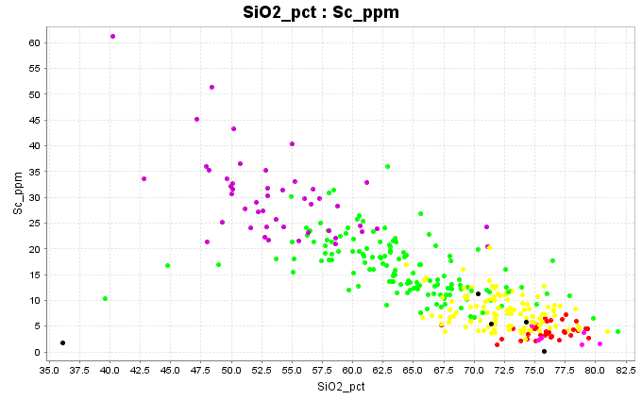
Classifying rock compositions from 4 acid digest ICP-MS analyses
4 acid digest ICP-OES/MS reports all the major elements except SiO2.
Without SiO2, plot trace elements against Sc. As a guide;
Basalt 30 to 50ppm Sc
Andesite 20 to 30ppm
Dacite 10 to 20 ppm
Rhyolite <10ppm Sc

Slide 7
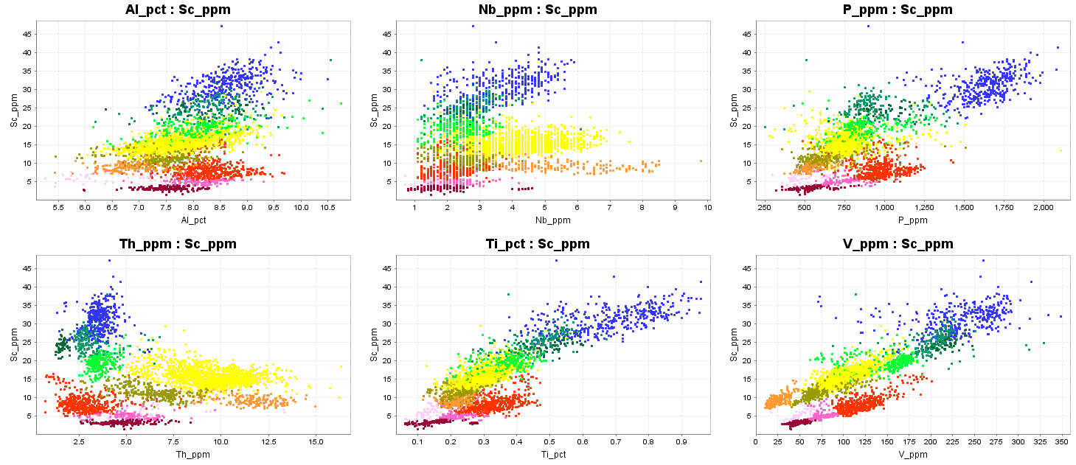
Classifying rock compositions from 4 acid digest ICP-MS analyses; Case study
Plot Sc vs Al, Nb, P, Th, Ti, V. Look for clusters in the data. Assign each cluster to a category. The chemistry will tell you something about the magma source, but it does not differentiate rock type, ie an intrusive, extrusive, volcaniclastic or epiclastic can all have the same immobile trace element signature.

Slide 8
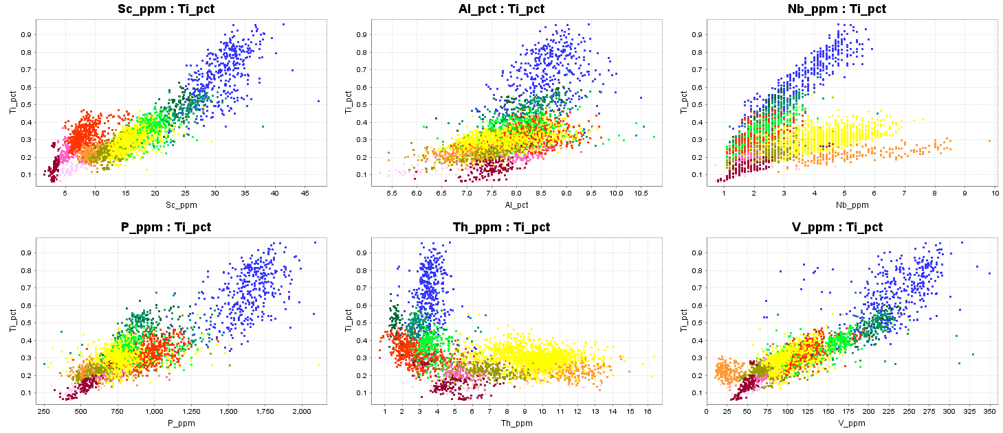
Classifying rock compositions from 4 acid digest ICP-MS analyses; Case study
Sc is a proxy for Fe in silicate minerals. Ti shows the progression of Fe-Ti oxide minerals with fractionation.
Take the same suite of elements and plot Ti first; ie Ti vs Sc, Al, Nb, P, Th, V. This shows patterns related to the accessory mineral phases in each magmatic event, eg magnetite, rutile, titanite, apatite, monazite etc.

Slide 9
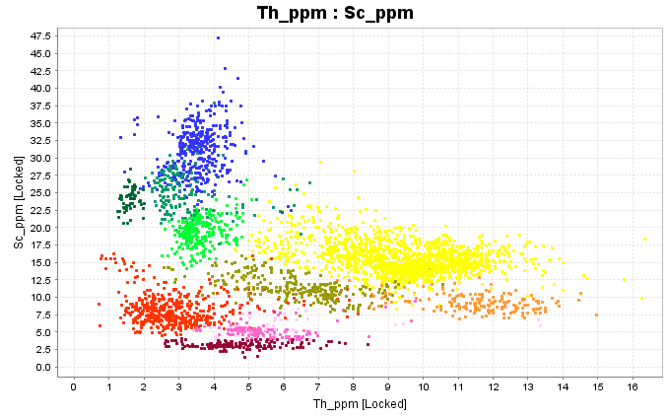
Classifying rock compositions from 4 acid digest ICP-MS analyses; Case study
In this particular case study, some of the clearest distinctions between different eruptive products are shown by a plot of Sc vs Th.

Slide 10
Classifying rock compositions from 4 acid digest ICP-MS analyses; Case study
In magnetite-bearing melts, as magnetite crystallizes and fractionates, melts evolve to lower V/Sc. Most melts follow this trajectory. There is a window in P-T-H2O space where hornblende crystallizes before magnetite; these melts evolve to higher V/Sc ratios with fractionation of hornblende. The ratio trends to higher values in more oxidized melts.
Fractional Crystallization of Fe-silicates
Field of porphyry Cu magmas
Fractional Crystallization of Magnetite

Slide 11
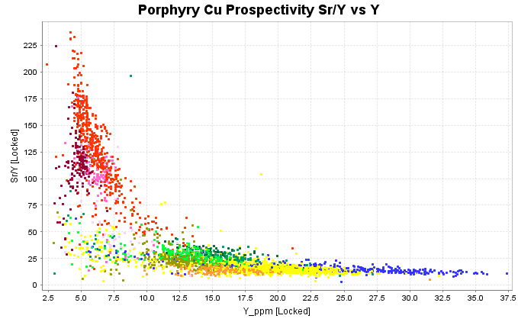
Classifying rock compositions from 4 acid digest ICP-MS analyses; Case study
All of these melts plot on a spectrum from high Sr-low Y to low Sr – high Y. This maps a transition from hydrous melting at high pressure where garnet is stable in the source region, all the plagioclase melts and high water content lowers the plagioclase liquidus, to low pressure melting where plagioclase is fractionating.
High pressure melting of HBL-bearing source
Field of porphyry Cu magmas
Mid-crustal melting

Slide 12
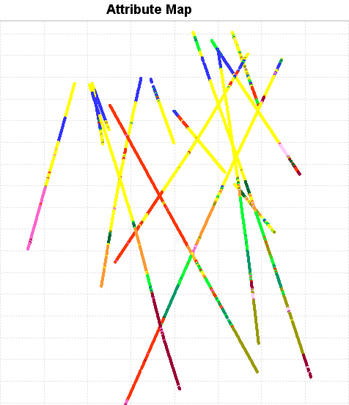
Classifying rock compositions from 4 acid digest ICP-MS analyses; Case study
This plot shows the classified rock compositions as a cross section. The red and pink colours are intrusions. The green, blue, yellow and orange are volcaniclastics. The volcaniclastics can be correlated from hole to hole and define volcanic stratigraphy.
1400
Elevation
1000
600
35000
35200
35400
East

Slide 13
Conclusions
It is difficult to consistently log lithology, especially in very altered rocks.
Immobile trace element chemistry provides quantitative data that can significantly improve the accuracy and consistence of logging; note, this is an aid to logging, it does not replace logging.
Consistent logging will lead to better geological interpretations, more reliable resource models, and better classification of ore-types.

Slide 14
Classifying alteration mineralogy from major elements
Master of Economic Geology Short Course: Geometallurgy
November 4 – 15, 2019

Slide 15
Introduction
Resource geologists tend to focus on tonnes and grade.
Orebodies are never homogenous.
Variable gangue mineralogy causes a range of Bond work index, power consumption for crushing and grinding, variable mill throughput rates, hence variable cash-flow.
Variable sulfide mineralogy affects recoveries of economic metals.
Resource geologists should be routinely collecting data that maps the silicate gangue and sulfides spatially, so that engineers and mets can test and predict the full range of variability in the orebody.

Slide 16
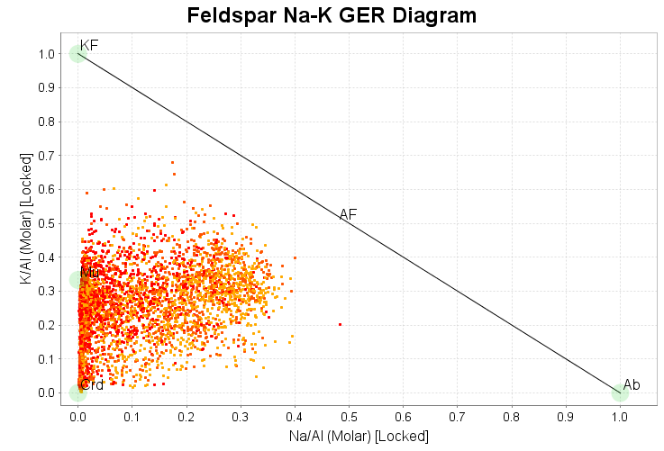
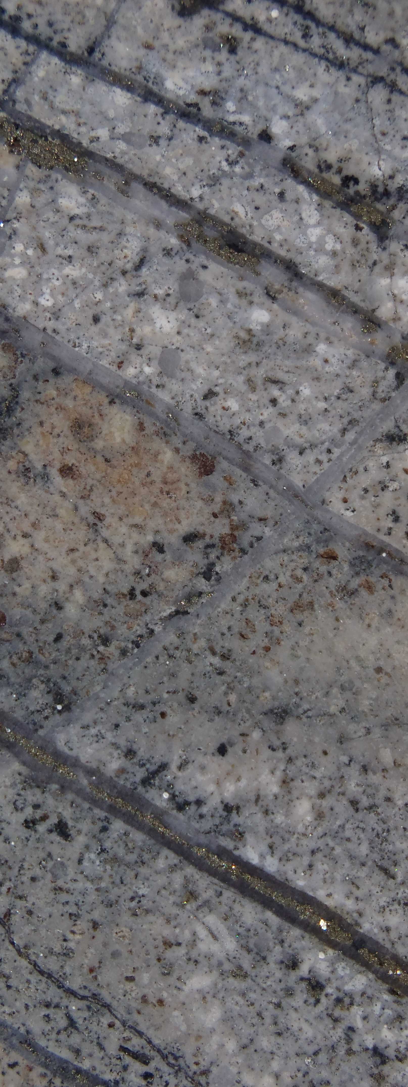
Alteration Mineralogy from Assays
Gold assays >0.5g/t
Gold with potassic alteration
Gold with intense illite
Gold with intense clay alteration
This one figure highlights the issue. This is a data set from an intermediate sulfidation epithermal system. These assays are a subset of the data, with Au > 0.5ppm. In this example, most of the gold is associated with illite (low Na/Al, K/Al >0.2). Some is with smectite and kaolinite (low Na/Al, K/Al <0.2). Some of the gold is with potassic alteration (abundant relict albite). How do the physical rock properties of these gangue zones vary? How are these gangue types distributed spatially?

Slide 17
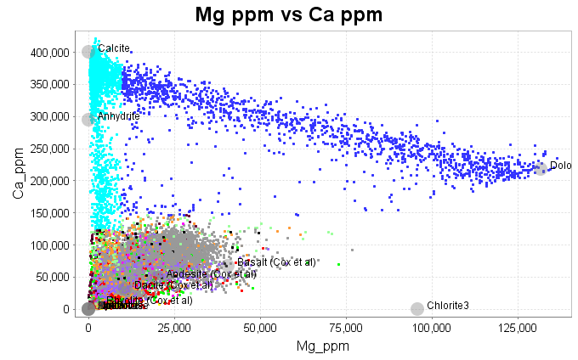
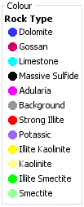
Classifying Alteration Mineralogy from 4 acid digest ICP-MS analyses; Case study
Plot Ca vs Mg. In this case study, there is a limestone unit which is partly replaced by dolomite. This plot shows a mixing trend between calcite and dolomite, and it also shows a mixing trend between calcite and silicate material (with low Ca and Mg)

Slide 18
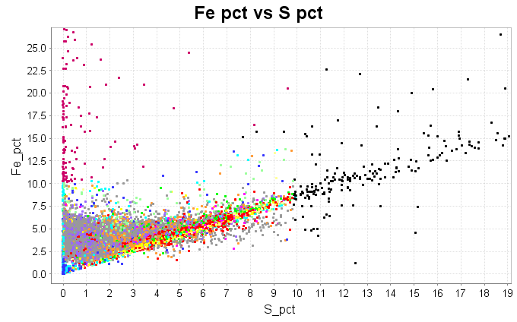
Classifying Alteration Mineralogy from 4 acid digest ICP-MS analyses; Case study
Plot Fe vs S. Samples with greater than 10% S (20 weight% pyrite) were classified as massive pyrite. Samples with >10 % Fe, but no S were classified as gossan.

Slide 19
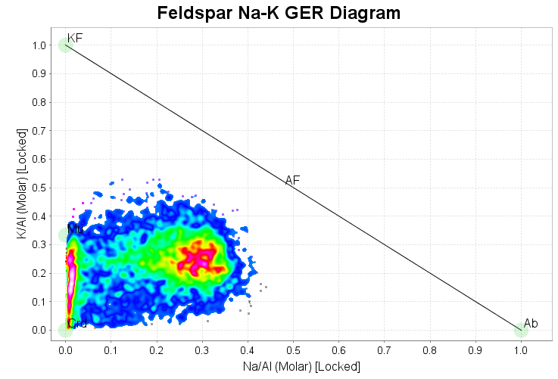
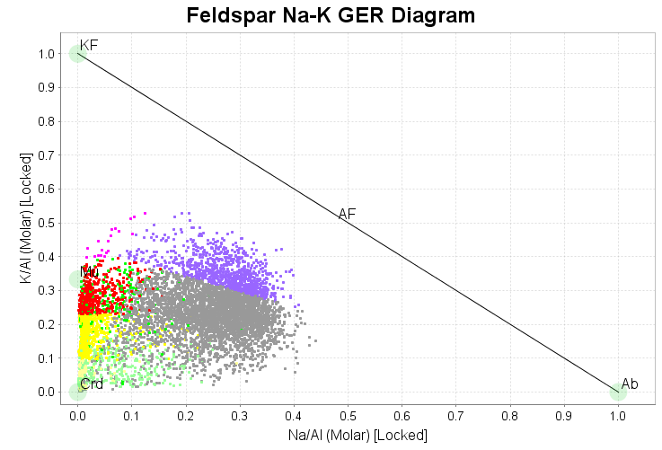
Classifying Alteration Mineralogy from 4 acid digest ICP-MS analyses; Case study
K/Al vs Na/Al molar ratio plot. Note the samples with intense Na depletion, plotting between the projected positions of muscovite and kaolinite. From this plot we cannot tell if the aluminous clay is kaolinite, dickite, smectite or even chlorite.
Gold occurs with muscovite, clay or potassic (feldspar-rich) alteration; highly variable ore types!
Gold assays >0.5g/t
Gold with potassic alteration
Gold with intense illite
Gold with intense clay alteration

Slide 20
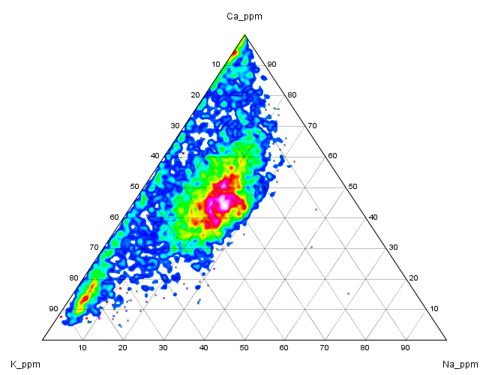
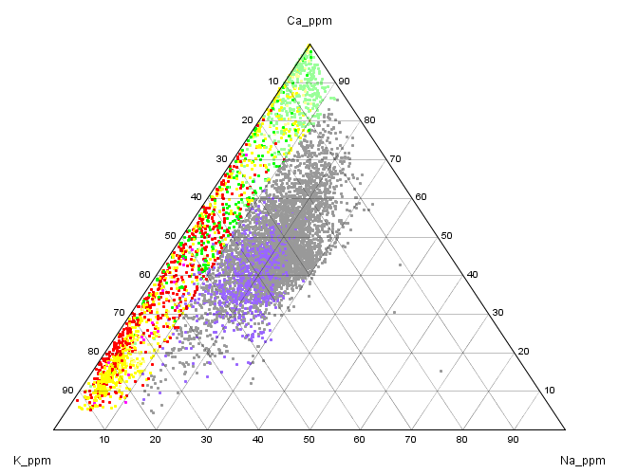
Classifying Alteration Mineralogy from 4 acid digest ICP-MS analyses; Case study
What are the low Na-K clay minerals?
Ca-K-Na ternary plot. Na-depleted samples plot along the Ca-K join. Advanced argillic minerals will have no carbonate, and no Ca in smectite. The green points are illite-smectite+/- carbonate. Yellow points are dominantly kaolinite.

Slide 21
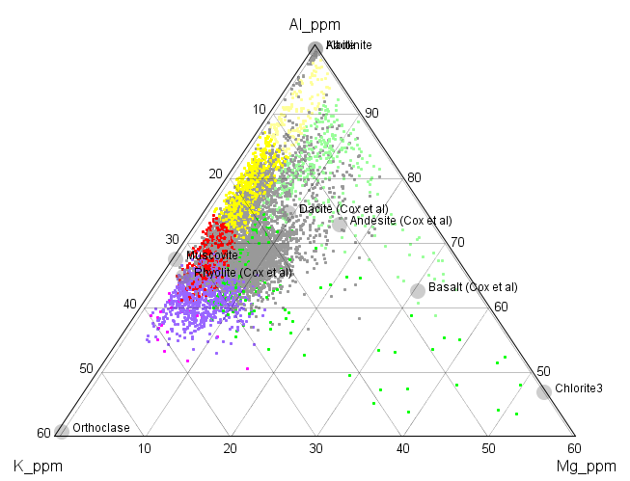
Classifying Alteration Mineralogy from 4 acid digest ICP-MS analyses; Case study
What are the low Na-K clay minerals?
Compare Ca-K-Na and Al-K-Mg ternary plot. Advanced argillic minerals have no Mg and plot along the K-Al join between muscovite and the Al-apex. The green points are depleted in Na but still have Ca and Mg; illite-smectite+/- carbonate. These classifications can now be plotted in 3D and modelled.

Slide 22
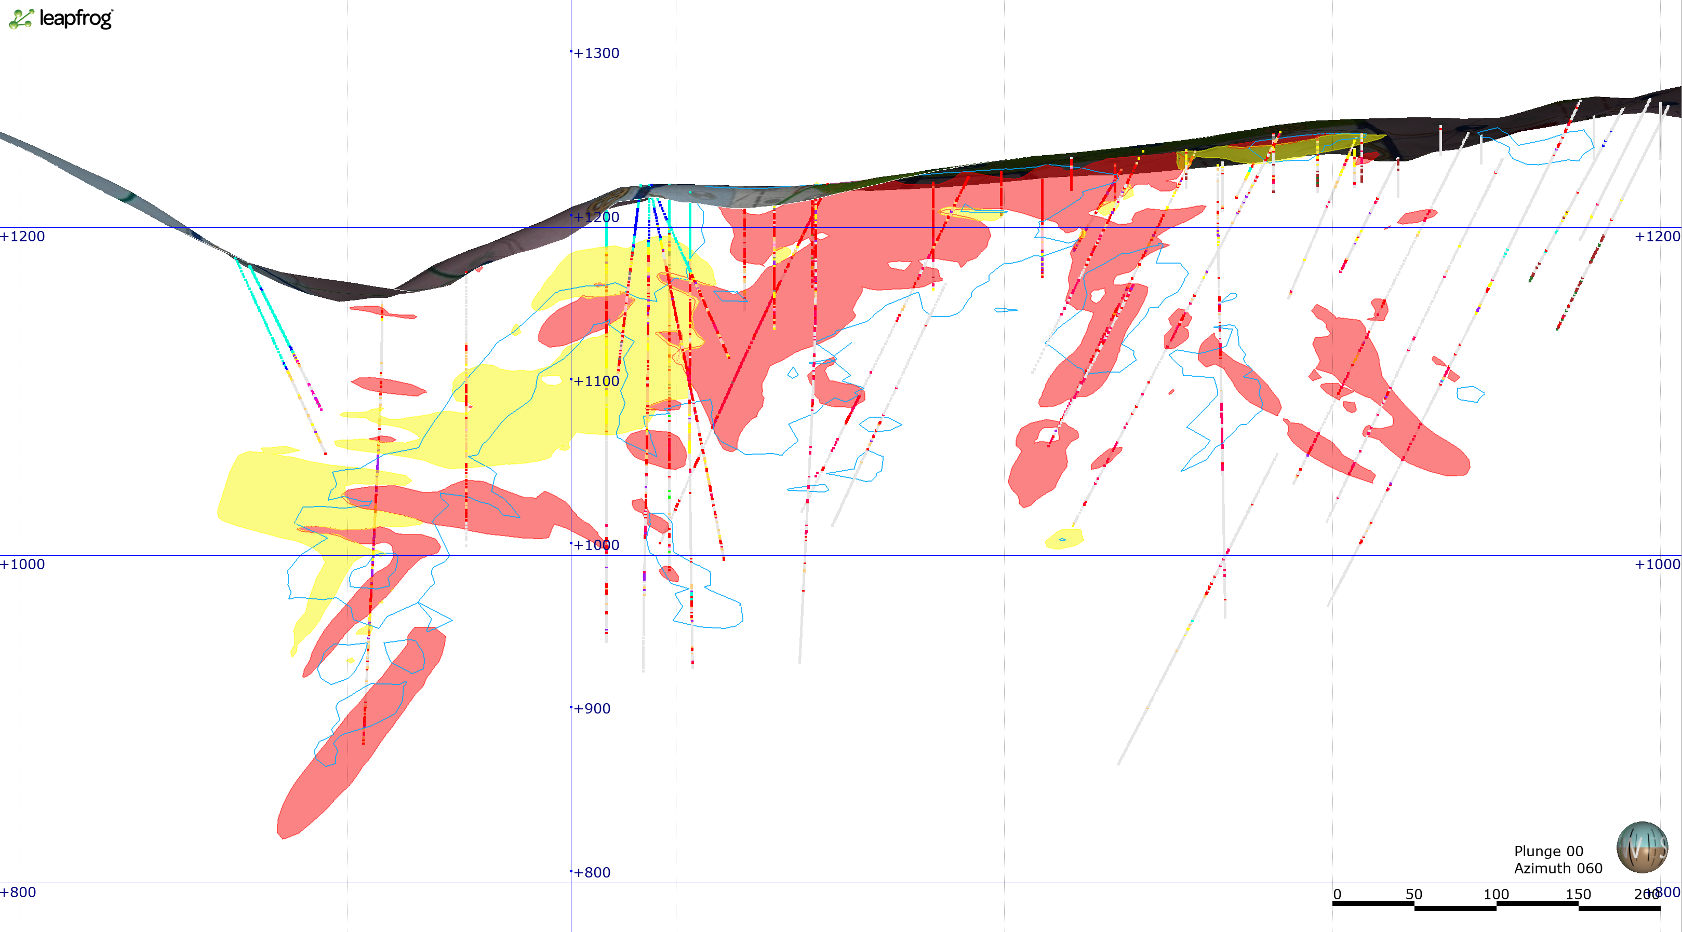
Classifying Alteration Mineralogy from 4 acid digest ICP-MS analyses; Case study
For simplicity, the ore types were grouped into illite-dominant (red) and clay-dominant (yellow) types. The blue lines are 0.5ppm Au grade shells. How does the mineral processing vary between the illite and clay-bearing gangue types?

Slide 23
Conclusions
It is REALLY difficult to consistently log alteration.
Much of the alteration mineralogy can be guesstimated and quantified from major element geochemistry. Identification of the clay mineralogy is vastly improved if SWIR data is collected along with the assay information.
Consistent logging will lead to better geological interpretations, more reliable resource models, and better classification of ore-types.

Slide 24
Quantitative Gangue Mineral Estimates from assay data
Master of Economic Geology Short Course: Geometallurgy
November 4 – 15, 2019

Slide 25
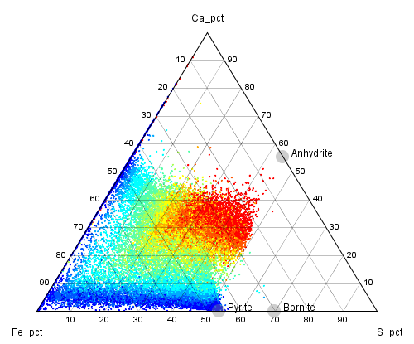
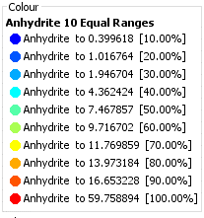
Case Study
Estimated Mineral percentages from assay data using the Linear Programming Simplex Method
Scott Halley
18/10/2019

Slide 26

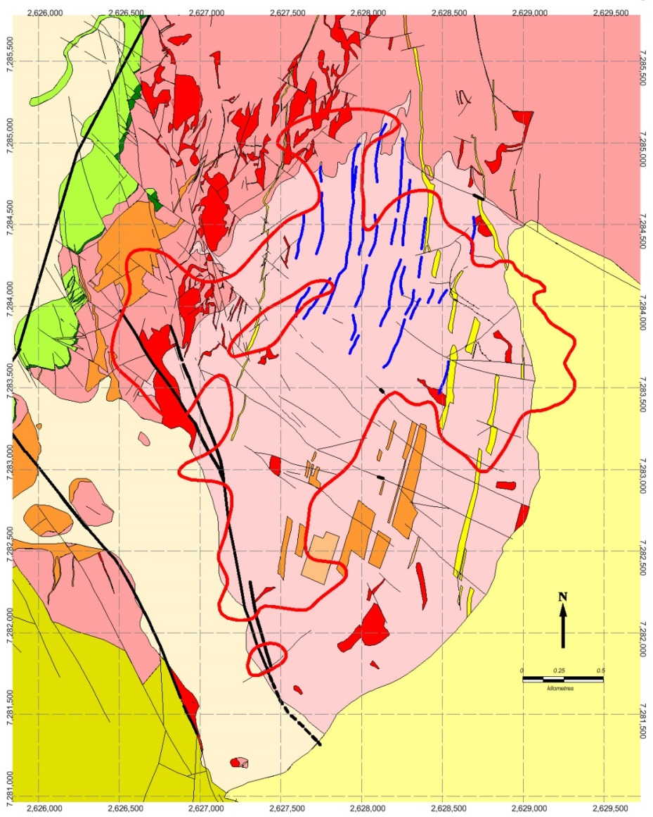
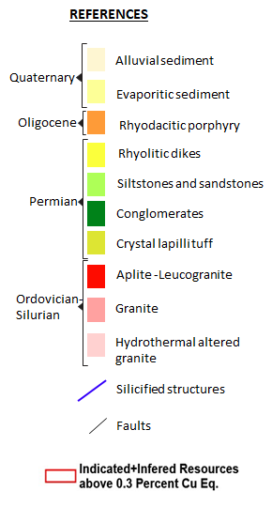
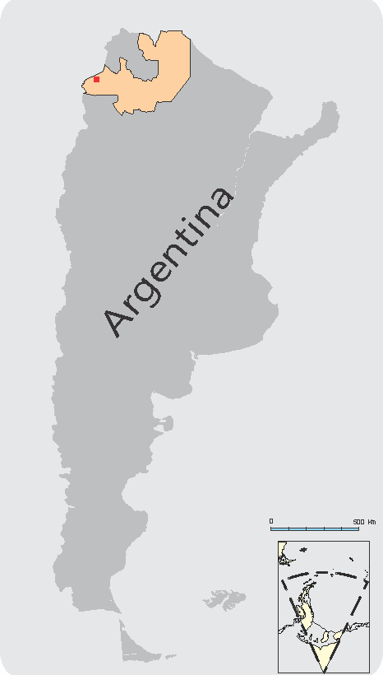
Case Study
The data shown in this presentation is from the Taca Taca porphyry Cu deposit in Argentina
First Quantum is thanked for permission to show this data.

Slide 27
Linear programming solved using the Simplex method
Linear programming methods aim to achieve the best outcome in a mathematical model where the requirements are represented by linear relationships
In this example the model aims to maximise the proportional sum of ‘property values’ assigned to each mineral to be calculated
The property value acts as a proxy for the likelihood of the mineral occurring
The Simplex method is an approach to solving linear programming models using slack variables, tableaus (matrices), and pivot variables as a means to finding the optimal solution of an optimization problem
The Solver add-in within Excel uses the Simplex method for solving linear programs
This method was applied to mineralogy calculations from geochemical analyses by Berry et al., 2011

Slide 28
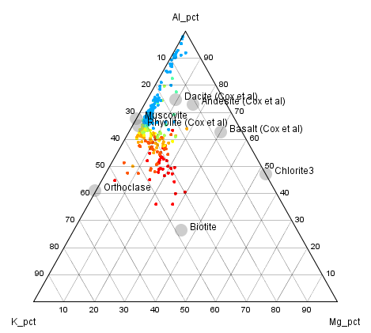
Quantitative Mineral estimates from chemistry alone are non-unique; there are always more variables than constraints.
For example, a point here could be a mixture
of orthoclase-muscovite-chlorite
It could be a mixture
of orthoclase-muscovite-biotite
Or
We could use extra information from qXRD, QEMSCAN or CoreScan to provide extra constraints,
Or we can use thermodynamics to predict the permissible mineral assemblage.

Slide 29
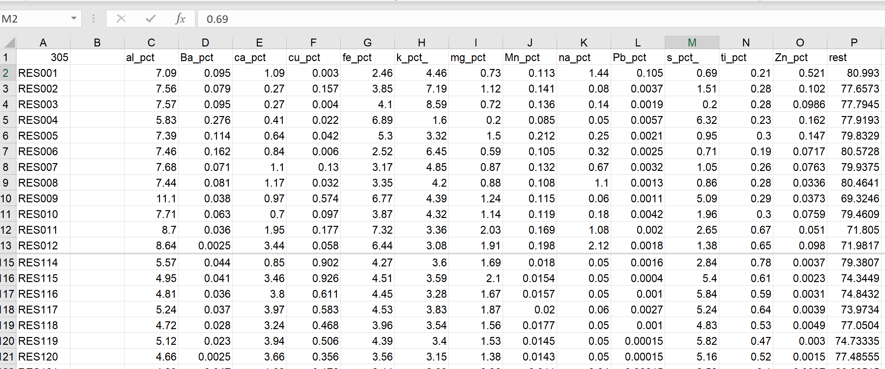
Set Up a data table
Weight_pct of elements with abundances >0.1%

Slide 30
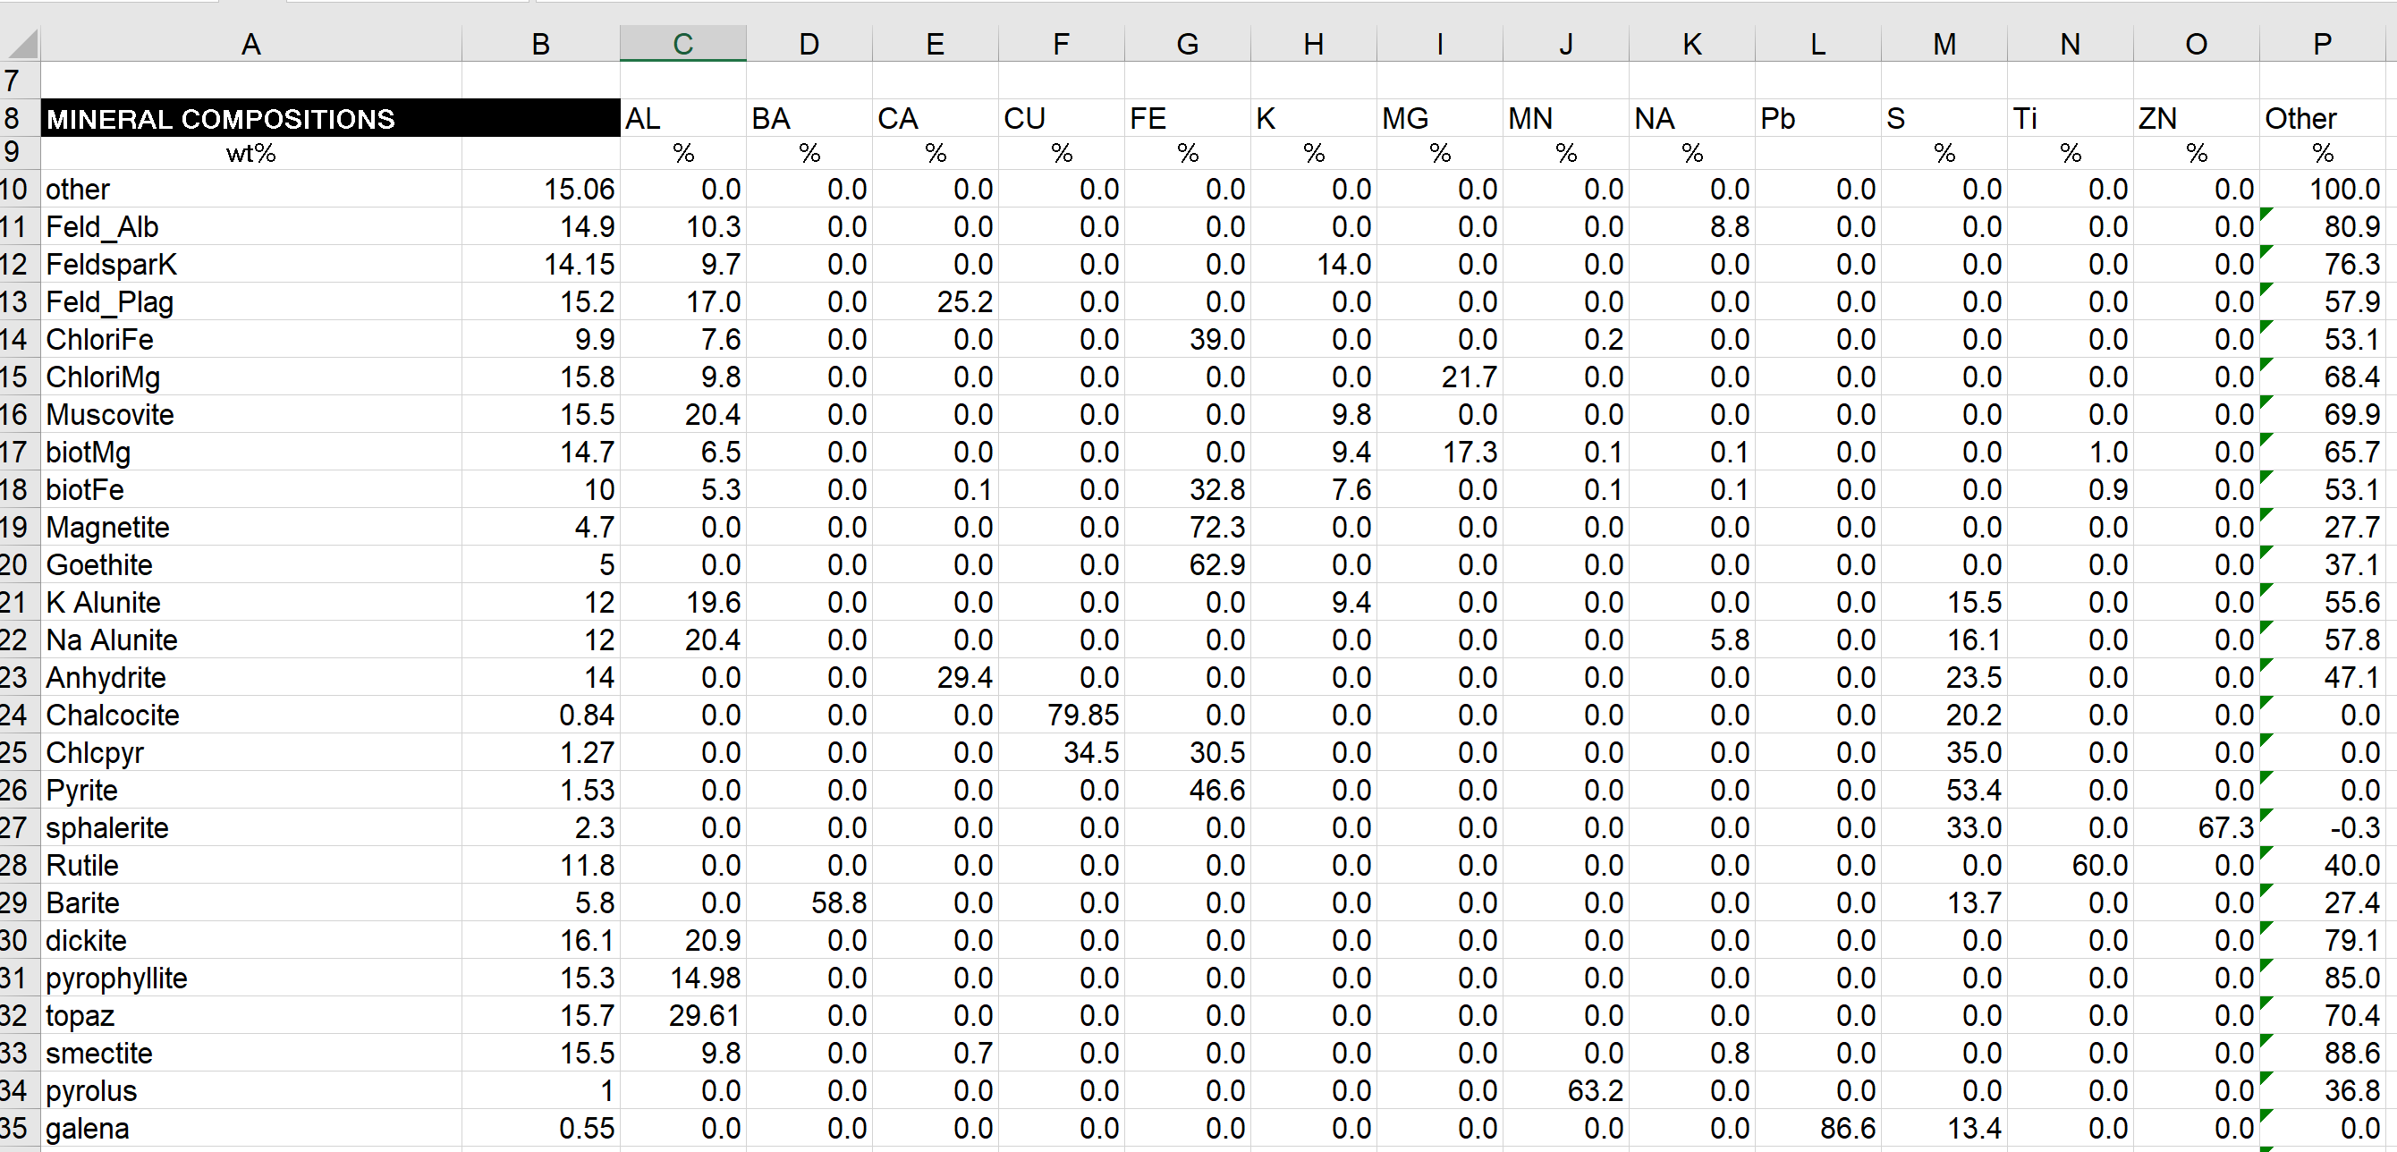
Set Up a matrix of minerals (compositions) to calculate.
The input for the Linear programming calculation is a matrix based on the weight percent of elements and a list of mineral compositions.

Slide 31
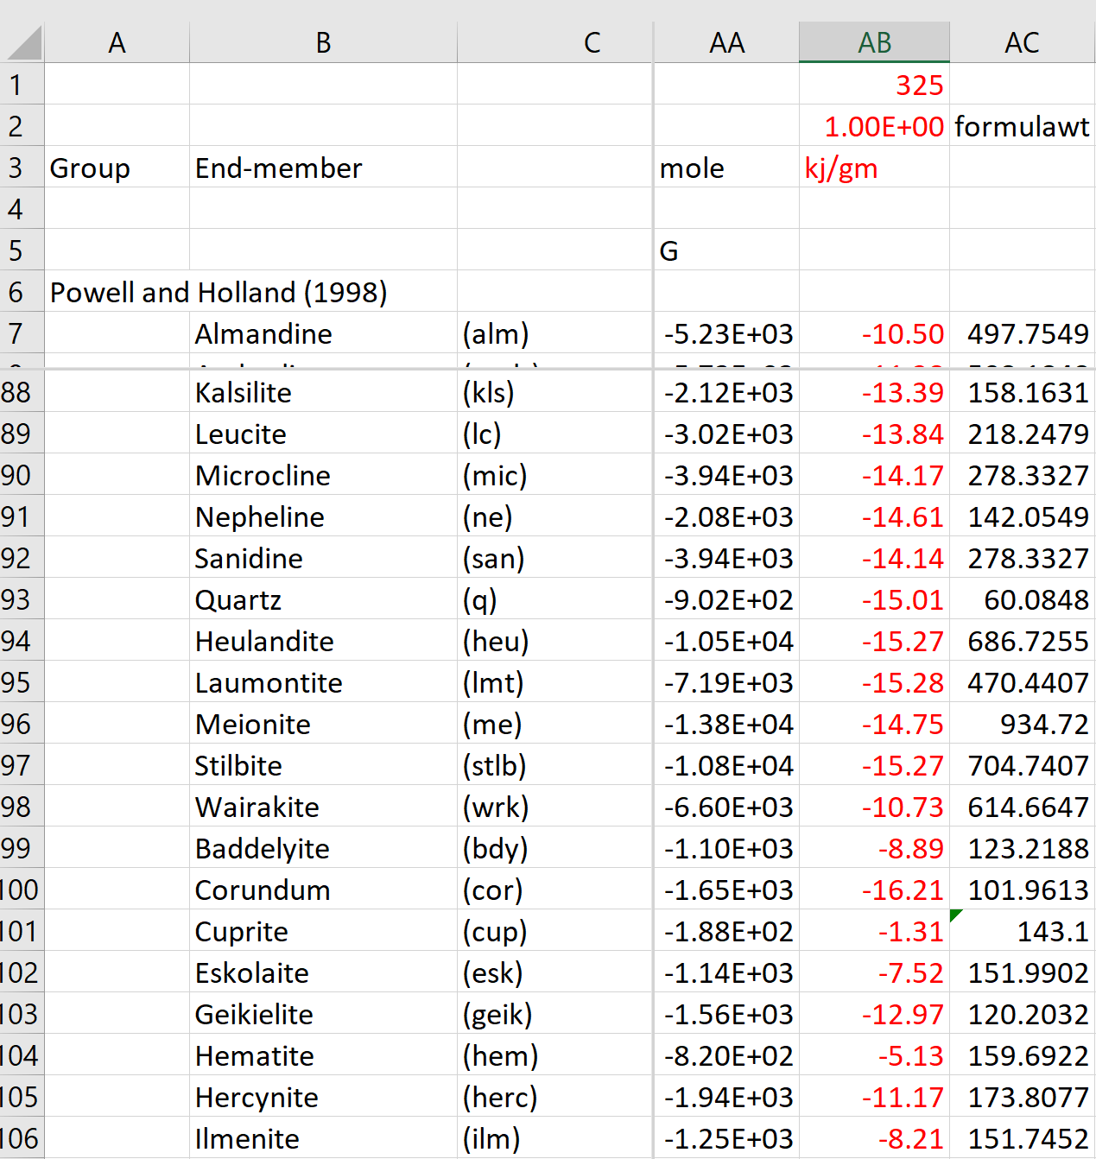
Enter an estimated temperature to calculate Gibbs Free energy per unit mass of mineral.
Use these values to populate the Gibbs function values in the Mineral Matrix spreadsheet.

Slide 32
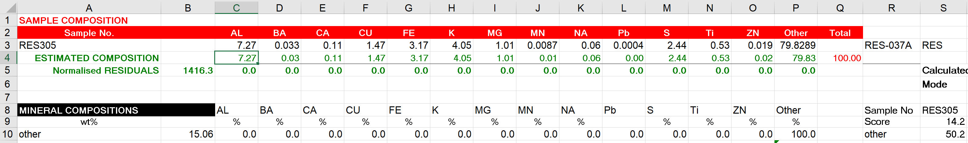
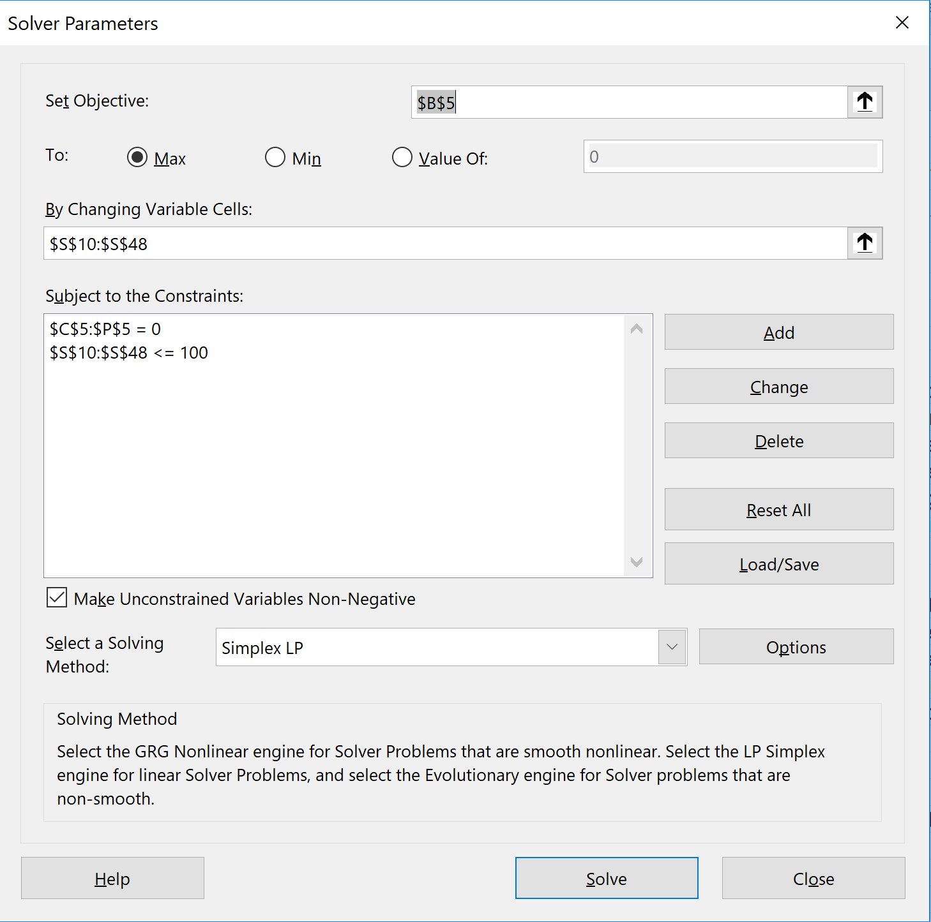
Copy and paste one assay result into the Linear Program set-up
Run Solver for this sample as a test to check the spreadsheet.

Slide 33
Calculation steps
1) Find a feasible solution (i.e. combination of minerals) for which the residuals (i.e. residual element abundances) are zero
2) Calculate the objective function for the feasible assemblage
  Objective function = sum product (property value * estimated mineral abundance)
3) Maximise objective function while meeting the restriction that the assemblage is feasible
  The best estimate of mineralogy is achieved when the objective function is maximised, this is the target for Solver

Slide 34
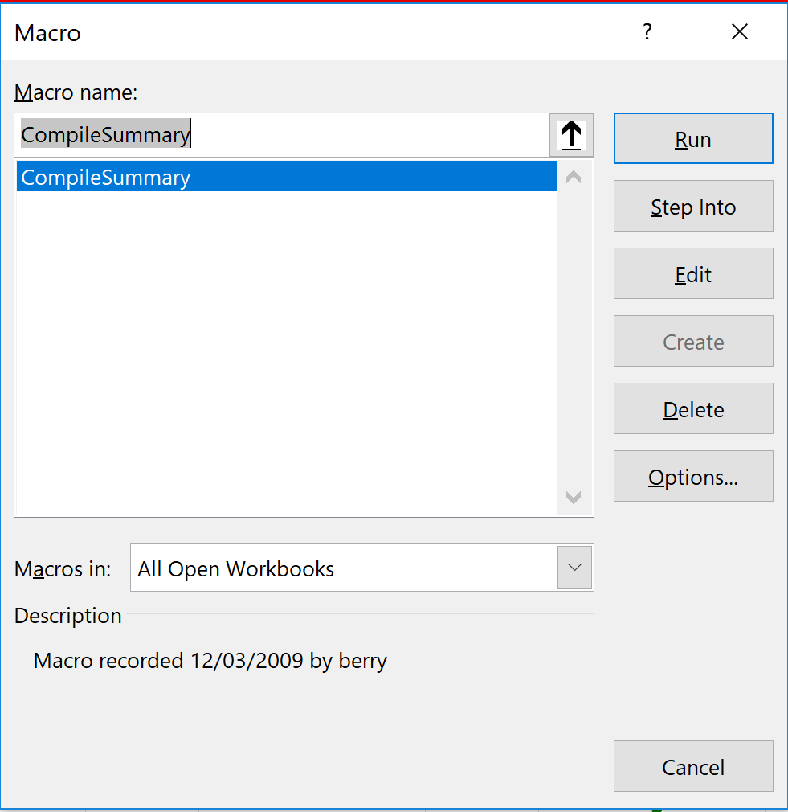
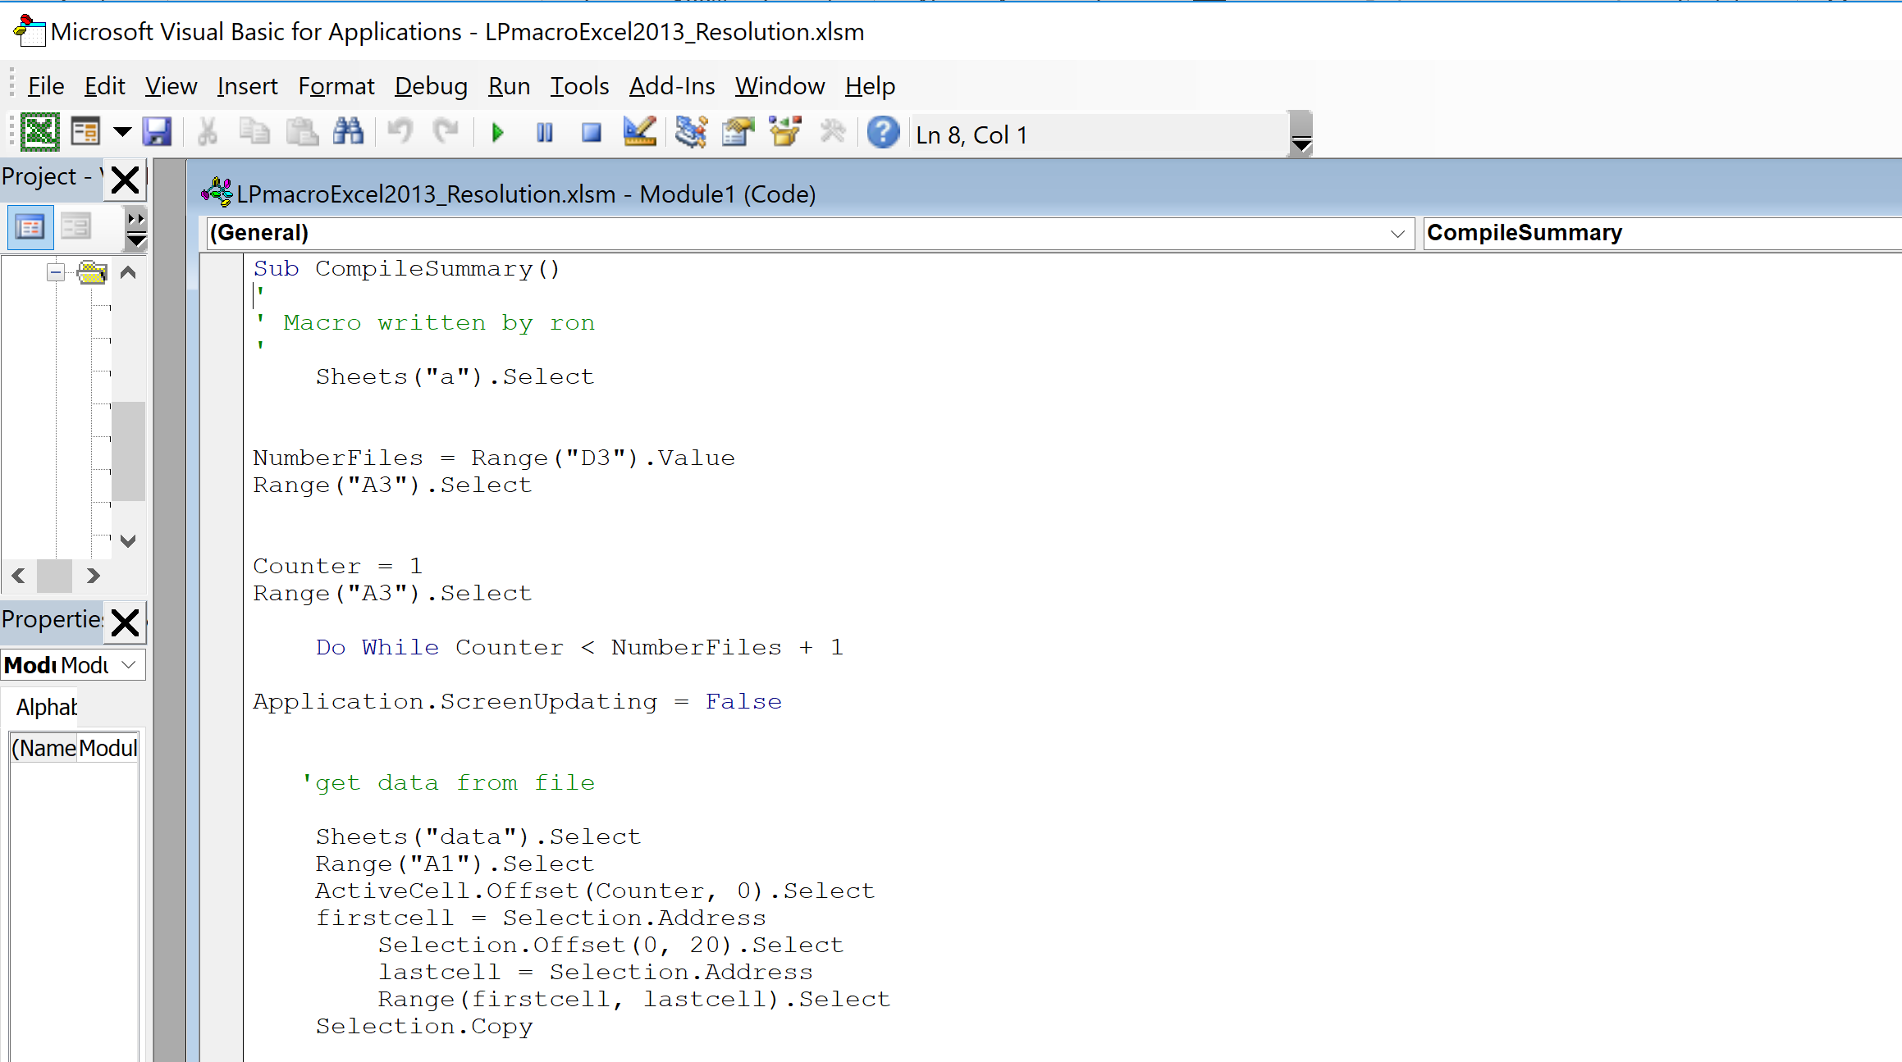
Macro
A Macro reads each assay, puts the values into Solver, takes the answer for that sample and puts it into a results table, then moves to the next assay. The Macro is editable to allow for changes in the matrix of elements and minerals.

Slide 35
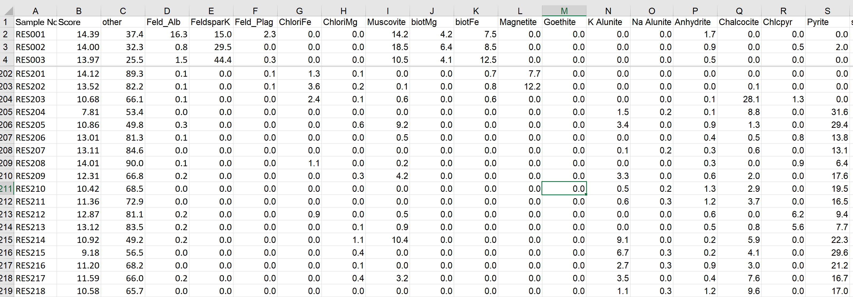
Run the program on a representative subset of the data.
Test the results to see if there are obvious errors; if so, incrementally change to Gibbs numbers until expected (plausible) results are obtained.
Then run the calculation for the entire data set.

Slide 36
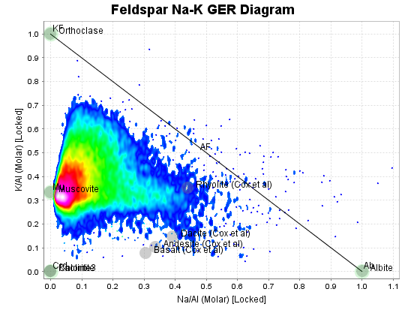
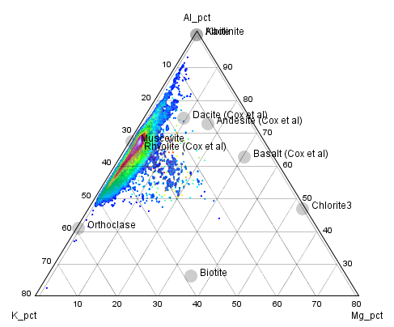
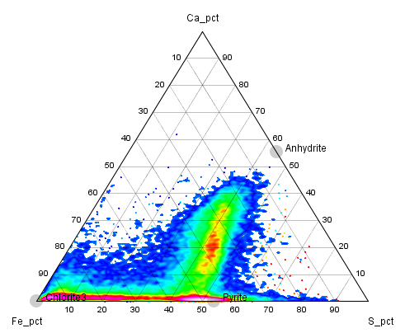
All Data
These are the 3 diagrams I rely on most for picking alteration mineralogy; from these we get an idea of feldspars, white mica, chlorite, advanced argillic Al-clays, pyrite and anhydrite. In the following slides, these plots are coloured by calculated percentages of minerals.

Slide 37
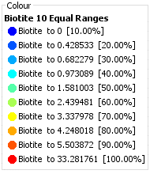
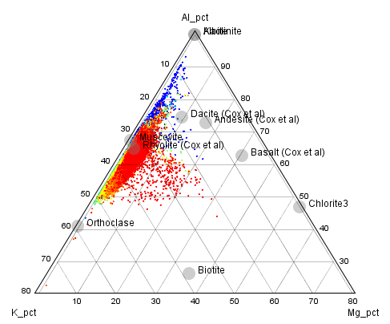
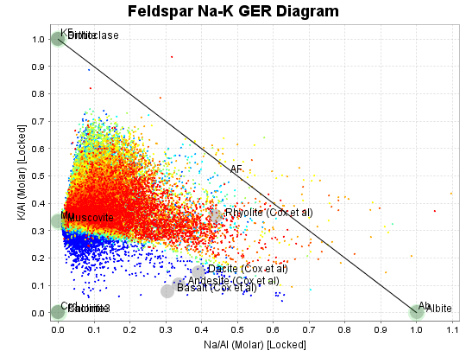
Biotite
Biotite is predicted for samples that plot above the Muscovite-Albite tie-line.

Slide 38
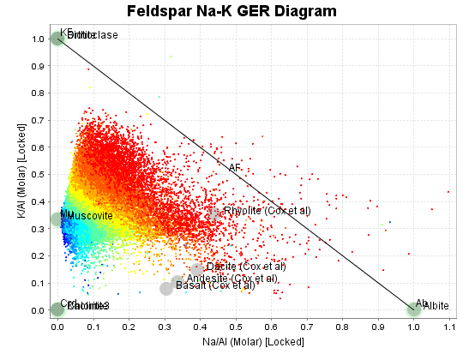
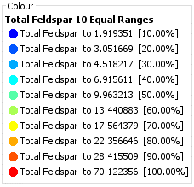
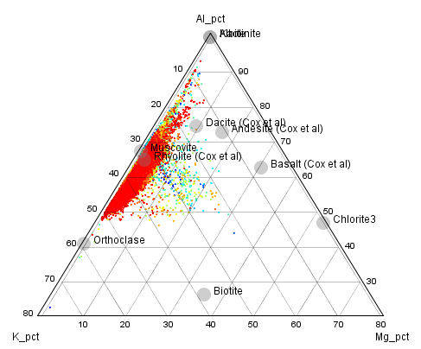
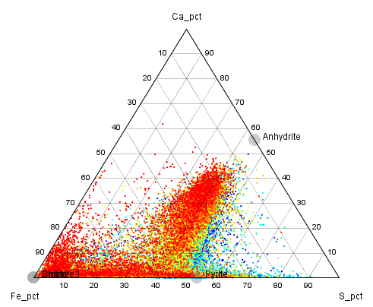
Feldspar

Slide 39
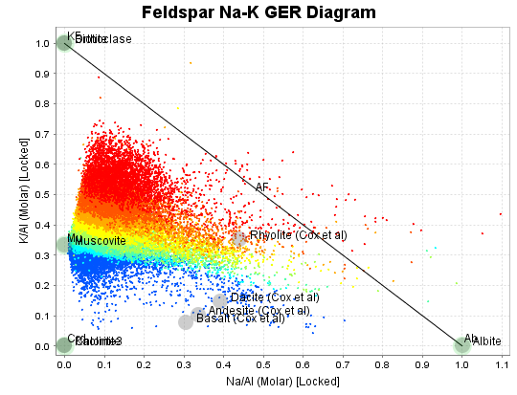
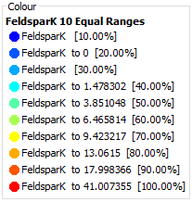
K Feldspar
The predicted amount of K feldspar increases approaching the Kspar-Albite tie line.

Slide 40
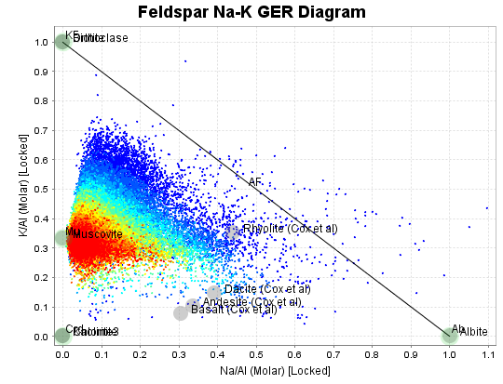
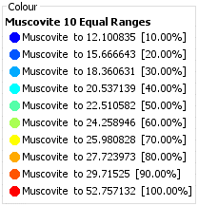
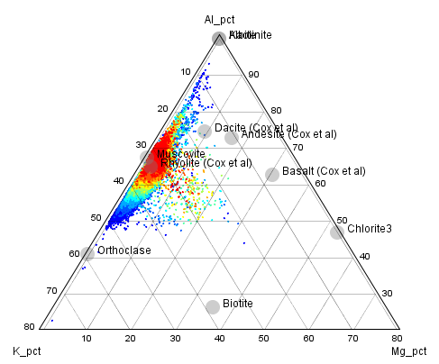
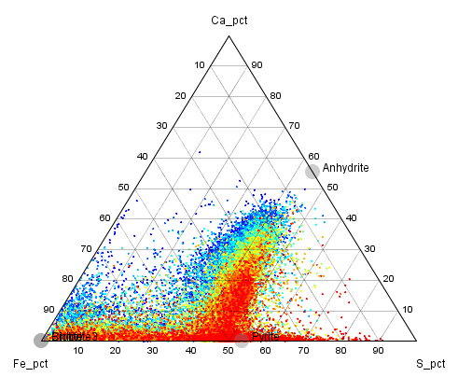
Muscovite

Slide 41
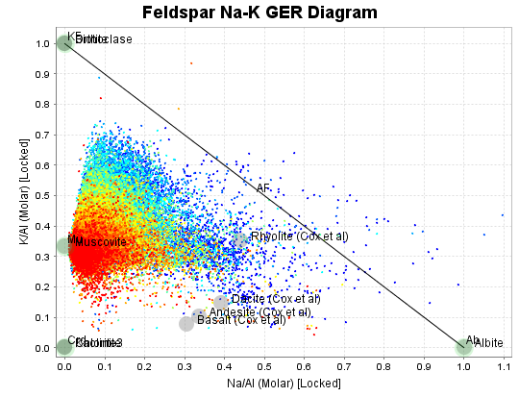



Pyrite

Slide 42




Anhydrite

Slide 43


Quartz

Slide 44

Case Study, 3D model
Pyrite wt%
Cu grade shells at 0.3, 0.4, 0.5, 0.6%.
Note the asymmetry in the pyrite distribution
N
Cross section Line
S

Slide 45

Case Study, 3D model
Anhydrite wt%
Cu grade shells at 0.3, 0.4, 0.5, 0.6%.
Note the anhydrite at depth and on the SE side of the ore zone.

Slide 46

Case Study, 3D model
Muscovite wt%
Cu grade shells at 0.3, 0.4, 0.5, 0.6%.
Note the high muscovite content above the ore zone, and to the NW.

Slide 47

Case Study, 3D model
Feldspar wt%
Cu grade shells at 0.3, 0.4, 0.5, 0.6%.
Note the feldspar on the SE side of the ore zone.

Slide 48

Case Study, Cross section
Anhydrite wt%
Cu grade shells at 0.3, 0.4, 0.5, 0.6%.
There is a very distinct anhydrite dissolution front. Most of the Cu above the dissolution front is supergene enriched.

Slide 49

Case Study, Cross section
Muscovite wt%
Cu grade shells at 0.3, 0.4, 0.5, 0.6%.
Muscovite content decreases with depth, and to the south.

Slide 50

Case Study, Cross section
Feldspar wt%
Cu grade shells at 0.3, 0.4, 0.5, 0.6%.
Feldspar content increases with depth, and to the south.

Slide 51

Case Study, Cross section
Pyrite wt%
Cu grade shells at 0.3, 0.4, 0.5, 0.6%.
Pyrite content decreases with depth, and to the south.

Slide 52

Case Study, Quartz-muscovite-feldspar centered ternary plot
All samples with Cu>0.3%
This plot defines a sericite-quartz-(pyrite) ore type and a feldspar-bearing ore type.

Slide 53

Case Study, estimated weight% pyrite vs anhydrite
All samples with Cu>0.3%
This plot defines a pyritic ore type and an anhydrite-bearing ore type.

Slide 54
Conclusions
The linear programming method does a reasonable job at calculating percentages of major minerals from assays.
It is most likely to make poor predictions when there are overprinting (non-equilibrium) mineral associations, especially with saprolite.
The outcomes would be improved by subsetting the data at the beginning into different alteration domains and setting different Gibbs Free Energy conditions for each domain. In addition, some mineral phases could be excluded from the calculations within specific domains.
Adding SiO2 by pXRF to a 4 acid digest ICP-AES assay suite significantly improves the mineral estimations. ALS does this as an add-on for around ~$3/sample.
A big advantage of calculated mineralogy compared with spectral methods (eg CoreScan) is that it is more quantitative, and it can measure framework silicates that do not respond to SWIR.
A very useful outcome here is that we can estimate Sulfide_S from total S – calculated anhydrite. This will be important for metallurgists.

Slide 55
Conclusions
The gangue minerals are estimated as weight percent values for EVERY assay interval. These can be treated as new assay fields.
Gangue mineral contents can be estimated into every block in the resource model, ie every ore block can have predicted weight percent quartz, feldspar, white mica, chlorite, pyrite, anhydrite etc, as well as an estimated metal grade.

Slide 56
Classifying Sulfide Mineralogy from Assays
Master of Economic Geology Short Course: Geometallurgy
November 4 – 15, 2019

Slide 57
Sequential leach analyses for Copper.
Mineral-selective leaches run in sequence on a single sample.
Sulfuric acid digest to dissolve oxidised copper minerals such as malachite, azurite, chrysocolla and portions of cuprite and tenorite.
Cyanide leach digest to secondary sulfides like chalcocite and covellite, and bornite.
4 acid digest on the residue to dissolve chalcopyrite.
This method is essential for creating domains for Cu species from oxidized to transitional to fresh rocks.

Slide 58

Sequential leach analyses for Copper.
Chalcopyrite, Native copper, Neotocite
Malachite, azurite, chrysocolla, cuprite and tenorite.
Chalcocite, Covellite, Bornite.

Slide 59


Sequential leach analyses for Copper.
MUST plot Residual 4acid_sol copper against S to test for other insoluble Cu minerals.
Chalcopyrite
Insoluble in H2SO4 and CN, BUT no sulfur!
Native Cu or insoluble Cu wad (Neotocite)
Chalcopyrite + Pyrite

Slide 60

How much of this is recoverable in heap leach?
How much of this is recoverable in flotation?

Slide 61


It is important to know the pyrite content.
Pyrite content affects flotation recoveries.

Slide 62

It is important to know the pyrite content.
Pyrite content affects concentrate grades.

Slide 63
How can we make a resource block model of Pyrite%?
If there is no sulfate in the system, it is an easy calculate.
If there is sulfate, then;
Assay for Sulfide _Sulfur, or
Calculate Sulfide _Sulfur
Sulfide_Sulfur assays;
Total S from ICP-OES,
S (Sulfate) Selective leach of sulfates (HCl or NaHCO3), Gravimetric finish
S (Sulfide) calculated by difference.

Slide 64

Estimated Mineralogy
Pyrite vs Anhydrite.
In this data, the amount of S that was added to the rock was limited by the abundance of Ca.
The rock contains anhydrite, albite, K-Spar, biotite
Total Ca, Na, K, Fe and Mg have not changed significantly; just added Sulfur

Slide 65

Estimated Mineralogy
Pyrite vs Anhydrite.
In this data, the amount of S that could have been added to the rock was limited by the abundance of Fe.
The rock contains white mica, pyrite and relict feldspar

Slide 66

Estimated Mineralogy
Pyrite vs Anhydrite.
Least-altered rock
Anhydrite
In this data, the amount of S that was added to the rock was limited by the abundance of Ca plus Fe.
The rock contains white mica, pyrite anhydrite and relict feldspar
Addition of Sulfur
Pyrite

Slide 67




Calculated Mineralogy
Pyrite vs Anhydrite.
A later exercise will show how to calculate weight percent of pyrite and anhydrite from assay data, so that sulfide_sulfur can be estimated without a separate analysis.

Slide 68
Conclusions
Sequential leach analyses for Copper AND total S assays are required to estimate copper mineral speciation, hence to define ore types.
From this, suitable samples can be selected for metallurgical characterization.
In mineral deposits that contain sulfates as well as sulphides, sulfide sulfur must be assayed or estimated so that flotation characteristics can be modelled and predicted in 3D

