Slide 1
Making Mineralogy Models from Corescan Data.
Scott Halley
September 2018

Slide 2
Suggestions for using Corescan Data
Primary objective is to make 2D maps and 3D models of mineralogy and chemistry
Corescan identifies mineralogy in core at 0.5 by 0.5mm resolution.
Results are tabulated as mineral picks composited to assay intervals; becomes essentially a point counting tool, with textural images as a bonus.
We could use numeric point counts to model distribution of each mineral, but…
The first objective should be to make a simplified 3D mineralogy model
Notes:
There are LOTS of different ways to use Corescan results. If your clients are not using it to make 2D maps and 3D models, then they are not getting the full benefit from the data. We should be plotting everything in 3D. The first end product I want from spectral data is to make a simplified 3D mineralogy model. I have a workflow that I developed for SWIR data, where I have a prioritized sequence of “indicator” minerals; I work through a series from hottest and most proximal to coolest and most distal, and assign each composited interval to a mineral zone based on the presence or absence of each indicator mineral above a certain threshold abundance.
The next stage of processing might be to make models of individual mineral species, but I like to see the global overview first (eg, like a porphyry copper model where we would have potassic, phyllic, advanced argillic, etc.)

Slide 3
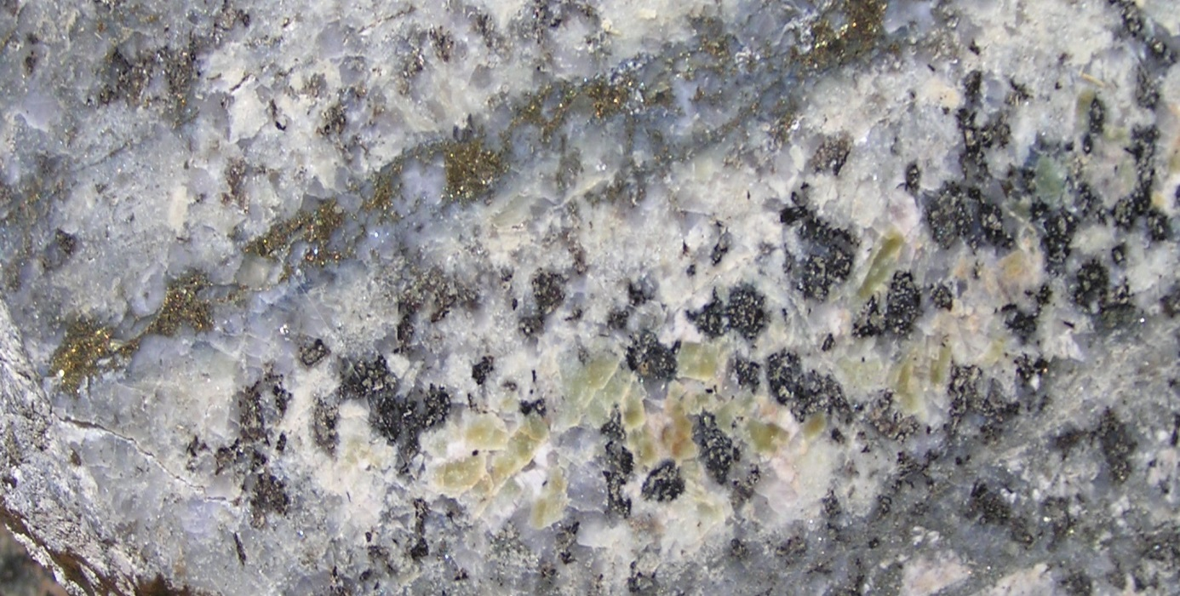
Prioritizing Mineral Species
Porphyry Cu deposit. Potassic alteration, biotite replacing hornblende; partly overprinted by muscovite-pyrite, partly overprinted by smectite. Biotite is NOT the most abundant mineral in this sample. However in a 3D mineralogy model for a porphyry Cu deposit, this should be classified as Potassic alteration.
Quartz-Py vein~ 300º
Muscovite selvage replacing plagioclase and biotite
Biotite + CCP replacing hornblende ~ 400º
Montmorillonite replacing plagioclase ~ 200º
Butte, Montana; potassic, phyllic, argillic alteration
Notes:
How do we deal with overprinting relationships?
Every porphyry copper system looks like this example. This specimen has had 3 different alteration assemblages superimposed. Potassic zones in porphyry Cu system always show some degree of overprinting with later fluids until the entire system has cooled to ambient temperatures.
In an exploration context, the most important factor here is that this is a really proximal sample; the potassic alteration shows we are in the center of the system.
In a geometallurgical context, the most important factor is the intensity and mineralogy of the overprinting minerals. The overprinting will modify the physical rock properties (ie, hardness, grindability), and will affect performance in the flotation circuit. We need to create models that are tailored for specific purposes. The workflow that I am going to present here is designed to create a mineralogical model for an exploration team.

Slide 4
This presentation is based on a data set that contains both Corescan data and geochem assays with a 4 acid digest ICP method.
Compare the mineralogy measured with Corescan against the whole rock assays.
Spectral mapping and WR geochem both have strengths and weaknesses
Complimentary data sets.
Notes:
I have 5 or 6 geochem plots from 4 acid ICP MS data that I use to predict mineralogy in Porphyry Copper systems. I am going to start by showing examples of these from various deposits, and then I will show an example where the geochem assay plots are coloured by mineralogy derived from CoreScan. We can see where the data sets predict the same result, see where they are different, and rationalize why they are different.

Slide 5
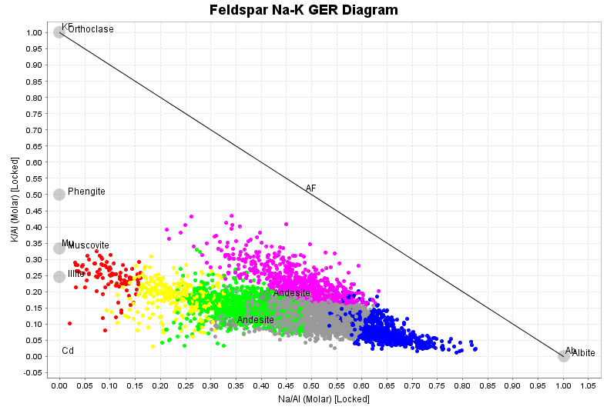
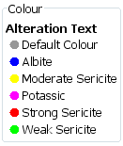
Whole rock geochem plots for mapping mineralogy in Porphyry Cu systems
K/Al versus Na/Al molar ratio plot.
Biotite
Muscovite
Least-altered rock
Albite
Notes:
One of the most useful plots is K/Al versus Na/Al, calculated on a molar basis. Consider a rock that is totally sericitized. The mineralogy of the rock might be muscovite-quartz-carbonate-pyrite. All of the K and Al in that rock will be within sericite. Muscovite has a composition of KAl₃Si₃O₁₀(OH)₂. Therefore the ratio of K:Al in the sericitized rock is 1:3. Similarly, a totally K feldspar (KAlSi₃O₈) altered rock will have a K:Al ratio of 1:1. In the same way, albitisation can also be tracked. Albite is NaAlSi₃O₈: Na:Al =1:1.
Potassic alteration typically involves just the replacement of hornblende by biotite. The amount of biotite that is formed is limited by the Fe content of the rock. Biotite alteration pushes the assay points a little way towards a K/Al value of 1, but doesn’t get very far before all of the HBL is consumed. It is common in porphyry systems that the potassic alteration shifts the alkali contents very little.

Slide 6
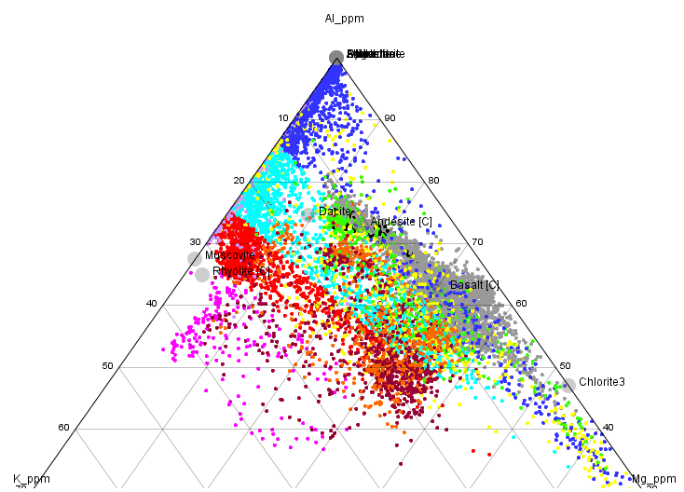
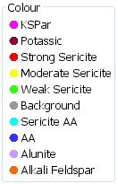
Whole rock geochem plots for mapping mineralogy in Porphyry Cu systems
Al-K-Mg ternary plot.
Advanced Argillic
Al-K-Mg ternary to map Mg depletion;
AA vs biotite, chlorite, smectite
Notes:
The K/Al versus Na/Al molar ratio plots don’t tell us anything about Fe-Mg minerals. The best plot for adding this in is a Al-K-Mg ternary plot. In very acid environments (ie advanced argillic alteration), Mg is removed from the rock. This plot differentiates AA alteration from sericite-chlorite-clay.

Slide 7
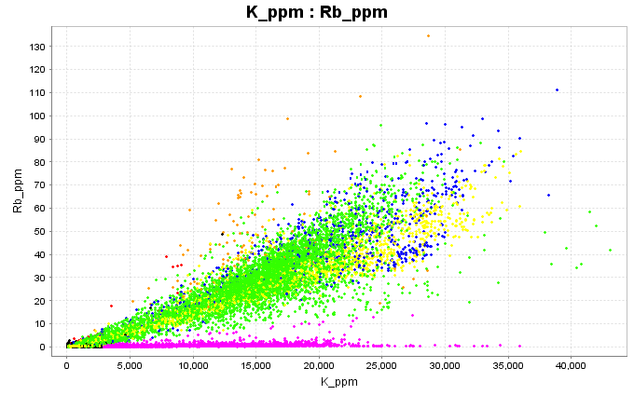
Whole rock geochem plots for mapping mineralogy in Porphyry Cu systems
Rb vs K to map alunite
Rb follows K into silicate minerals, but K sulfates do not contain Rb
Notes:
In silicate mineral, potassium and rubidium are highly correlated. However, Rb does not substitute into sulfates. Therefore Rb vs K is a very effective way to identify alunite-bearing samples within an assay dataset.

Slide 8
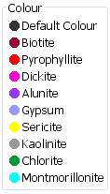
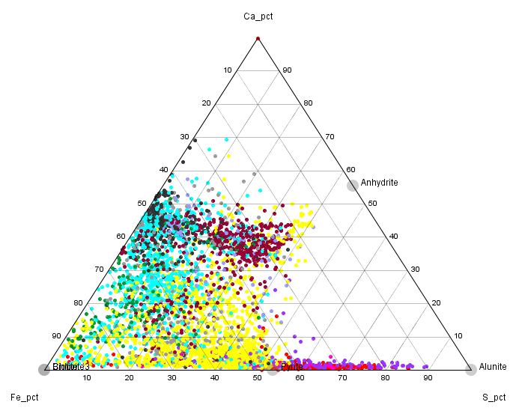
Whole rock geochem plots for mapping mineralogy in Porphyry Cu systems
Ca-Fe-S ternary plot.
Least-altered rock
These samples must contain anhydrite
Notes:
Ca-Fe-S ternary plot. As magmatic SO2 disproportionates to H2SO4 and H2S, S is added to the rock. This process moves the data points directly towards the S apex. Potassic alteration retains most of the Ca. As this reaction progresses further, the acid breaks down feldspar, and Ca is removed. This moves the data points directly away from the Ca apex. Sericite pyrite alteration ultimately plots at the projected position of pyrite on the Fe-S join. Points that plot on the S-rich side of the join between the Ca apex and pyrite must contain sulfates. Alunite samples will have little Ca.

Slide 9
For your deposit type, decide on a priority sequence of minerals from hottest and most proximal, to coolest and most distal.
Use the percentage of pixels per assay interval containing each mineral as a point count value.
Pick a percentage of pixels for that mineral as a threshold to include those samples in a particular mineral zone.
Notes:
eg for a porphyry system, I might have a priority list;
Biotite
Anhydrite,
Alunite,
Pyrophyllite,
Dickite,
Kaolinite,
White Mica,
Chlorite,
Smectite

Slide 10
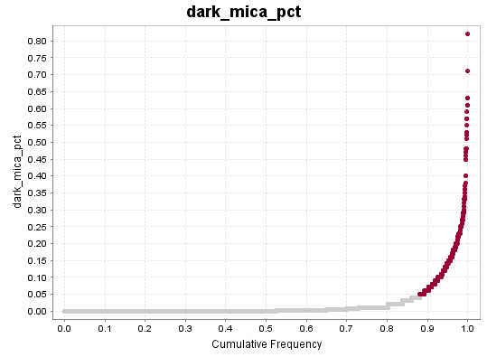
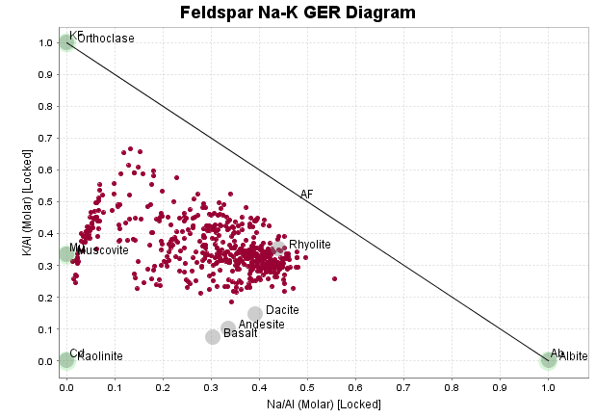
Porphyry Cu example, Biotite
Cumulative frequency plot of Biotite_pct.
Assay intervals with >5% biotite assigned to the biotite zone.
How does this compare with assay data?
Corescan clearly recognizes biotite; hard to pick from the assays;
Assays pick the feldspar compositions, with Corescan doesn’t.
Biotite with intense KSpar
Biotite with increasing KFS
Biotite after HBL
K/Al versus Na/Al molar ratio plot.
Notes:
This plot shows 3 associations of biotite. There is biotite in rocks that have very little change in their primary K, Na and Ca contents; biotite in rocks that have lost some Na; biotite in rocks that have lost nearly all of their Na and are flooded with high temperature K feldspar. We couldn’t map the biotite alteration from the assay data, but we couldn’t map the feldspar alteration from the Corescan data.

Slide 11
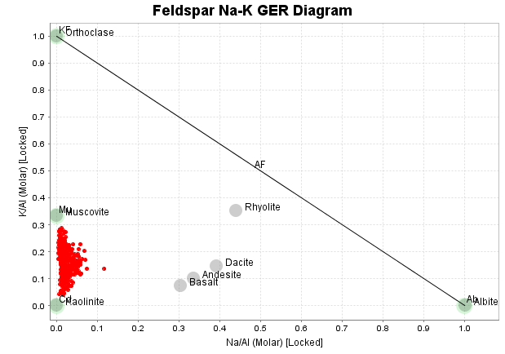
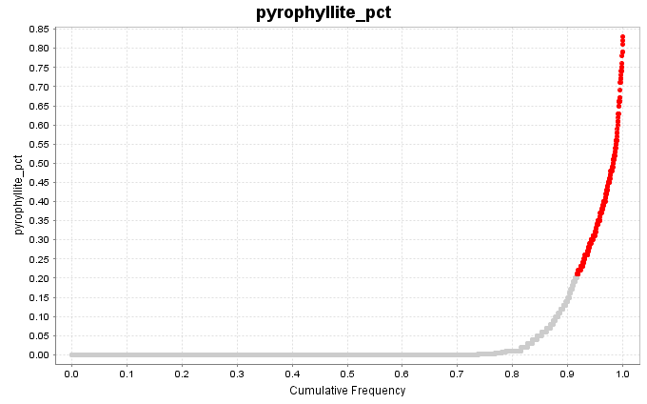
Porphyry Cu example, Pyrophyllite
Cumulative frequency plot of Pyrophyllite_pct.
Assay intervals with >20% pyrophyllite assigned to a pyrophyllite zone.
How does this compare with assay data?
Corescan clearly recognizes pyrophyllite; Always mixed with some K mineral.
Assays can’t differentiate which advanced argillic phyllosilicate.
Pyrophyllite mixed with muscovite +/- alunite
K/Al versus Na/Al molar ratio plot.
Notes:
Corescan unambiguously picks pyrophyllite, and picking mixtures of pyrophyllite with muscovite with Corescan is also unambiguous. All of these points should be assigned to a Pyrophyllite domain because the presence of this mineral is diagnostic of a hot and very acid environment.

Slide 12
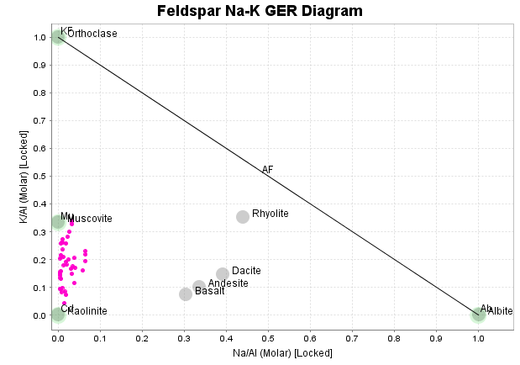
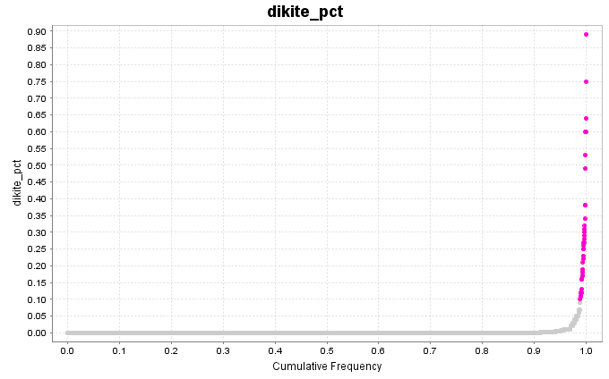
Porphyry Cu example, Dickite
Cumulative frequency plot of Dickite_pct.
Assay intervals with >10% dickite assigned to a dickite zone.
How does this compare with assay data?
Corescan clearly recognizes dickite; Always mixed with some K mineral.
Assays can’t differentiate which advanced argillic phyllosilicate.
Dickite mixed with muscovite
K/Al versus Na/Al molar ratio plot.
Notes:
As with pyrophyllite, Corescan unambiguously picks dickite and mixtures with muscovite. This mineral is diagnostic of a moderate temperature, highly acidic environment.

Slide 13
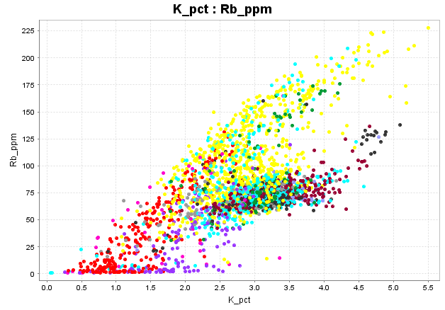
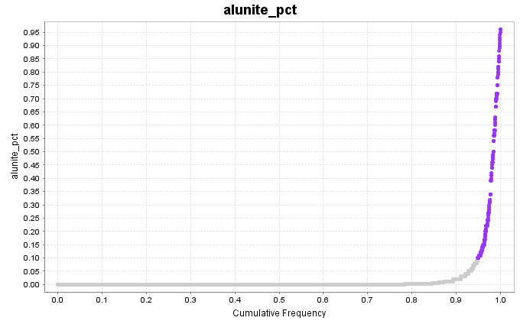
Porphyry Cu example, Alunite
Cumulative frequency plot of Alunite_pct.
Assay intervals with >10% alunite assigned to an alunite zone.
How does this compare with assay data?
Both methods map alunite REALLY well.
Alunite mixed with pyrophyllite
Rb vs K plot.
Notes:
You can see that there are some pyrophyllite points here with NO rubidium. These are pyrophyllite-alunite mixtures. I should have given a higher priority to alunite rather that pyrophyllite, as alunite is likely to be more proximal. When alunite is identified from the assay data, as in this example, we can also use the assay data to work out the K/Na ratio in the sulfate. I haven’t bothered to include the plot in this presentation, but the Na/(Na+K) ratio measured from the assays correlates very well with the shift in the 1485nm wavelength measured from the alunite spectra!

Slide 14
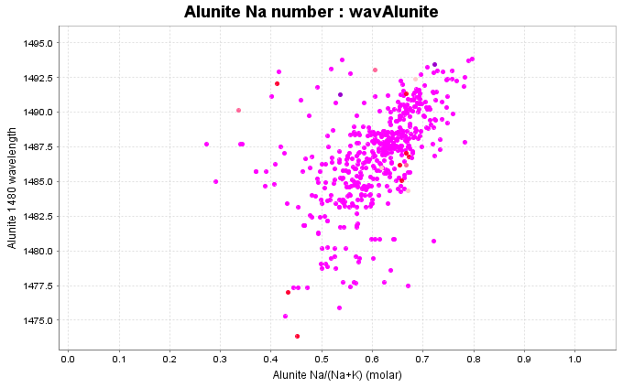
Porphyry Cu example, Alunite
the Na/(Na+K) ratio measured from the assays correlates very well with the shift in the 1485nm wavelength measured from the alunite spectra

Slide 15
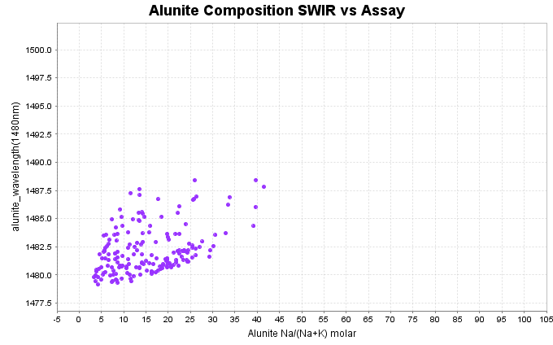
Porphyry Cu example, Alunite
the Na/(Na+K) ratio measured from the assays correlates very well with the shift in the 1485nm wavelength measured from the alunite spectra

Slide 16
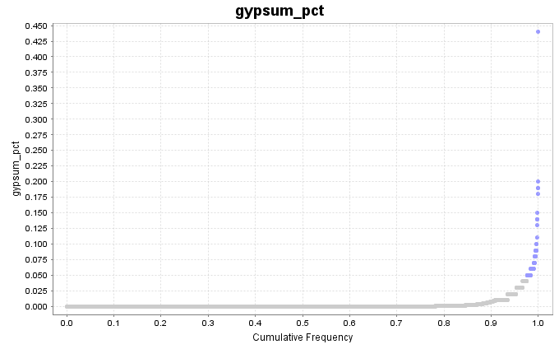
Porphyry Cu example, Gypsum
Cumulative frequency plot of Gypsum_pct.
Assay intervals with >5% Gypsum assigned to an Anhydrite zone.
Notes:
Spectrally, gypsum and anhydrite are indistinguishable. I should also have assigned a higher priority to Gypsum. There is a significant amount of anhydrite, particularly with the biotite-bearing samples.

Slide 17
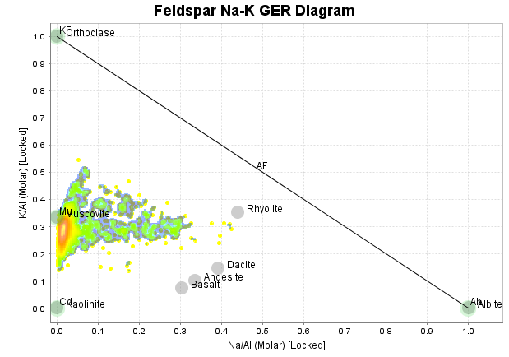
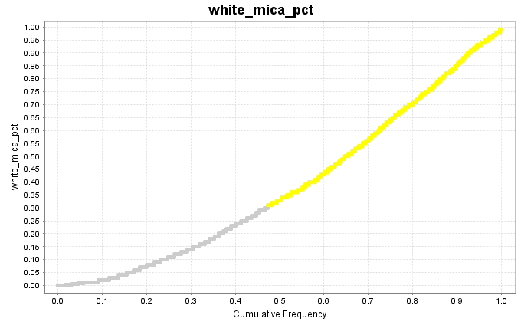
Porphyry Cu example, White Mica
Cumulative frequency plot of White Mica_pct.
Assay intervals with >30% white mica assigned to an sericite zone.
How does this compare with assay data?
Mostly, this works really well, but a significant number of intervals contain quite a bit of relict feldspar.
K/Al versus Na/Al molar ratio plot.
Notes:
Most of the samples classified as white mica are intensely sericitised. A small proportion are partially altered.

Slide 18
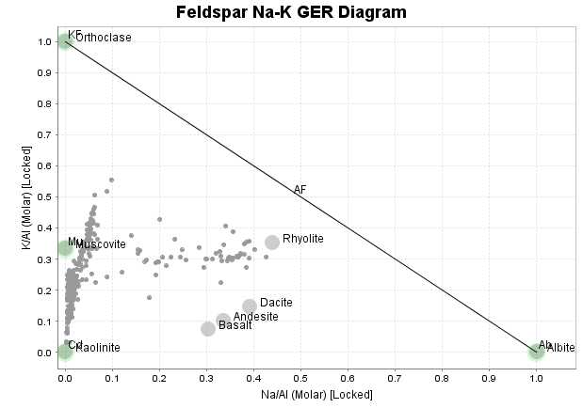
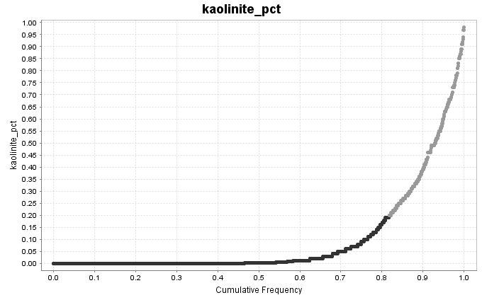
Porphyry Cu example, Kaolinite
Cumulative frequency plot of Kaolinite_pct.
Assay intervals with >20% kaolinite assigned to a kaolinite zone.
How does this compare with assay data?
Corescan clearly recognizes kaolinite; hard to pick from the assays;
Corescan doesn’t clearly pick what is mixed with the kaolinite.
Kaolinite dusting in hydrothermal KSpar
Kaol with sericite
Kaol dusting in weakly altered rock
K/Al versus Na/Al molar ratio plot.
Notes:
Things start to get interesting, and complicated, when we look at the clay minerals. There are 3 associations of kaolinite. There are strongly Na-depleted rocks with low K. This is low temperature advanced argillic alteration. There are occurrences of kaolinite in relatively weakly altered rocks; this is probably a dusting of kaolinite in cloudy primary feldspar. There is another group of kaolinized samples in low Na – high K rocks; this is a low temperature overprint of kaolinite in the most intensely potassic alteration in the heart of the porphyry Cu system. Feldspars (especially hydrothermal feldspars it seems) are highly susceptible to hydrolysis reactions. Feldspar + water = clay. It would be difficult to visually recognise much of this kaolinite without the spectral data, but we wouldn’t recognise the context of the kaolinite types without the assay data.

Slide 19
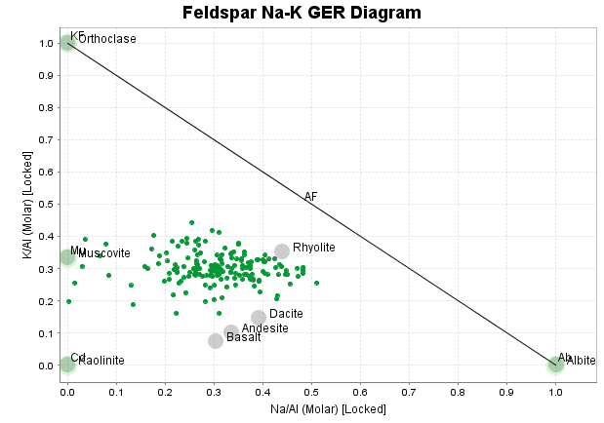
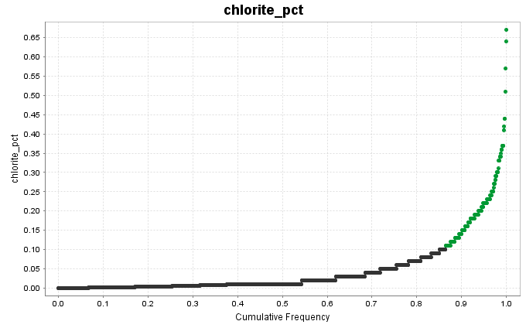
Porphyry Cu example, Chlorite
Cumulative frequency plot of Chlorite_pct.
Assay intervals with >10% chlorite assigned to a chlorite zone.
How does this compare with assay data?
Chlorite is just a hydrolysis reaction; Hbl + water = Chlorite
Cannot recognize this from assay data
Notes:
Lots of rocks become chloritised without any significant addition or removal of major elements.

Slide 20
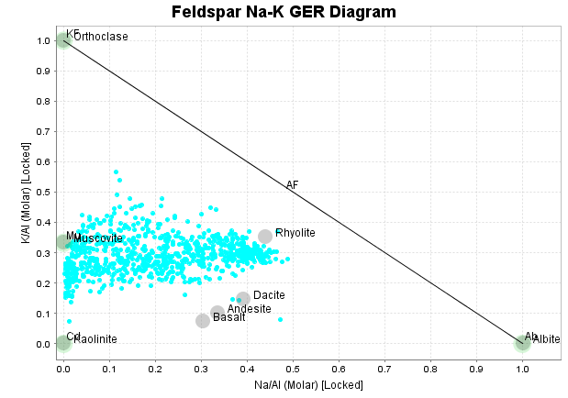
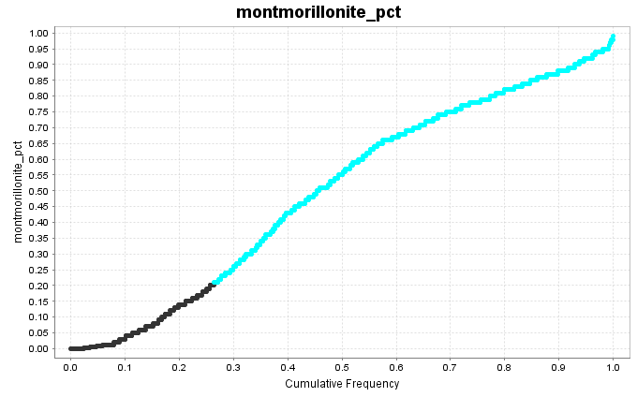
Porphyry Cu example, Montmorillonite
Cumulative frequency plot of Montmorillonite_pct.
Assay intervals with >20% montmorillonite assigned to a semctite zone.
How does this compare with assay data?
Large group of smectites in rocks with no Na and no Ca??
Smectites consistently overestimated; difficult to differentiate clays and white mica
Can’t be picked from chemistry.
Unlikely to be Montmorillonite
Montmorillonite
Smectite dusting in weakly altered rock
K/Al versus Na/Al molar ratio plot.
Notes:
Spectral matching for montmorillonite does not work well! There is a complete continuum from muscovite to interlyered illite-smectite to smectite. It seems difficult to get the cutoff between dominantly illite to dominantly smectite to match the geochem. The most sodium depleted samples here chemically are a better match for illite than for smectite. This is common in most data sets. However, we also see plenty of examples that clearly are smectites, but with no Ca or Na. Which clay mineral is this? (Montmorillonite is a Ca-Na smectite). Much of the smectite in this data is dusting or replacing feldspar with much change in the bulk chemistry of the rock. This form of clay alteration cannot be mapped just from assays.

Slide 21
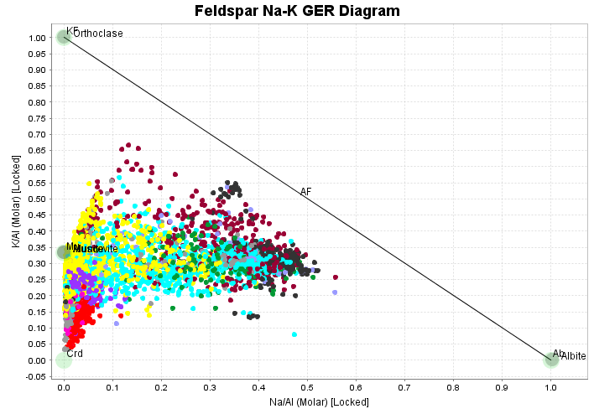
Corescan composited to assay intervals; geochem plots coloured by Corescan mineralogy
Notes:
This is a K/Al versus Na/Al molar ratio plot from this data set showing the assay points coloured by mineralogy classifications derived from Corescan.

Slide 22
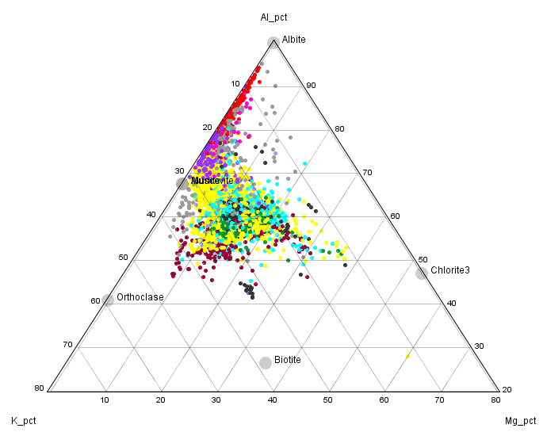
Corescan composited to assay intervals; geochem plots coloured by Corescan mineralogy
Notes:
This is a Al-K-Mg ternay ratio plot from this data set showing the assay points coloured by mineralogy classifications derived from Corescan.

Slide 23
Corescan composited to assay intervals; geochem plots coloured by Corescan mineralogy
Notes:
This is a Ca-Fe-S ternay plot from this data set showing the assay points coloured by mineralogy classifications derived from Corescan.

Slide 24
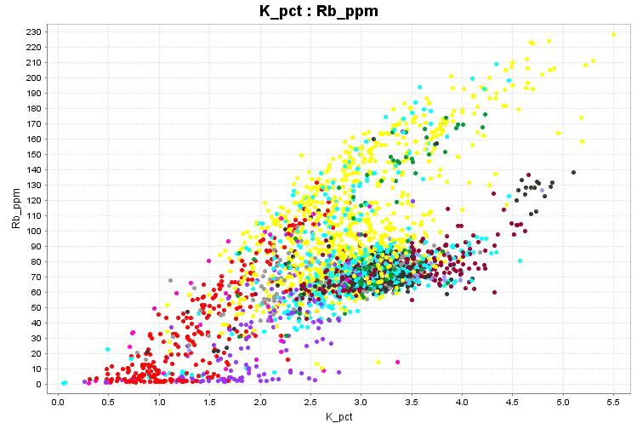
Corescan composited to assay intervals; geochem plots coloured by Corescan mineralogy
Notes:
This is a Rb-K plot from this data set showing the assay points coloured by mineralogy classifications derived from Corescan.

Slide 25
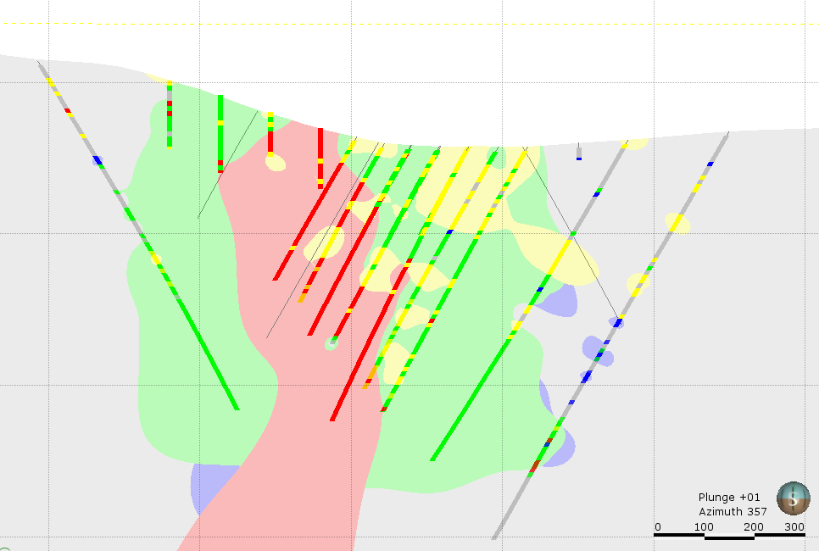
Leapfrog has good algorithms for converting mineralogy categories into 3D models.
Notes:
Once a Corescan data set is attributed with a priority Indicator mineral for each interval, there are simple processes in software packages such as Leapfrog to convert data in this format into 3D models.

Slide 26
Conclusions
There are easy workflows that can summarize Corescan data to make simplified alteration models very rapidly.
Categorized interval data is an ideal format for making 3D models in Leapfrog.
Corescan maps clay mineralogy that many (most) geologists will never pick visually. It maps clay mineralogy that cannot be interpreted from whole rock assays.
Whole rock assay data fills in the mineral components that are aspectral, eg feldspars.
We need integrated Corescan and whole rock geochem to calculate quantitative mineralogy.

