Slide 1
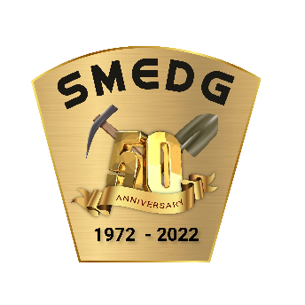
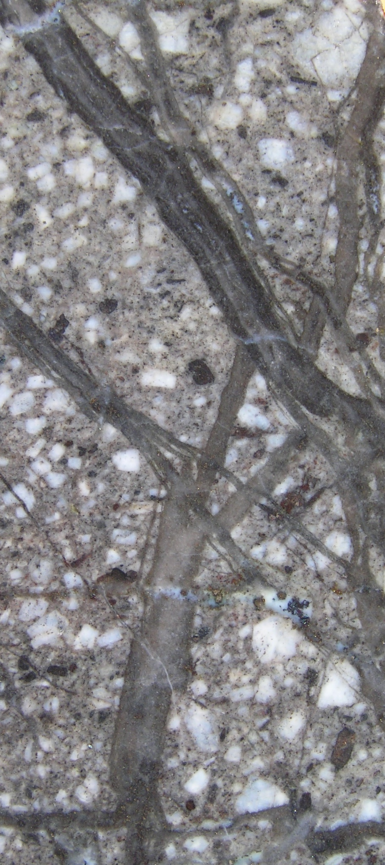
How to Recognise Magmatic Fractionation from Routine Drill Core Assays.
SMEDG GOLDEN JUBILEE CONFERENCE
Scott Halley
25th August 2022

Slide 2
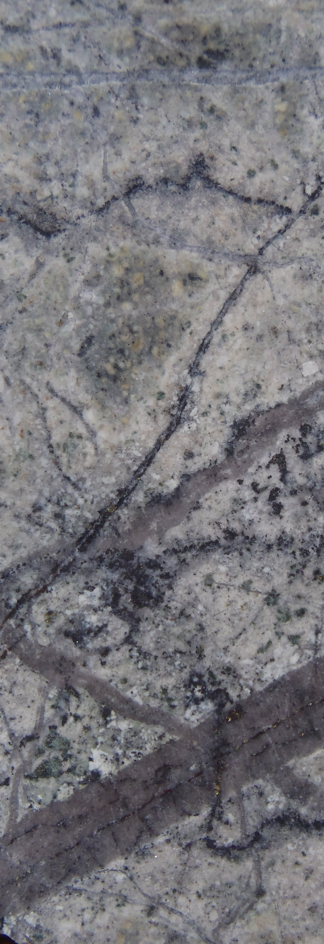
Outline of this presentation
What have been the most significant recent advances.
What could we be doing better.
New developments in the near term?
Case study
Tracking magmatic fractionation in an alkalic porphyry Cu-Au system using routine drill core assays.

Slide 3
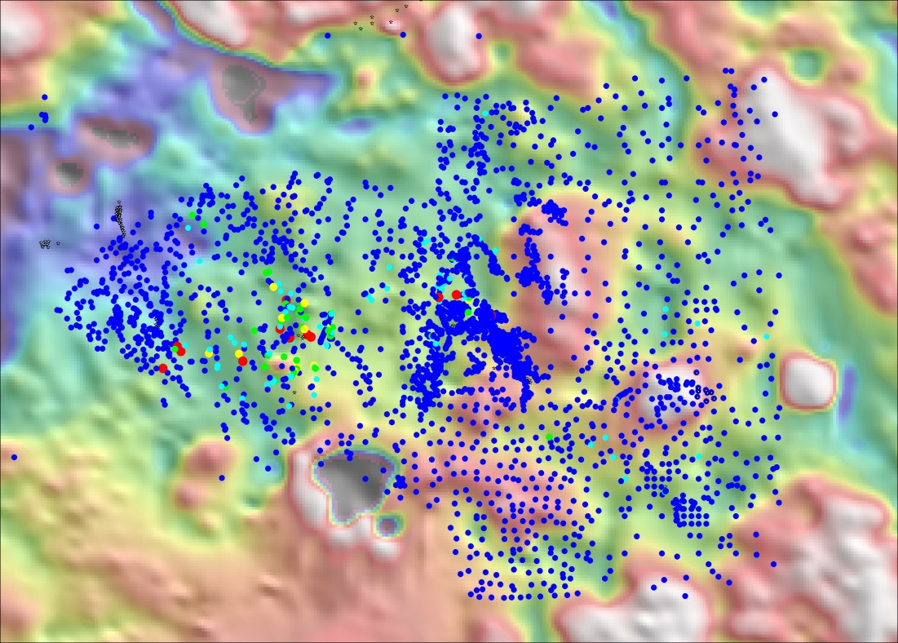
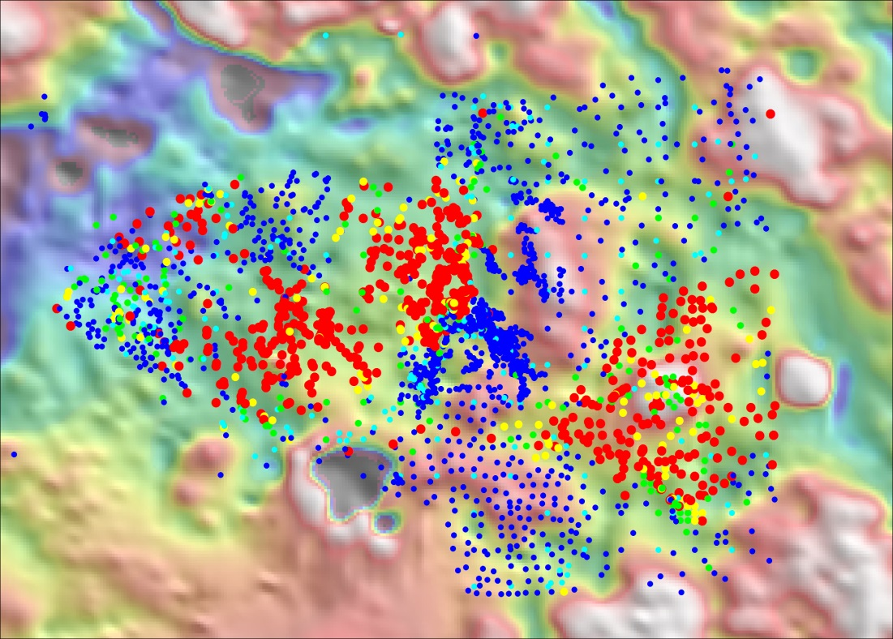
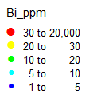
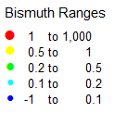
Most significant advances in Geochemistry in the last 50 years
Commercial Low detection limit ICP-MS
Advances in computer hardware and software
ICP-AES, circa 2000. detection limit 5ppm
ICP-MS, circa 2010. detection limit 0.01ppm
Bismuth in rock chips
Notes:
During the last 40 years, the analytical method for pathfinder elements has changed from atomic absorption spectroscopy to neutron activation analysis to ICP atomic emission spectroscopy to ICP mass spectroscopy. The figures in this slide highlight the impact of commercial development of ICP-MS. The field of view here is about 8km by 5km. The survey covers an outcropping porphyry Cu system on the eastern side, and 2 blind porphyry Cu occurrences in the center and to the west. The blind porphyries have NO copper expression in surface geochem. Bismuth is an element that substitutes into the lattice of pyrite, and in this case, it highlights the extent of the phyllic alteration above and surrounding the porphyry centers. If these samples had been measured with ICP-AES 20 years ago, the detection limit would have been 5ppm, and the figure on the left shows what that would have looked like. With modern ICP-MS the detection limit is 0.01ppm, on the right. The commercial development of ICP-MS with a larger suite of elements, very low detection limits and fantastic precision, has dramatically changed geochemistry. (Porphyry systems typically show a zoning pattern from Cu to Mo to Se to Sn to Bi to Te to As to Sb; zoned in response to a temperature gradient). Within that footprint, there is typically depletion most notably in Mn and Zn due to the acidity of the hydrothermal fluid. The pathfinders are therefore a proxy for temperature and pH in mineralizing systems).
Consider this scenario. Imagine you were exploring for a porphyry Cu deposit under cover; say somewhere like North Parkes, with 20 meters of Tertiary sediments above the prospective host rocks. If you had to use an aircore rig to drill for in-situ bedrock samples for geochemistry, what drill spacing would you need to be able to identify when you were within the geochemical footprint of a porphyry? What spacing would you need to be able to recognize the zoning pattern within the porphyry system? 200m by 200m; 500m by 500m; 1km by 1km; 2kmby 2km? At that spacing, how many false negatives would you have within the footprint perimeter? How many false positives would you have outside the footprint perimeter? These are really fundamental questions for any explorer!
In my experience, consulting to around 200 different mining companies around the world, there are very few exploration geologists who really understand the footprints of the deposits they are looking for. Why is that? It has a lot to do with deposit descriptions in the public domain. There are thousands of good descriptive papers on the geology of porphyry Cu deposits. There are hundreds of papers describing in detail the alteration mineralogy of porphyry systems; describing real mineralogy not just schematic mineral zoning models. However there are remarkably few papers using real geochemical data showing the zoning around porphyries. The papers that are published show data collected with old analytical methods rather than modern ICP-MS.
Something we could do to increase the likelihood of new discoveries is form a collaboration between companies to compile atlases’ of geochemical footprints of deposits, all presented in a consistent format so we can compare apples with apples.

Slide 4
What are the things we do poorly in Geochemistry
Routinely analyze 48 elements, but plot just Cu and Au
Global shortage of knowledgeable geochemists
Applied geochemistry in not taught in universities
Not enough teamwork;
exploration geos don’t talk to geochemists or geophysicists
mining geos don’t talk to engineers or metallurgists
Notes:
What are the things we do poorly?
I believe I see more exploration geochemical data than most other people on the planet. Around ½ of the data sent to me is still measured by ICP-AES.
Most geologists still just plot Cu and Au because they don’t know what to do with the other elements. This is because the geochemistry skills that new graduates will need on the job are not taught at universities. Knowledgeable geochemists are in short supply and teaching staff at universities do not have access to exploration and mining data around which they could create teaching courses. If mining companies wanted to improve the skill levels in new graduates, this gap is something they could very easily fix.
It is also very common practice in exploration for geologists, geochemists and geophysicists to work independently of each other. In the most successful teams, the different disciplines work collaboratively.

Slide 5
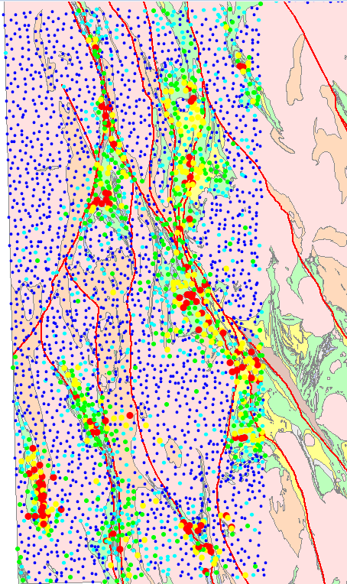
Bellevue, 3m oz
Bronzewing, 2m oz
Geochemistry 101
Still the best exploration tool
Arsenic Map from GSWA regolith geochemistry project;
Sir Samuel, Leonora, Menzies map sheets.
Darlot, 4m oz
Agnew, 5m oz
Thunderbox, 2m oz
Sons of Gwalia, 10m oz
King of the Hills, 3m oz
Kookynie, 1m oz
GSWA sheetwash sampling, 1999.
3,000 samples, 50,000 km²
Menzies, 1m oz
Notes:
In the 1970’s and 1980’s especially, it was relatively common for large exploration teams, and some government survey groups to collect large regional geochemical data sets. This example is from the Geological Survey of Western Australia. It shows the arsenic assays from surface samples across the Menzies, Leonora and Sir Samuel 1:250,000 map sheets. The footprint of every large orogenic gold system on these map sheets has an expression in the arsenic geochem, even at a nominal spacing of 1 sample per 16km2. (This survey is one of the earliest large regional campaigns using ICP-MS).
At the time those large regional surveys were being done, the available assay methods were appropriate for Au, Cu, Pb, Zn, Mn, and Mo. It is ironic now that we have methods that are orders of magnitude better, these kinds of surveys are rarely attempted!

Slide 6
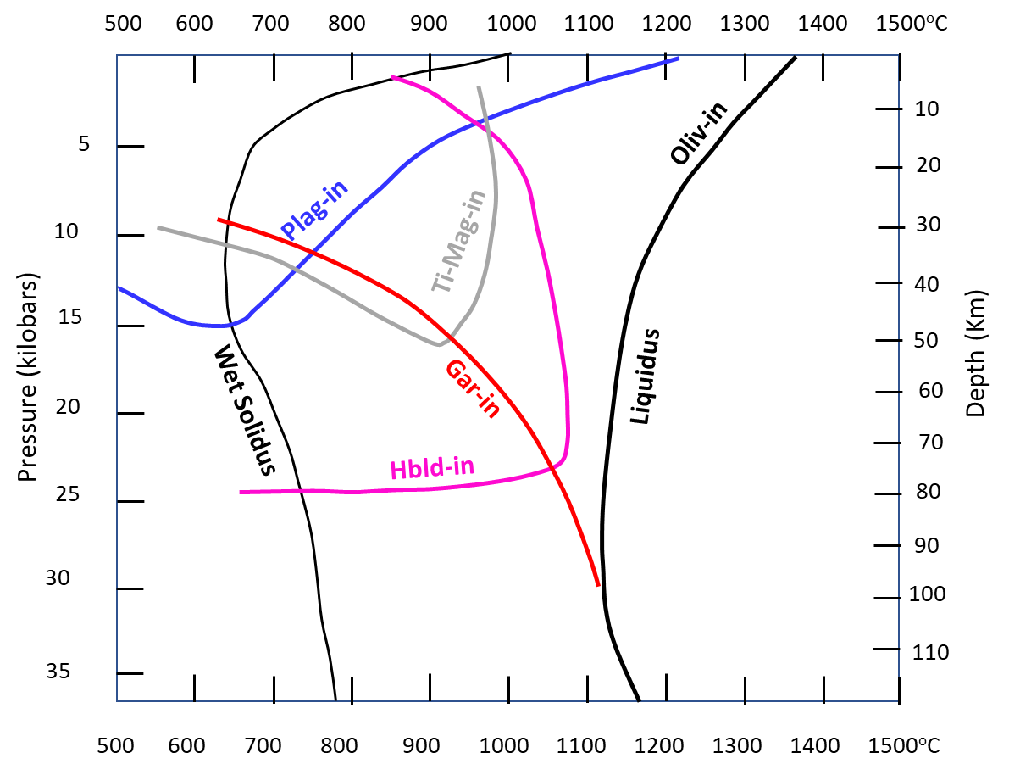
Calc-alkaline magmas; high pressure vs low-pressure fractionation.
Pressure, water content and oxidation state in a magma change the order of crystallization of minerals.
This leads to big differences in trace element signatures.
Initial Melt
Picritic Tholeiite water saturated
Accumulation of dissolved H2O through multiple cycles of replenishment and crystallisation in high-pressure magma chambers can explain the distinguishing chemical features of copper-ore-forming calc-alkalic arc magmas. The distinguishing features include unusually high contents of Sr and V, and unusually low contents of Sc and Y. …. The distinction from ordinary andesitic, dacitic and rhyolitic arc magmas can be enhanced by using ratios …. Sr/Y and V/Sc
Loucks, R.R., 2014. Distinctive composition of copper-ore-forming arc magmas. Australian Journal of Earth Sciences, 61(1), pp.5-16.
Notes:
The following discussion is intended as an example of the sort of information that can be gleaned from good quality 4 acid digest ICP-MS analyses; the type of analyses that many exploration companies are now collecting.
Gold rich porphyry systems must involve some extra process that does not happen in regular calc-alkaline Cu-only porphyries. This process almost certainly involves a step where sulfide-saturation and gold sequestration in sulfide droplets occurs in an intermediate stage of magma evolution. In this example, I’ll show data from one drill hole in an alkalic Cu-Au deposit that gives some clues.
Distinctive characteristics of Au-rich alkalic porphyries compared to Cu-only calc-alkaline porphyries is that they are much more oxidised, have higher V/Sc ratios, commonly have abundant magnetite, tend to have significantly less sulfur, commonly have more numerous and chemically distinctive, but smaller volume intrusions. These observations are from comparing alkalic porphyries in the East Lachlan, Tethyan, British Columbia, Maricunga and Alaska.
This figure has been adapted from Bob Loucks. Think about the effects temperature, pressure and water content have on the order of crystallization of various minerals and how that is reflected in the trace element signatures of the melts. In this discussion, I’m considering hornblende, magnetite, plagioclase and titanite, and the elements scandium, vanadium, niobium, yttrium and strontium.
Both V and Sc have chemistry that is similar to Fe. Sc substitutes for Fe in silicates, while V has a preference for oxides, especially as conditions become more oxidized. A consequence of this effect is that under P-T-H2O conditions where hornblende crystallizes before magnetite, magmas evolve to higher V/Sc ratios (i.e. Sc is removed with hornblende, but V stays in the melt). If magnetite fractionation begins before hornblende, then the V/Sc ratio becomes progressively lower.
Most of the Ti would normally go into titanomagnetite, but in high P environments with high H2O, titanite crystallizes before magnetite. Titanite is a junk mineral which takes in Niobium, Yttrium, Th, HREE and LREE. As a result, magmas that fractionate titanite are strongly depleted in the full suite of high field strength elements. This effect is particularly evident in a plot of Ti vs Nb.
High P and high H2O has a profound influence of the plagioclase liquidus. As a result, Sr is retained in the melt. Porphyry Cu magmas are typified by increasing V/Sc and increasing Sr/Y because they are generated under conditions of high P and high H2O by partial melting of a basaltic source region. Since the end of the Archean, tectonic environments where these conditions exist have been rare, and pretty much restricted to magmatic arcs where porphyry Cu systems are generated. Note however that around 60% of Archean granites have this same signature.

Slide 7
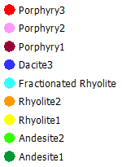
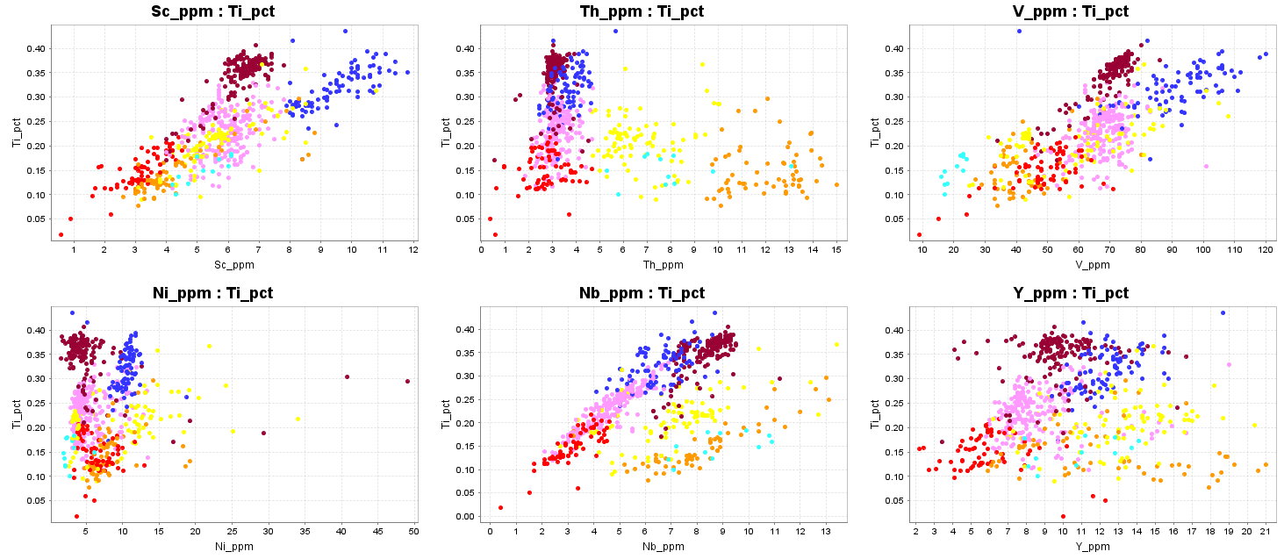
Compositions from immobile trace elements
Dark blue group has relatively high Sc (more Fe-silicates)
Pale blue group has low V (fractionated magnetite)
Yellow group is moderately high Th, orange group has significantly higher Th; both plot on different Ti-Nb trends
Burgundy-pink-red plot on the same Ti-Nb trend; probably co-magmatic suite.
Burgundy-pink-red; note how Y decreases as Nb decreases (relative to Ti).
Notes:
Let's take the theory from slide 6 and put it into practice with some real data. This data is from a single drill hole that is angled across an alkalic gold-rich porphyry somewhere in the Maricunga Belt.
I have plotted Ti against a few other useful immobile trace elements, including Sc, V, Nb, Th and Y in particular. Note Zr and Hf are not included because zircons do not dissolve very well with a 4-acid digest.
I have attempted to sort the assay results into geochemical populations which should match the logged geological intervals reasonably well. There is a bit of a mismatch because there are some heterogeneous breccias, and there is always be some ambiguity arising from overlap in the geochemical populations. This overlap can only be resolved by going back to the drill core with assays in hand.
Note the orange, yellow and pale blue groups. These groups have high Th and high Y. They have NOT fractionated titanite. The pale blue group is depleted in V; it has fractionated magnetite. They plot on distinct Ti vs Nb trends which indicate they have distinct opaque oxide minerals. These samples are low pressure (mid-crustal) melts.
The blue group has some similarities to the burgundy-pink-red trend, but is defined by higher Sc.
The burgundy-pink-red trend are the types of magmas that are associated with porphyry Cu systems. Note how the rate of decline of Y relative to Ti mirrors the decline in Nb. This is the influence of titanite fractionation.

Slide 8
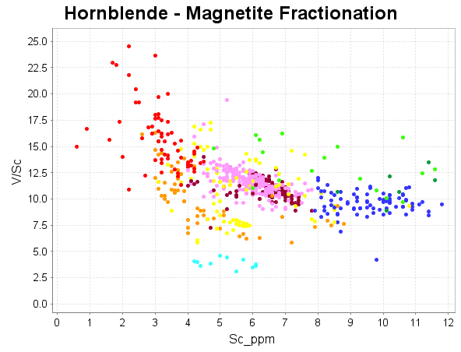
Compositions from immobile trace elements
V/Sc vs Sc.
The pale blue group is depleted in V due to fractional crystallization of magnetite.
Burgundy-pink-red; increasing V/Sc due to fractional crystallization of hornblende from an oxidized magma (scandium depletion as it is retained in hornblende)
Notes:
Plot V/Sc versus Sc. We don’t get SiO2 from ICP analyses, but in this figure increasing SiO2 corresponds with decreasing Sc.
Average crustal V/Sc is around 7. The pale blue group is depleted relative to that.
The burgundy-pink-red trend are the types of magmas that are associated with porphyry Cu systems. This plot shows increasing V/Sc with increasing SiO2 that is typical of porphyry Cu systems.
The burgundy to pink to red trend is mapping progressive fractionation in a porphyry Cu suite.

Slide 9
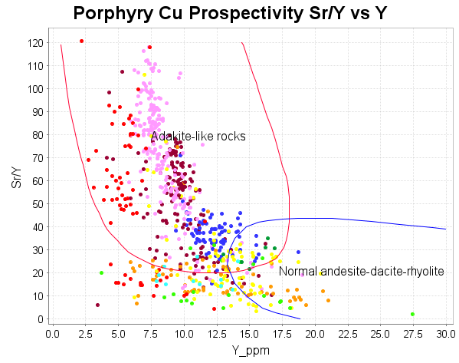
Compositions from immobile trace elements
Sr/Y vs Y.
Burgundy-pink-red; high Sr since these have NOT fractionated plagioclase, Y depletion due to titanite fractionation.
Use this plot with caution since Sr is soluble in acid fluids!!
Notes:
Plot Sr/Y versus Y.
The burgundy and pink groups show the effect of titanite fractionation (low Y) and lack of plagioclase fractionation (high Sr).
The red group is more depleted in Y, but something is going on with plagioclase!

Slide 10
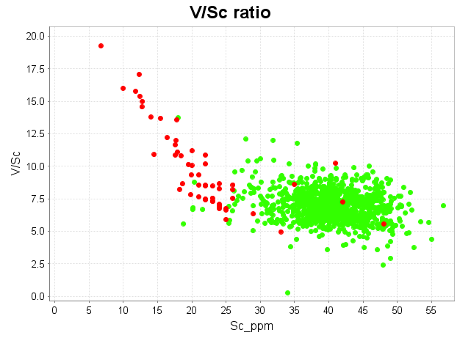
Tholeiitic Basalt versus Alkalic Basalt
Lunnon basalt (green) vs Eastern Australian Tertiary basalt (red)
Alkali basalts have low Sc, strong HFSE enrichment, high TiO2, high P2O5, and unusually high Zr/Hf.
Low degree of partial melting; melts alkali feldspars, Fe-Ti oxides, accessory minerals
Highly Oxidized magmas.
Notes:
Some clues about what might be going on with alkalic porphyries comes from comparing them with other magma types. This plot shows a comparison Low Th basalts in green from the Eastern Goldfields (from Smithies, 2021) compared with alkali basalts from Tasmania (red) from the Geoscience Australia OzChem database. These rocks all have similar SiO2 values, around 50%.
Alkali basalts have unusually low Sc< but strongly increased V/Sc ratio compared with tholeiites. Alkali Basalts are invariably strongly magnetic, while tholeiitic basalts are almost always non-magnetic (ilmenite series). Alkalic basalts are formed as a result of a low degree of partial melting under P-T-X-H2O conditions where Fe oxides (with Fe3+) melt before Fe silicates (with Fe2+). V from the oxides goes into the melt, while Sc is retained in pyroxenes. This effect generates really oxidized magmas with really high V/Sc. I think it is not widely appreciated how the degree of partial melting (or the degree of fractionation) influences oxidation states of magmas.
So, the question with alkalic porphyries is whether the unusually high V/Sc ratio is the result of hornblende fractionation or partial melting of magnetite. Perhaps the answer is a combination of both!

Slide 11
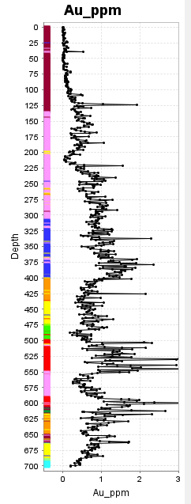
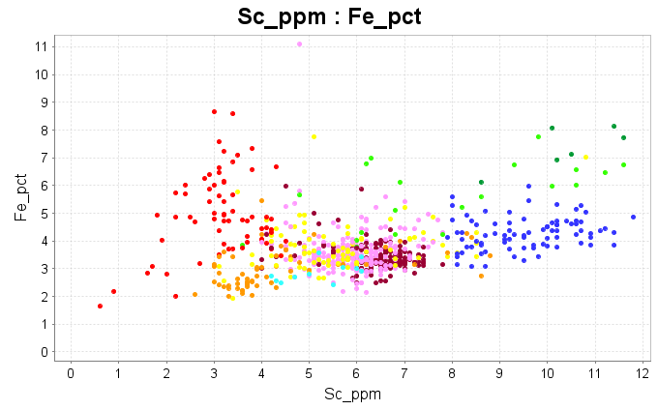
Compositions from immobile trace elements
Siderophile elements.
Burgundy-pink-red; This is a suite of hydrous, high pressure melting, porphyry Cu-type magmas. The red group is distinctly alkalic (as shown in later slides). A common characteristic in alkalic porphyries is enrichment in Fe, even where large amounts of hornblende has fractionated, eg lower Fe silicates, but higher Fe oxides, and very strong V/Sc enrichment.
Notes:
Plot Fe vs Sc.
Sc is highly correlated with the silicate-hosted component of Fe, e.g. hornblende, pyroxene etc.
This plot shows the strongly fractionated porphyry (red) is very strongly enriched in Fe. In this case, that extra Fe reports as magnetite, mostly in quartz-magnetite veins. This effect is hydrothermal, but it is interesting that it seems localised to that particularly fractionated porphyry phase.

Slide 12
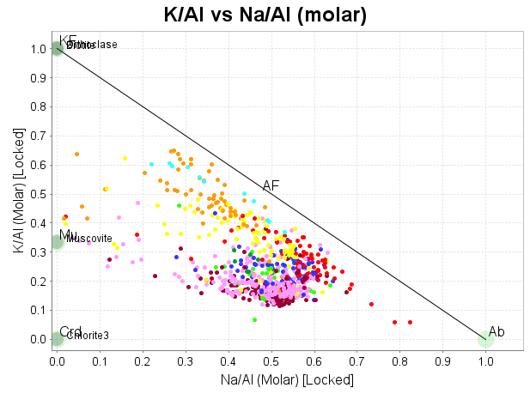
Compositions from immobile trace elements
Alkali elements.
This system has very little hydrothermal mobility of K and Na. The alteration involves addition of S and rearrangement of existing components into new minerals.
P1 and P2 would be defined as calc-alkaline. Porphyry3 is distinctly alkalic.
Notes:
This plot is a molar ratio of K/Al versus Na/Al. These diagrams are useful because they allow you to “read” the mineralogy and see alteration trends. On this diagram orthoclase plots at 1 on the y-axis, muscovite plots at 0.33 on the y-axis and albite plots at 1 on the x-axis.
The drill hole used in this example is really interesting. It has gone through the high-grade core of the porphyry system, below the level of phyllic alteration. Each of the compositional groups in this figure plots as a relatively tight cluster. That clustering means there has been quite limited mobility of K and Na as these rocks have been altered. The alteration involves addition of S, H2O and Cu, but the existing components of the rock were rearranged into a suite of new minerals without much loss or gain of the primary components. Where each of the compositional groups plots on this diagram therefore is a reasonable indication of the primary magmatic compositions. See how the orange, yellow and red groups plot near the alkali feldspar line, but are quite potassic. We would expect that from mid-crustal melts that have fractionated a significant amount of plagioclase. The burgundy, pink and red groups move closer to the feldspar line with increasing fractionation.
Rocks are classified as being “alkalic” based on K2O + Na2O AT A GIVEN SiO2 CONTENT. The mid-crustal melts plot close to the alkali feldspar line because they have fractionated a lot of plagioclase and therefore also have a high SiO2 value. The red group has not fractionated very much plagioclase (still has high Sr). These rocks have high alkalis as a result of a low degree of partial melting of a protolith like the pink or burgundy group (with a low degree of melting, alkali feldspars melt before calcic plagioclase). This effect is probably related to magma recharge/replenishment.

Slide 13
Compositions from immobile trace elements
Cu, Au cumulative frequency plots coloured by compositions.
Burgundy-pink-red; This is a suite of hydrous, high pressure melting, porphyry Cu-type magmas. Note how the grades increase with increasing fractionation.
Notes:
The porphyry suite includes 3 different pulses of intrusions, the burgundy, pink and red. These cumulative frequency plots show what happens to the grade as the magmatic system fractionates. Note for those proponents of machine learning; identifying magmatic “fertility” involves much more than just identifying melts sourced from high-pressure, water-saturated melting of a mafic source rock.

Slide 14
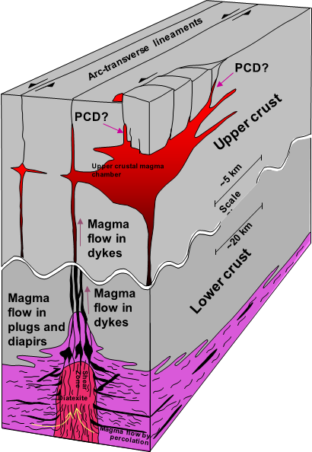
Why do Alkalic porphyries have high Au?
Porphyry magmas in the MASH zone or mid crustal staging chambers are on the P-T-H2O cusp of magnetite crystallization and sulfide immiscibility.
Magnetite crystallization -> Sulfide saturation;
Magma recharge -> melt magnetite, melt alkali feldspars, dissolve sulfides
Small batches of HIGHLY oxidized magma strongly enriched in Cu-Au
Modified from Richards (2003)
Notes:
This is my speculative interpretation of what happens in Au-rich alkalic porphyries.
We know porphyry magmas have fractionated a lot of hornblende; we can see that effect in the V/Sc ratio.
Once those magmas are emplaced in the upper crust, they crystallize magnetite.
What would happen if porphyry magmas had residence time in a mid to upper-crustal staging chamber as depicted in this figure from Jeremy Richards? Those magmas must be on the cusp of magnetite crystallization/fractionation and therefore sulfide saturation. If that chamber went through repeated cycles of magma recharge, then remelting of magnetite could lead to Fe-rich magmas with very high V/Sc, very oxidized, with continuous refining of the Au/Cu ratio as sulfides exsolved then dissolved back into the melt, and increasing (K+Na)/SiO2 and feldspars crystallized and were then resorbed. The difference between a calc-alkaline Cu-dominant porphyry and an alkalic Au-rich porphyry might come down to residence time and magma recharge in the upper crust.

Slide 15
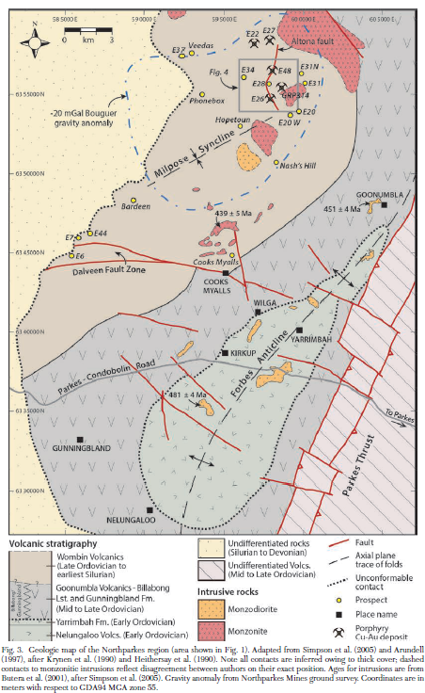
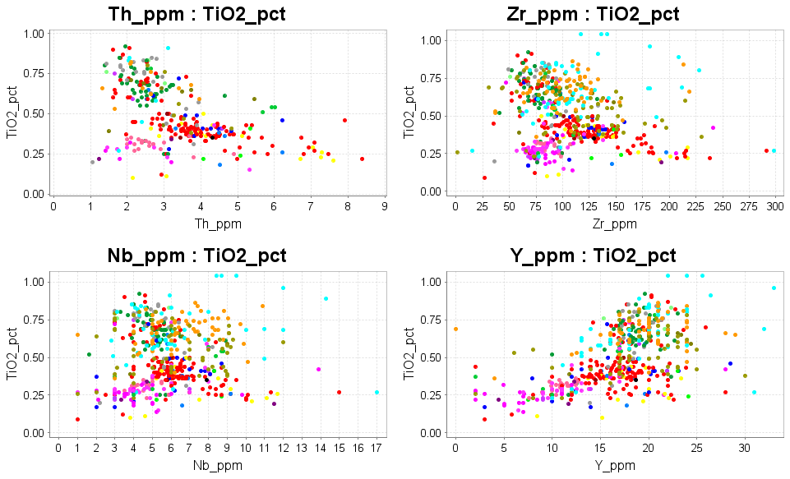
Application
In a porphyry district, sample all of the mapped intrusions and classify them geochemically. Identify the prospective suite on your maps. Note there are 4 different magma suites in this data.
Pacey, A., Wilkinson, J.J., Owens, J., Priest, D., Cooke, D.R. and Millar, I.L., 2019. The anatomy of an alkalic porphyry Cu-Au system: geology and alteration at Northparkes Mines, New South Wales, Australia. Economic Geology, 114(3), pp.441-472.
Notes:
Why is that observation interesting, and how do we put it to use?
There has been >25 years of research into magma chemistry in the East Lachlan, much of it around the Parkes district. As part of his Ph.D. and Econ. Geol. paper, Adam Pacey compiled all the open file data from the North Parkes area. Note different studies analysed slightly different suites of elements and critically, the older data did NOT include Scandium.
These data basically show 4 compositional clusters. The Wombin, Goonumbla and Nelungaloo Volcanics and monzonites have high TiO2 (0.6 to 1%). Porphyry magmas never have this much Ti. Alkali feldspar granites (mid-crustal melts) have higher Th and Zr. The large biotite quartz monzonite stocks (precursors to the mineralized porphyries) are in red. The fractionated porphyries associated with orebodies are in magenta. Have a look at the scatter in the red points. Many of these samples have been mis-classified.
Now imagine you are drilling one of these igneous complexes hidden by transported cover; after the first pass of aircore drilling at 500m by 500m, or 200m by 200m, you have a handful of oxidized chips from the bottom of each hole. You need to identify small fingers fractionated suite in amongst a sea of the non-fractionated hornblende diorites. This identification would be very difficult without using good quality 4 acid digest ICP-MS geochemistry on the bottom-of-hole samples.

Slide 16
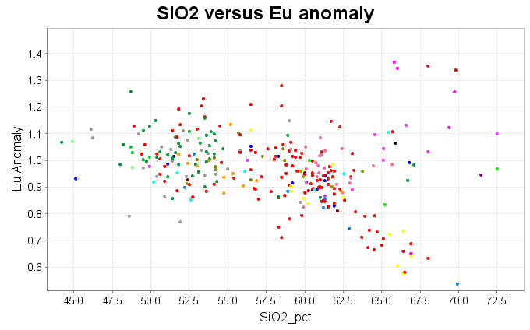
North Parkes Regional WR compilation from Adam Pacey
Broadly 4 groups; andesitic volcanics, BQM, QMP, AFP
Note the samples that are mis-classified
QMP
AFP

Slide 17
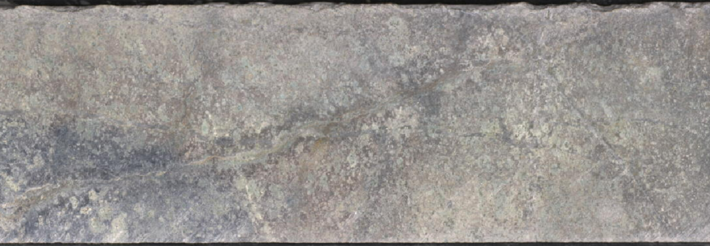
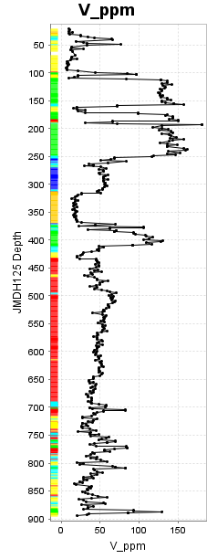
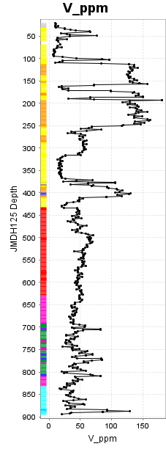
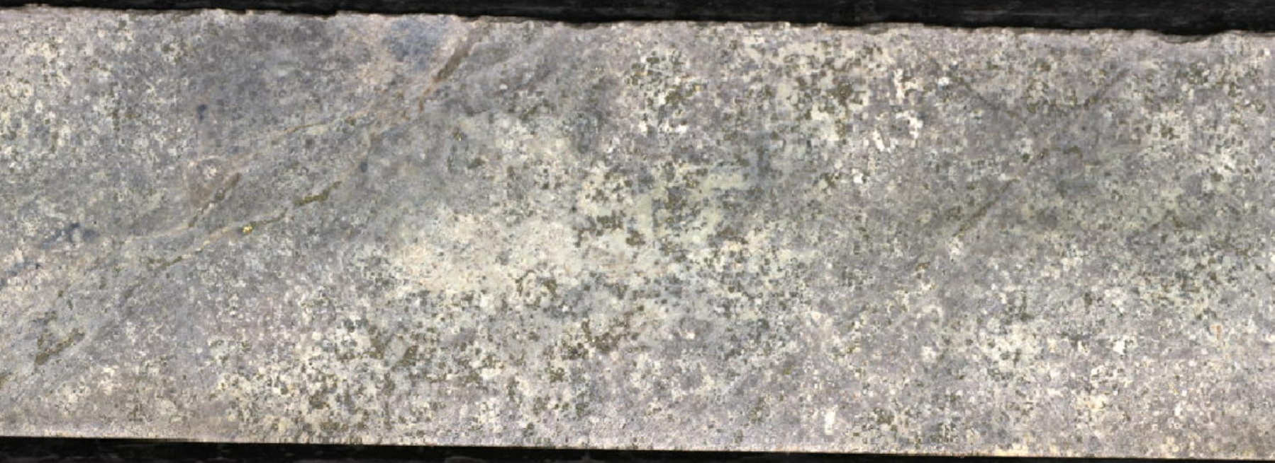
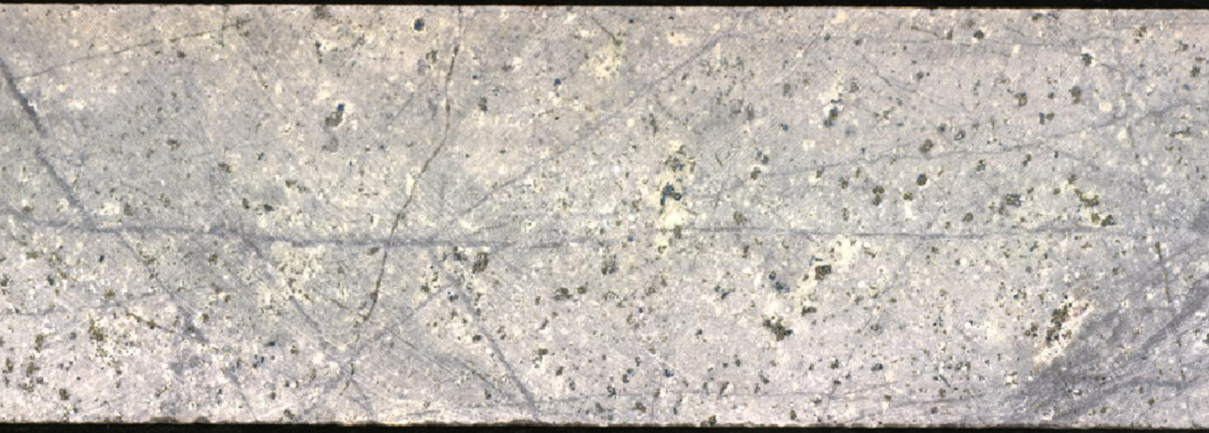
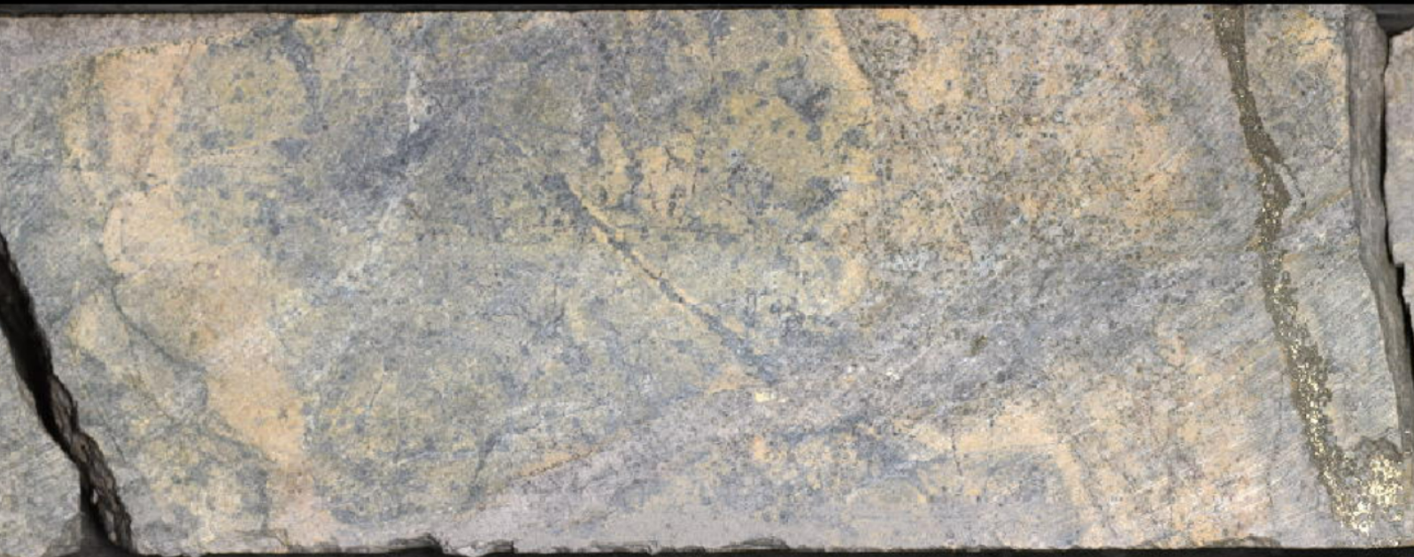
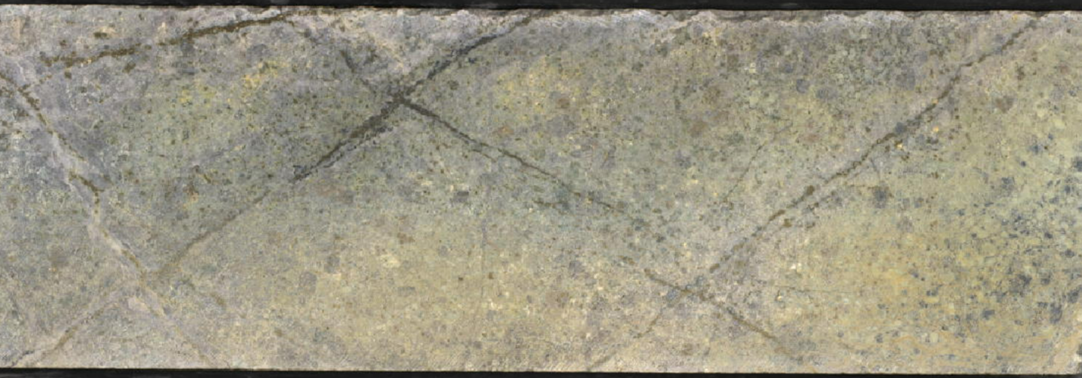
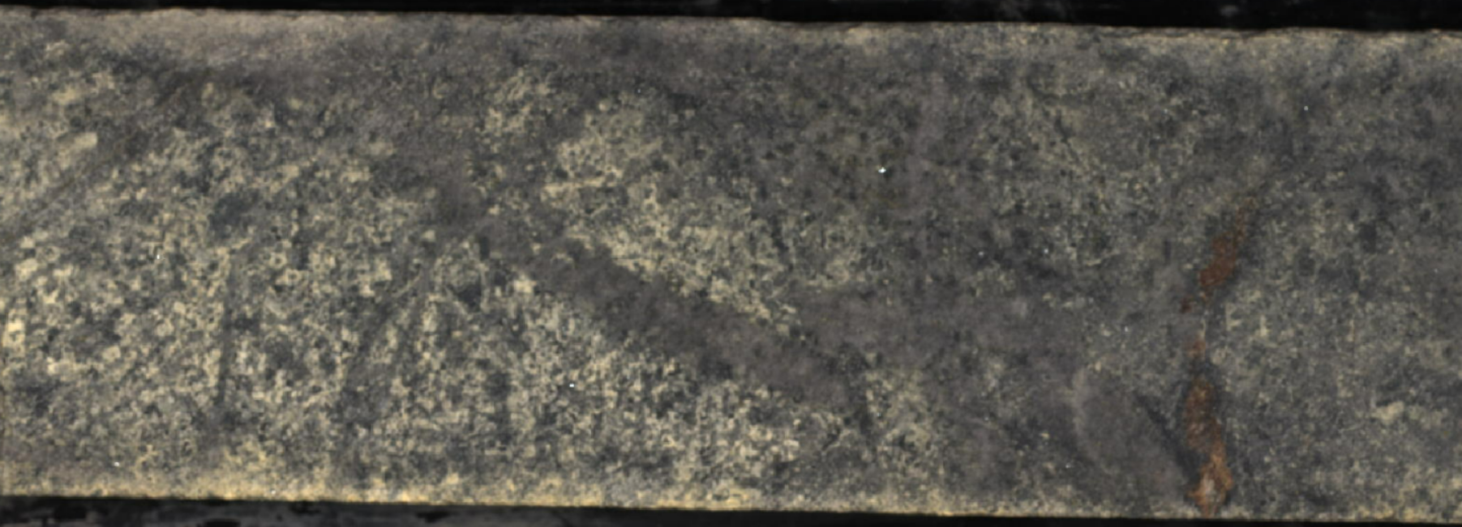
220m
Chemical Classification
Logged Rock Type
280m
300m
405m
520m
790m
Notes:
This data set is from a different porphyry deposit.
Pick an immobile element that varies significantly between different rock types; in this case I chose Vanadium. Plot it as a strip log (down hole plot).
The log in the centre is coloured by geochemical classifications; the log on the right is coloured by logging codes (shown in the legend).
Notice how there are step changes in the V content. Each step is a lithological contact. In the lithology log, the yellow and orange groups were logged as varieties of rhyolite. I would expect rhyolite to have 50ppm V or less. The logging does not match changes in composition; i.e. contacts were not recognised, and much of this interval is andesitic, not rhyolitic. The alteration here is advanced argillic (quartz-pyrite-pyrophyllite-dickite) and even very experienced loggers could not see through this alteration. Look at the interval from 700 to 900m. V levels are mostly 40 to 50ppm (so very felsic) but most of it is logged as tonalite. The V levels are very variable and both the chemical classifications and logged lithologies are very mixed. I am very suspicious that this interval is a coarse clastic or breccia, dominantly rhyolitic, but logged as something more mafic because of the chlorite alteration.
Now look at the main porphyry interval, from 430 to 700m. The geologists have logged 2 different types of porphyry, but chemically I can only distinguish one. In this case, I would trust the geologists. This logging is from a very experienced team who have several major discoveries to their names. In calc-alkaline porphyries there are commonly multiple intrusions that can be recognised visually (different textures) but are geochemically identical.
The moral of the story is best practice is to combine 4 acid digest ICP-MS with visual logging. They are (or should be) complimentary data sets.

Slide 18
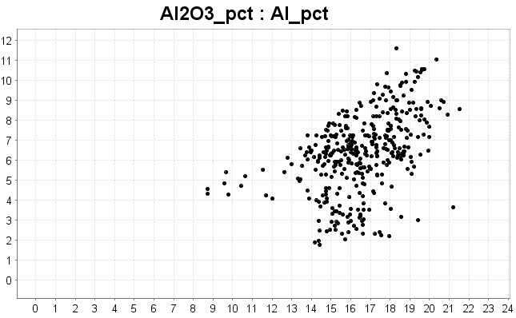
What will be the next advances in Geochemistry?
Improvements in digest methods need to catch up with advances in analytical methods
4 acid digest ICP-AES vs Li-borate fusion
Al_pct 4 acid digest
Al₂O₃_pct_LiBorate fusion
Notes:
Over the last 30 years, analytical methods have improved dramatically, with much lower detection limits and fantastic precision. By far the greatest source of error in analyses for many (most) elements comes from the digestion method. The example shown is atypical because it is SO bad, but it highlights the issue. (4 acid digestions usually result in Al being under-reported by around 5%). These analyses are of the same set of rocks; one set of analyses uses a 4 acid digest, and the other uses a lithium borate fusion. With a 4 acid digest, some of the Al may reprecipitate as an Al-fluoride complex. Some of the K may reprecipitate as a K perchlorate. There is commonly incomplete dissolution of Zr, Hf, Ti, Nb, Ta, Ba, Cr and Sn. Every commercial assay laboratory does their 4 acid digestion a little differently, so no 2 laboratories will generate the same values for the same rocks! Some laboratories get close to a total digest, but many don’t.
The top of my wish list for improved geochemical data would be an improved and more consistent digest method. Maybe that is a modification of a fusion process; maybe a beefed-up laser ablation. Having a more complete, more consistent digest that can be replicated between laboratories would do as much for the advancement of geochemistry as the advent of ICP-MS did.

Slide 19
Summary
Systematic sampling
suitable sample media
4 acid digest
Low detection limit ICP-MS
Compile atlases of mineral deposit geochem footprints
Across our known deposits, if we sampled in-situ material at 200m x 200m, 500 x 500, 1km x 1km, do we actually know what the geochem footprints and zoning would look like?
Donate real-life exploration and mining data to universities for teaching
Notes:
What works; the most effective reconnaissance involves systematic sampling of in-situ material using a 4 acid digest ICP-MS analysis. The ultra-low detection limits of this method make it plausible to use very broad spaced sampling patterns to detect the footprints of hydrothermal systems.
The entire industry would benefit from collaboration to publish footprints of known mineral systems where the geochemical data is presented in a consistent format to allow direct comparisons between deposits and formulate a geochemical footprint template for different deposit types.
Companies can play their part in having better trained students and new graduates by making exploration and mining data sets available for teaching purposes.

