Slide 1
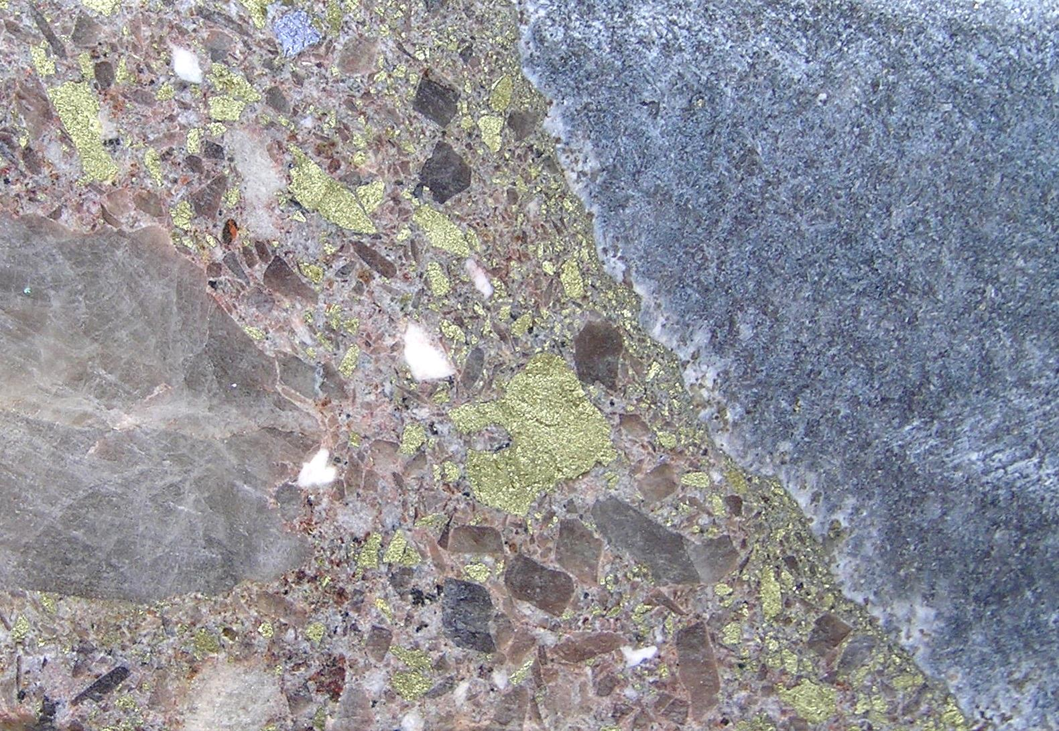
Exploration for Sediment-hosted Copper deposits
Garry Davidson Symposium
CODES
Scott Halley
October 24 2018
Carbonate Breccia, Kansanshi, Zambia
Acknowledgements to First Quantum and Barrick Lumwana

Slide 2
Location of Major Deposits
Redstone
Udokan
Kupferschiefer
White Pine
Lisbon Valley
Spar Lake
Aynak
Dzhezkazgan
Cenozoic
CACB
Mesozoic
Paleozoic
Proterozoic
(Hitzman et al., 2005)

Slide 3
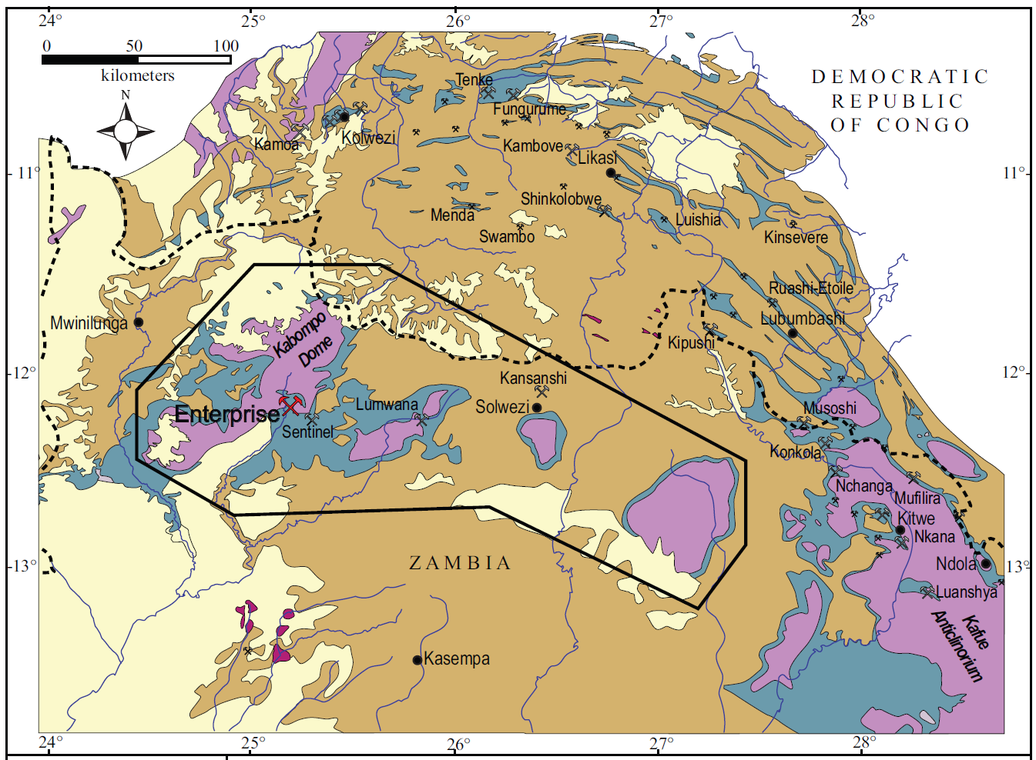
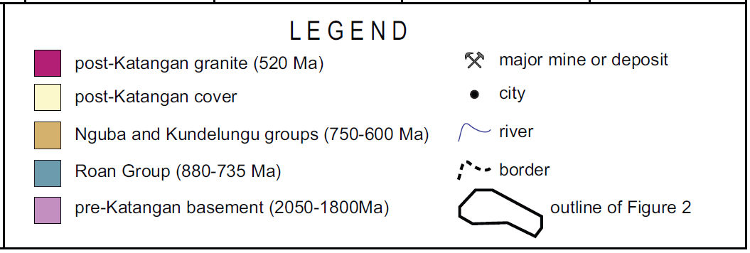

Slide 4
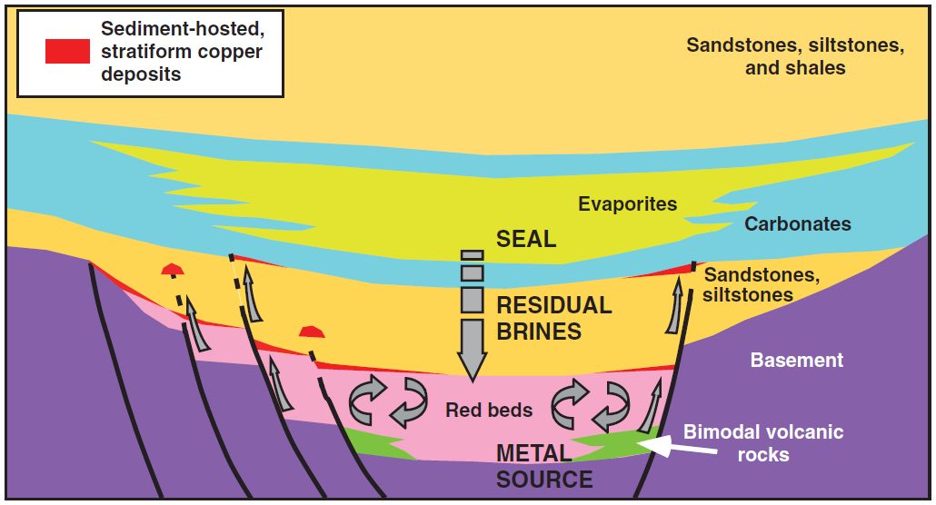
Sediment-hosted Copper deposits
Key ingredients;
Salt
Red Beds
Reduced shales
Hitzam, Selley and Bull, 2010, Econ Geol, vol 105
Notes:
Schematic cross section across an intracratonic, hydrologically closed basin that is typical of those hosting giant
and supergiant sediment-hosted stratiform copper deposits. Synrift red beds and minor bimodal volcanic rocks floor the
basin. Marine sandstones, siltstones, and shales, which may locally be organic rich, transgressively overlie this red-bed sequence.
This siliciclastic sequence grades upward into marine carbonates that contain a thick evaporite sequence. In most
productive basins, the evaporites contain significant halite and may have evolved to magnesium and potassium salts. The
upper portion of the basin contains shallow marine to continental siliciclastic sediments. The total thickness of the sedimentary
sequence may range from several to more than 10 km.
The sediment-hosted stratiform copper system consists of residual brines or brines from evaporite dissolution that move
downward into the basal, oxidized red-bed sequence. Heat from burial and, in some cases, high heat flow and/or igneous activity
initiate convection of these highly saline brines, which are capable of leaching metals from both the red-bed sediments
and the basement. Oxidized, metal-rich brines circulate upward to the top of the red-bed sequence, where they encounter
organic-rich sediments that provide the reductants necessary to precipitate copper sulfides. Fluids may also utilize fault architecture
within the basin to escape to higher levels and precipitate sulfides when they encounter significant zones of either
in situ or mobile (natural gas, petroleum) reductants. The evaporite beds provide an effective top seal to the hydrologic system,
whereas the basin edges themselves provide lateral containment.

Slide 5
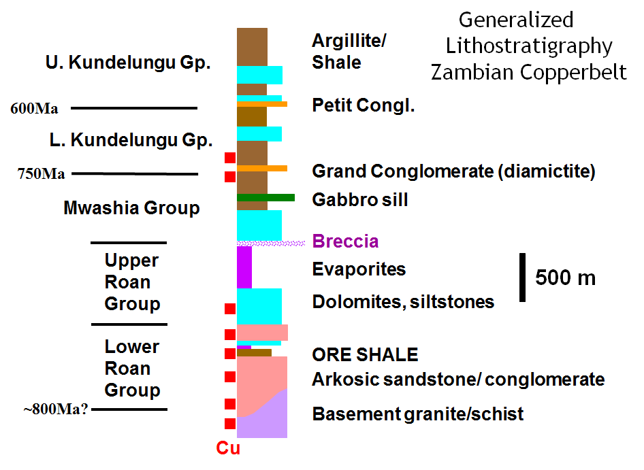
Dominantly “reduced” facies above the Roan
Dominantly “oxidized” facies in the Roan

Slide 6
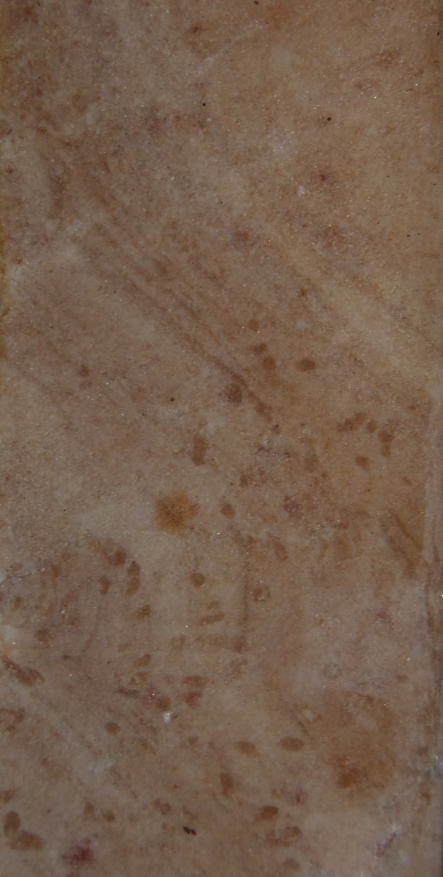
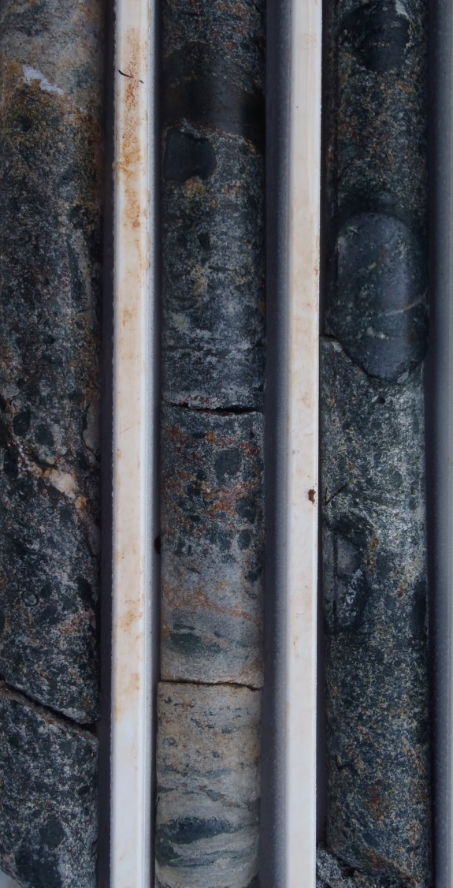
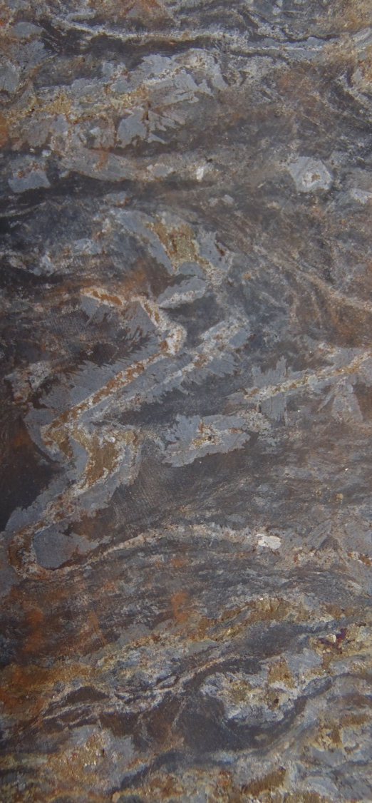
Hitzam, Selley and Bull, 2010, Econ Geol, vol 105
Salt
Red Beds
Reduced shales
Red Beds, Lower Roan sandstone
Enterprise Ni deposit
Evaporite; carbonate-filled breccia
After evacuation of salt, Kabompo Dome
Carbonaceous siltstone
Sentinel Cu Mine

Slide 7
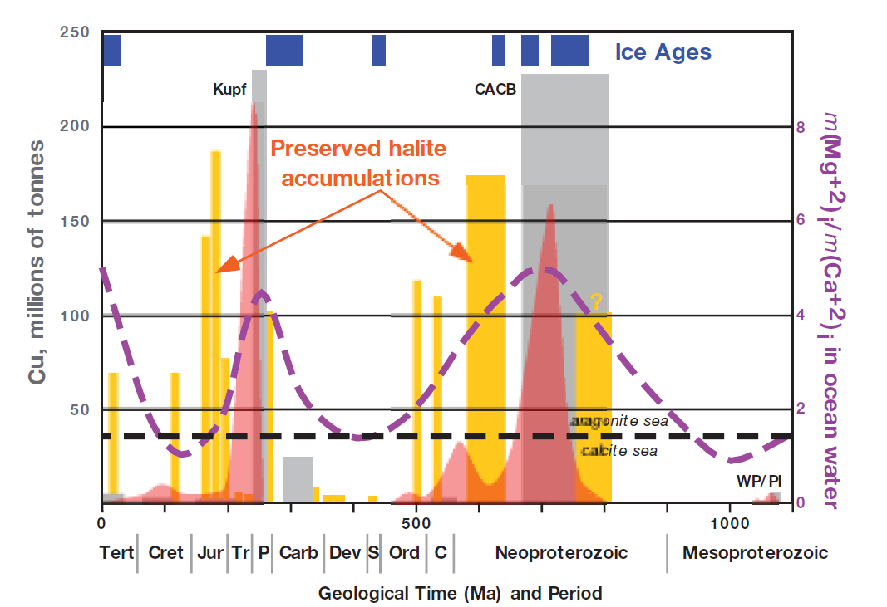
Evaporites through Time
Pangea
Rodinia
Hitzam, Selley and Bull, 2010, Econ Geol, vol 105
Notes:
Contained copper for sediment-hosted stratiform copper deposits by age of host rocks (gray); red curves schematically
illustrate the probable ages of sulfide precipitation in the major districts. Mineralization in the Central African Copperbelt
(CACB) and the Kupferschiefer (Kupf) extends to significantly younger ages (>100 m.y.) than the host rock, whereas
the age of mineralization in the White Pine/Presque Isle (WI/PI) system is early relative to host-rock age.
The ages of major glacial events in blue; ages of preserved halite accumulations (in yellow) and evidence for
significant ~750–800 Ma evaporites in the Katangan and Central Australian basins; and variation in seawater chemistry as portrayed by the m(Mg2+)i/m(Ca2+)i ratio (purple dashed line). The plot illustrates temporal correlations between periods of major sediment-hosted stratiform copper deposits and ice
ages and Mg2+-rich, and therefore sulfate-rich seawater. There appears to be little correlation of mineralization ages with
periods of increased halite precipitation.

Slide 8
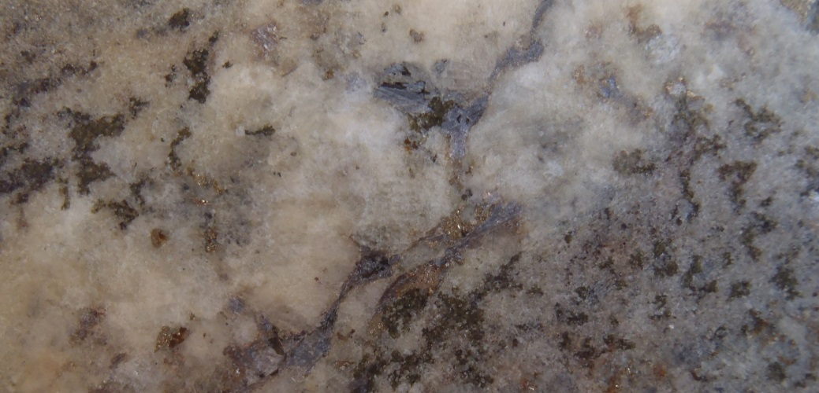
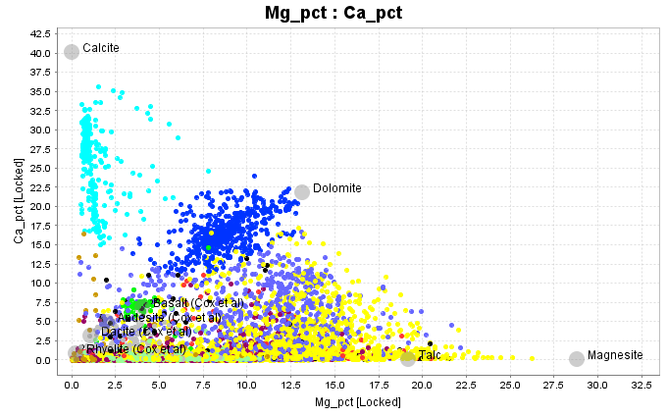
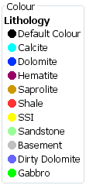
Alteration Signatures of Brines
Hypersaline Brines create distinct alteration signatures
Magnesium Metasomatism
Quartz sandstone altered to Magnesite+Talc+Millerite (NiS)+Vaesite (NiS2)
Enterprise Ni deposit
Ca vs Mg

Slide 9
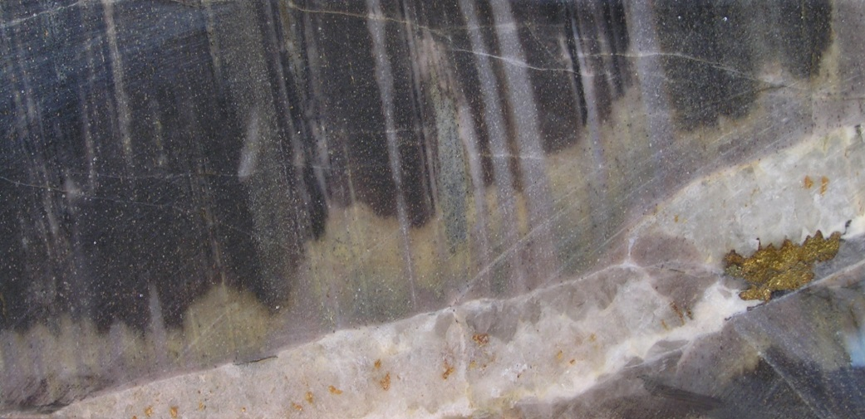
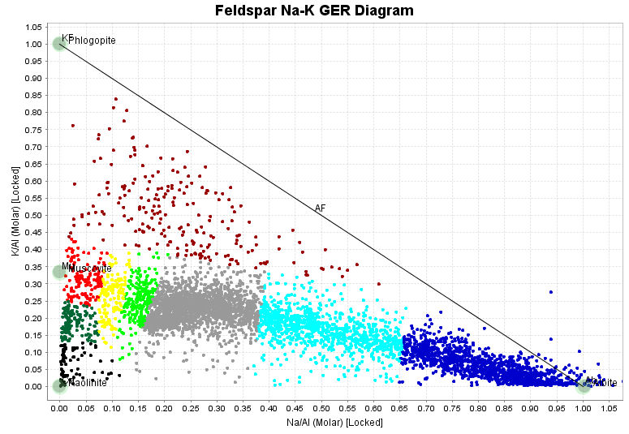
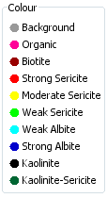
Alteration Signatures of Brines
Hypersaline Brines create distinct alteration signatures
Feldspar-rich alteration
Albite (+/- Carbon) around a quartz+CCP vein,
Kansanshi, Zambia
3KAlSi₃O₈ + 2H⁺ ⬄ KAl₃Si₃O₁₀(OH)₂ +6SiO₂ + 2K⁺

Slide 10
Alteration Signatures of Brines
Hypersaline Brines create distinct alteration signatures
Ni-Co mobility
Hypersaline brines make pyrite with unusually high Ni and Co contents
Pyrite map from Telfer

Slide 11
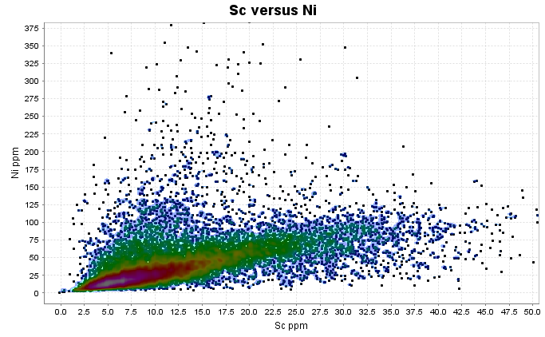
Alteration Signatures of Brines
Ni-Co mobility
In background rocks, Ni is highly correlated with Sc.
Ni enrichment is measured with a Ni/Sc ratio
Ni substituting for Mg in talc
Ni substituting for Fe in Fe-Mg-silicates

Slide 12
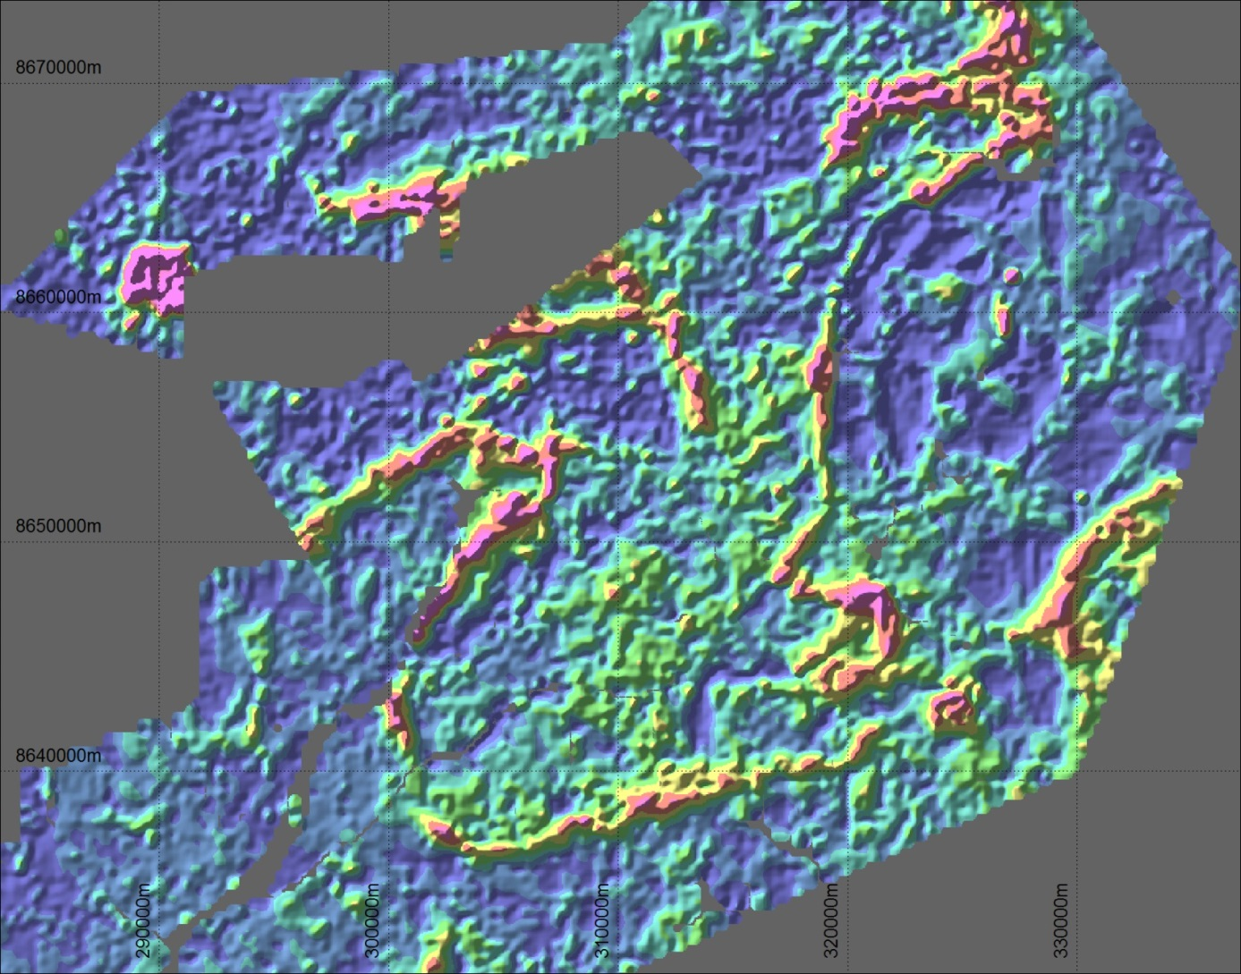
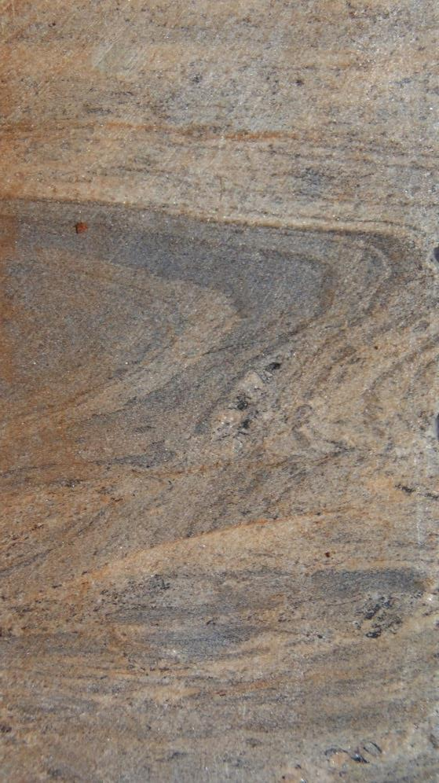
Alteration Signatures of Brines
Gridded image of Ni/Sc ratio;
Mapping nickeliferous hydrothermal talc in lower Roan red beds.
Quartz-Talc-Hematite,
Enterprise, Zambia
Flat fold axes, detachment surfaces, flat foliation

Slide 13
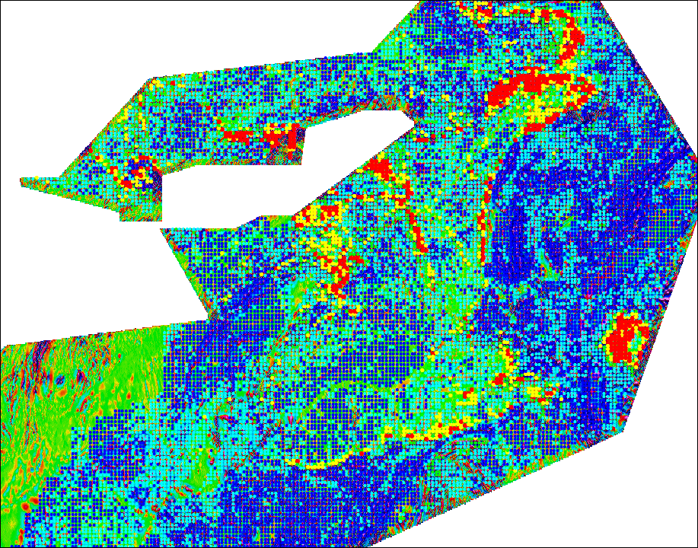
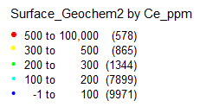
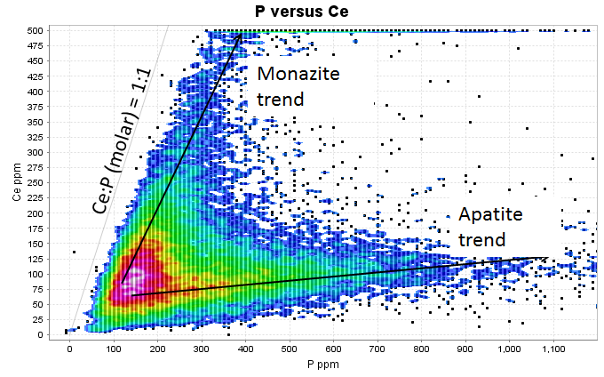
Alteration Signatures of Brines
Hypersaline Brines create distinct alteration signatures
LREE mobility
Monazite; (Ce, La, Nd, Th)PO₄

Slide 14
Timing of Mineralization
Diagenetic, compaction-driven?
Orogenic, deformation-driven?
Intrusion-related, thermally-driven?
All of the above!!

Slide 15
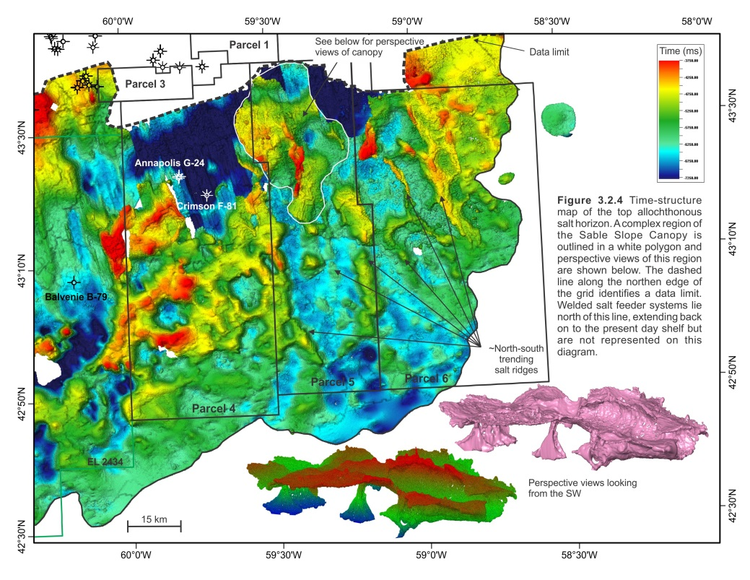
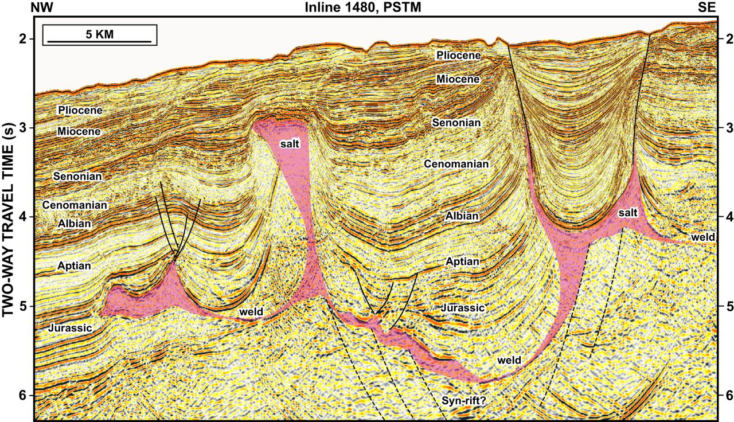
Salt Tectonics
low density => salt diapirism
Low mechanical strength => shallow-dipping slip planes
https://callforbids.cnsopb.ns.ca/2016/01/ns16-1-parcels/salt-tectonics
Salt tectonics along the Atlantic margin of Morocco
Gabor Tari and Haddou Jabour
Geological Society, London, Special Publications, 369, 337-353, 26 March 2013, https://doi.org/10.1144/SP369.23

Slide 16
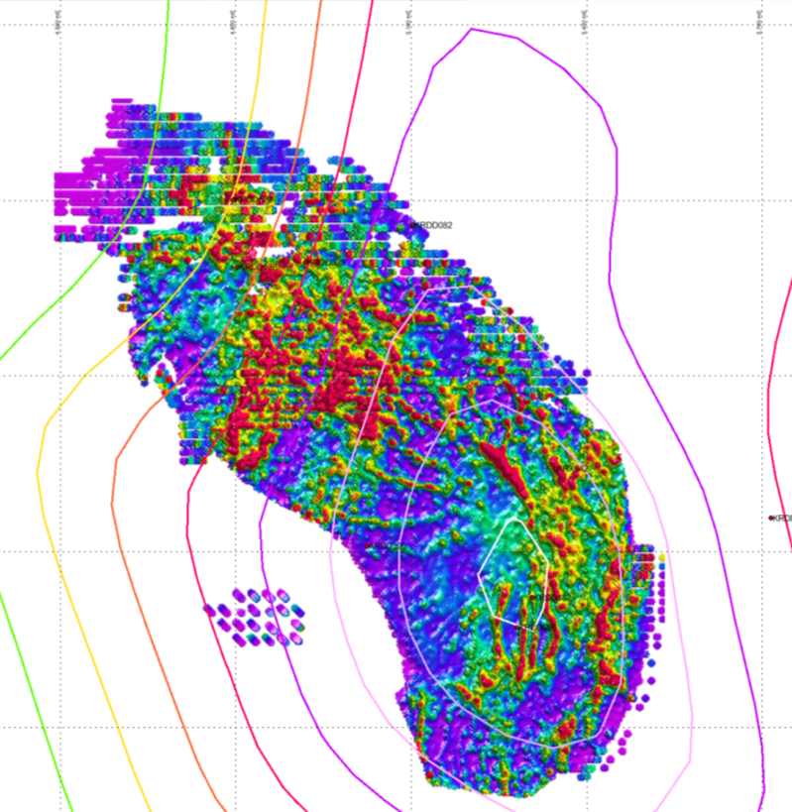
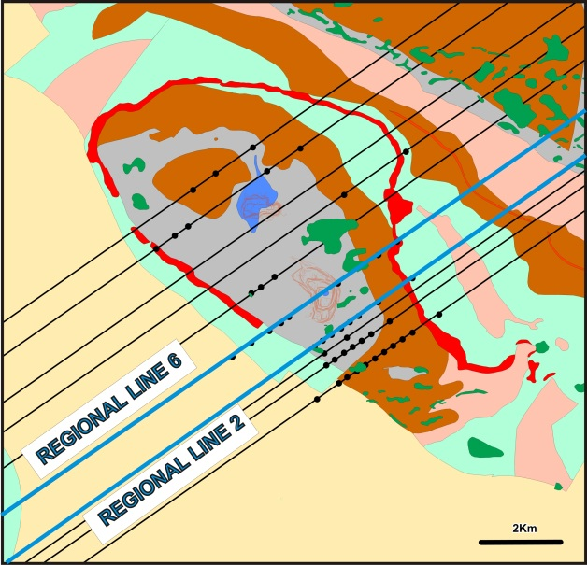
Timing of Mineralization; Kansanshi
Recumbent fold; detachment in evaporite
Radial vein array cross-cutting folds
SW
NE
2 km

Slide 17
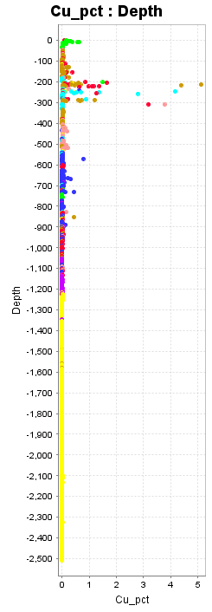
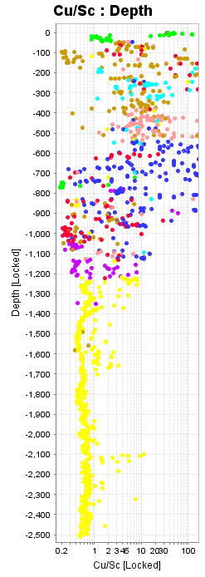
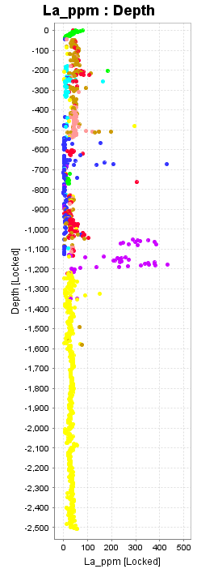
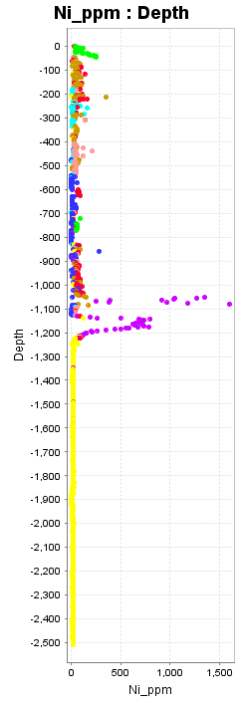
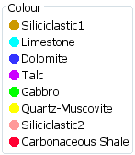
Kansanshi
Unusually thick sequence of Lower Roan red bed
Total removal of Cu, Co, Mo etc from red bed
Ni-talc and hydrothermal monazite at the top of red bed

Slide 18
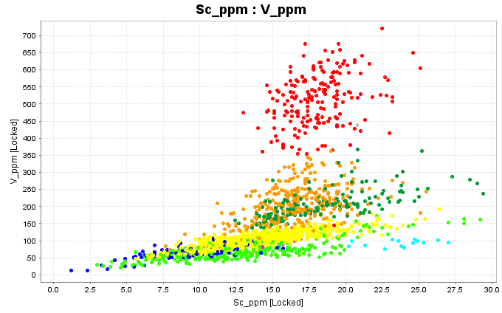
Reductants in shales
Organic shales commonly have enrichment in V-Mo-U and other metals;
Pick V enrichment by plotting against Sc
Background
V:Sc = 7:1

Slide 19
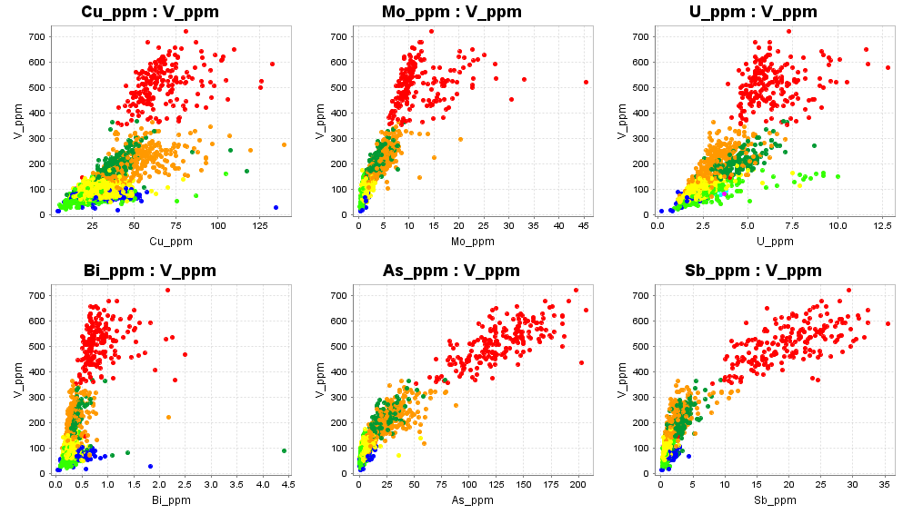
Reductants in shales
Organic shales commonly have enrichment in V-Mo-U and other metals

Slide 20
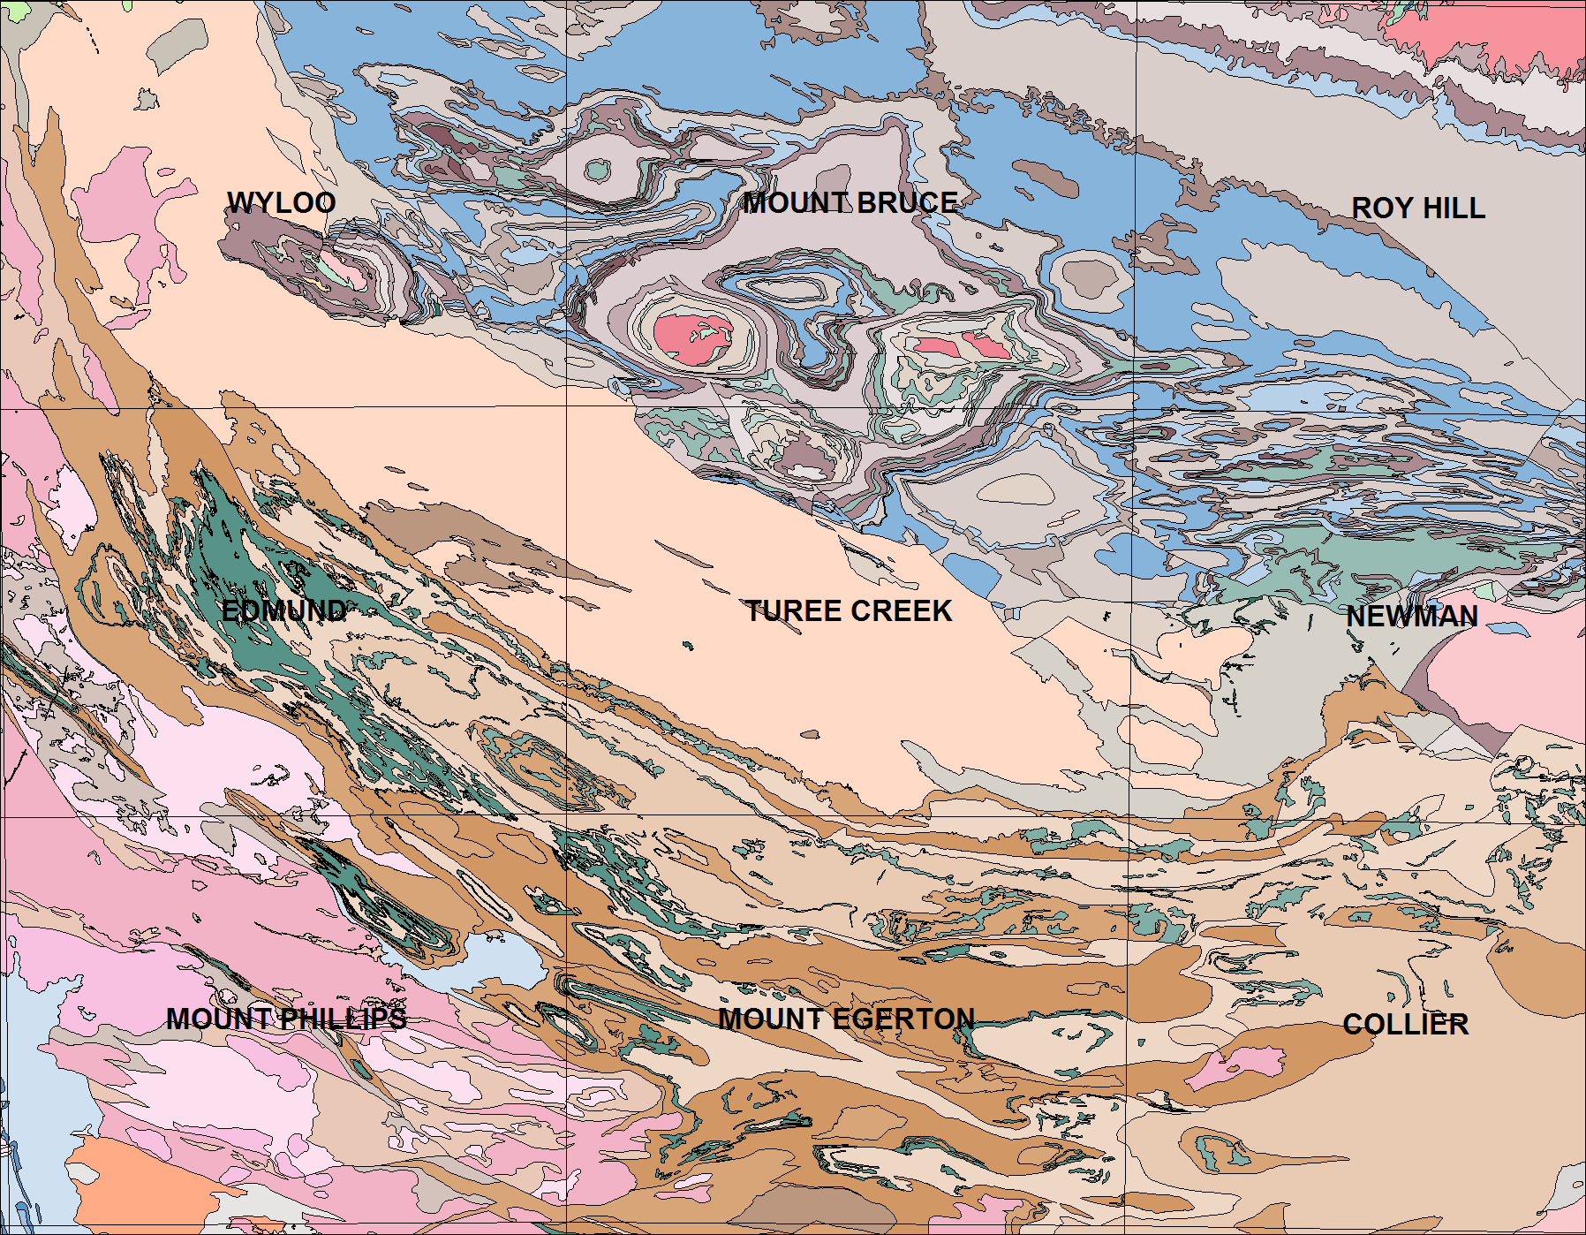
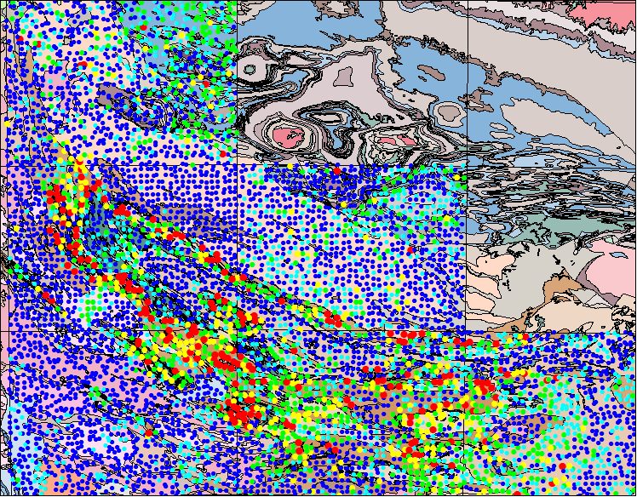
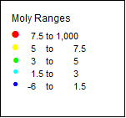
Reductants in shales
Organic shales commonly have enrichment in V-Mo-U and other metals

Slide 21
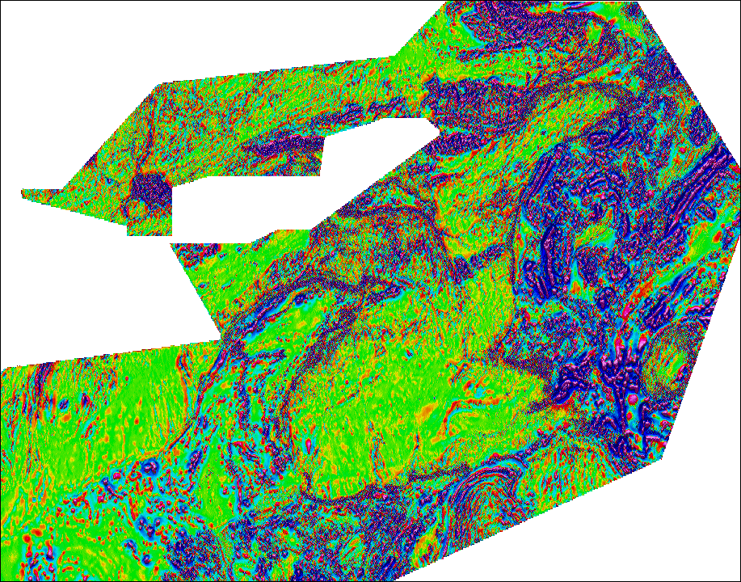
Geophysics
Magnetics
Basement and lower Roan; hematite => magnetically quiet
Mwasha, Grand Conglomerate; Fe-rich, reduced, => magnetically complex
Redox Boundary

Slide 22
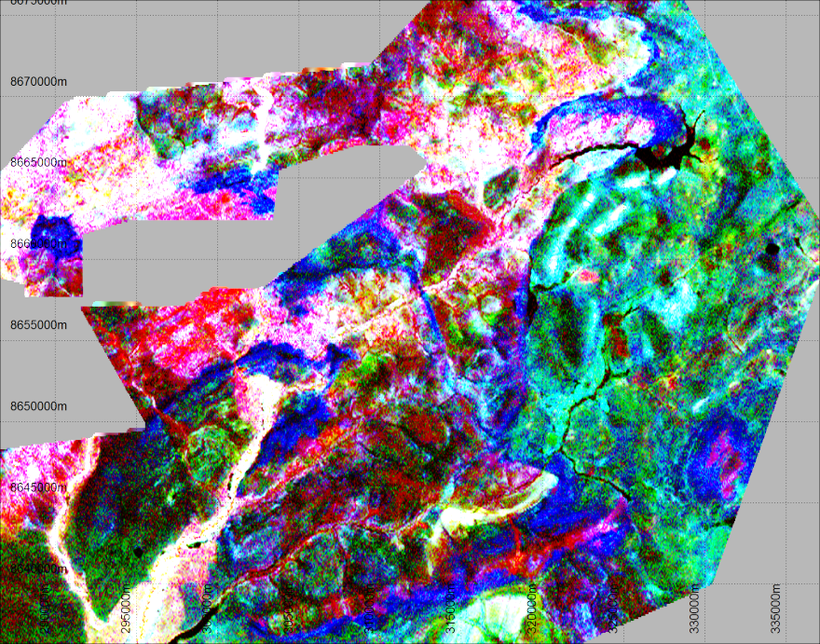
Geophysics
Radiometrics; K-U-Th RGB
Hydrothermal Monazite in the red beds mapped with radiometrics

Slide 23
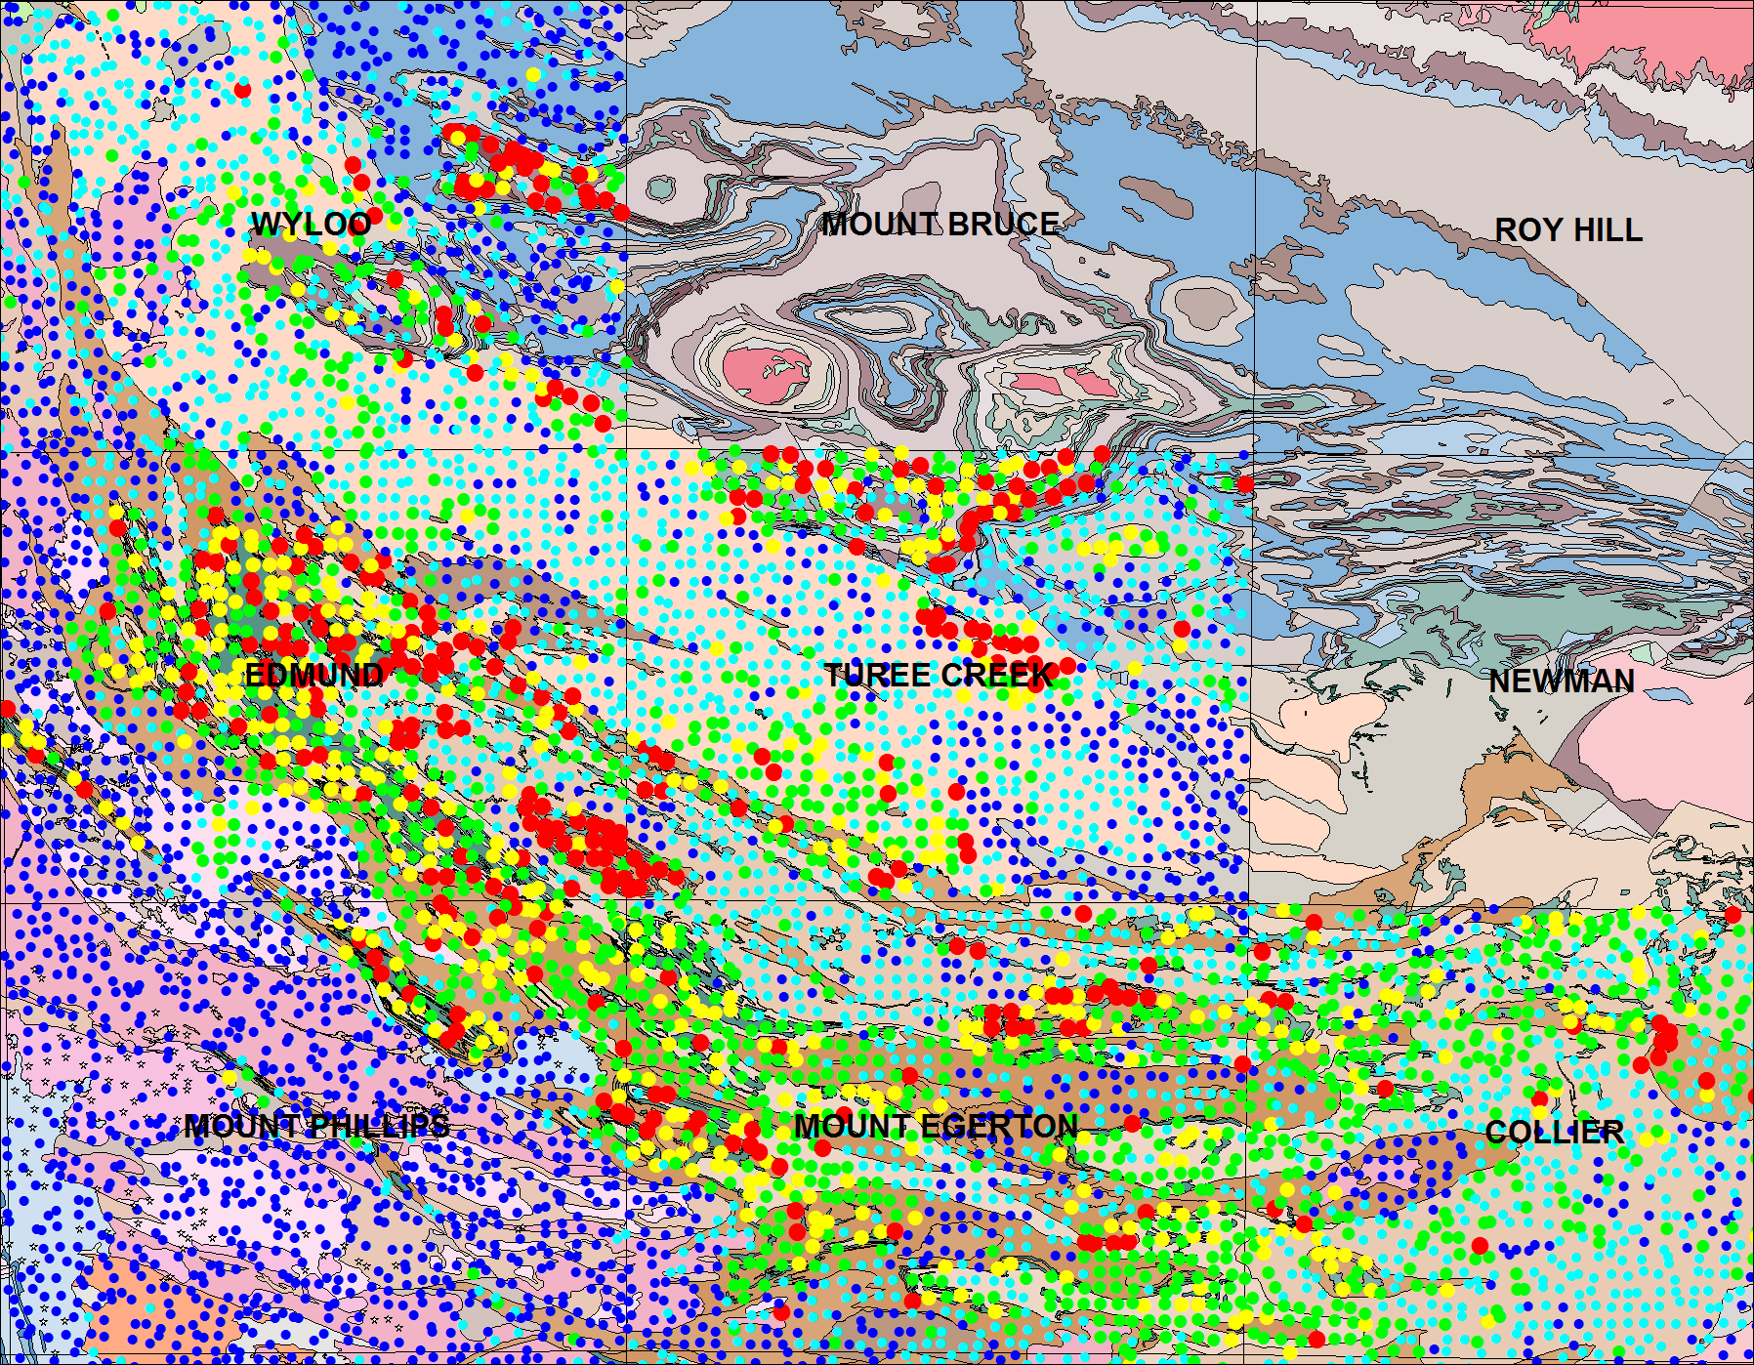
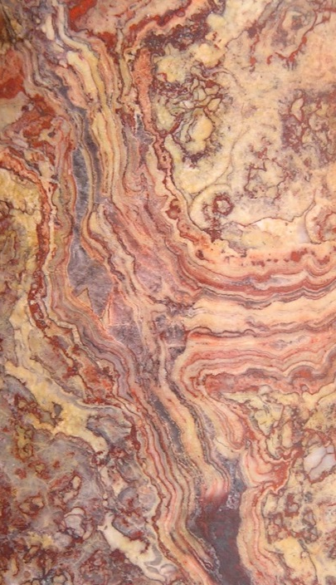
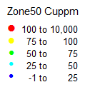
Geochemistry; Copper
Mafic rocks have background of 100ppm Cu; Felsic rocks have background of 10ppm Cu
Copper assays map bedrock geology; real anomalies hard to pick in variable “background”
Colloform ankerite-hematite-barite. Abra, WA
Notes:
Raw copper assays predominantly reflect bedrock geology.

Slide 24
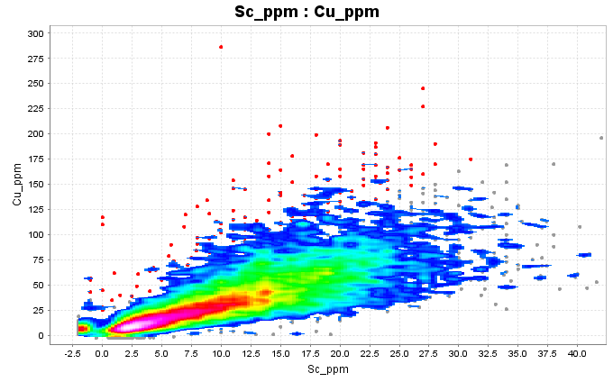
Geochemistry; Copper
Plot Copper versus Scandium to account for variable silicate-hosted component of copper
Addition of sulfide-hosted copper
Silicate-hosted copper
Notes:
Measure copper enrichment as a positive departure from the expected linear Cu to Sc trend. This is easily measured as a Cu/Sc ratio.

Slide 25
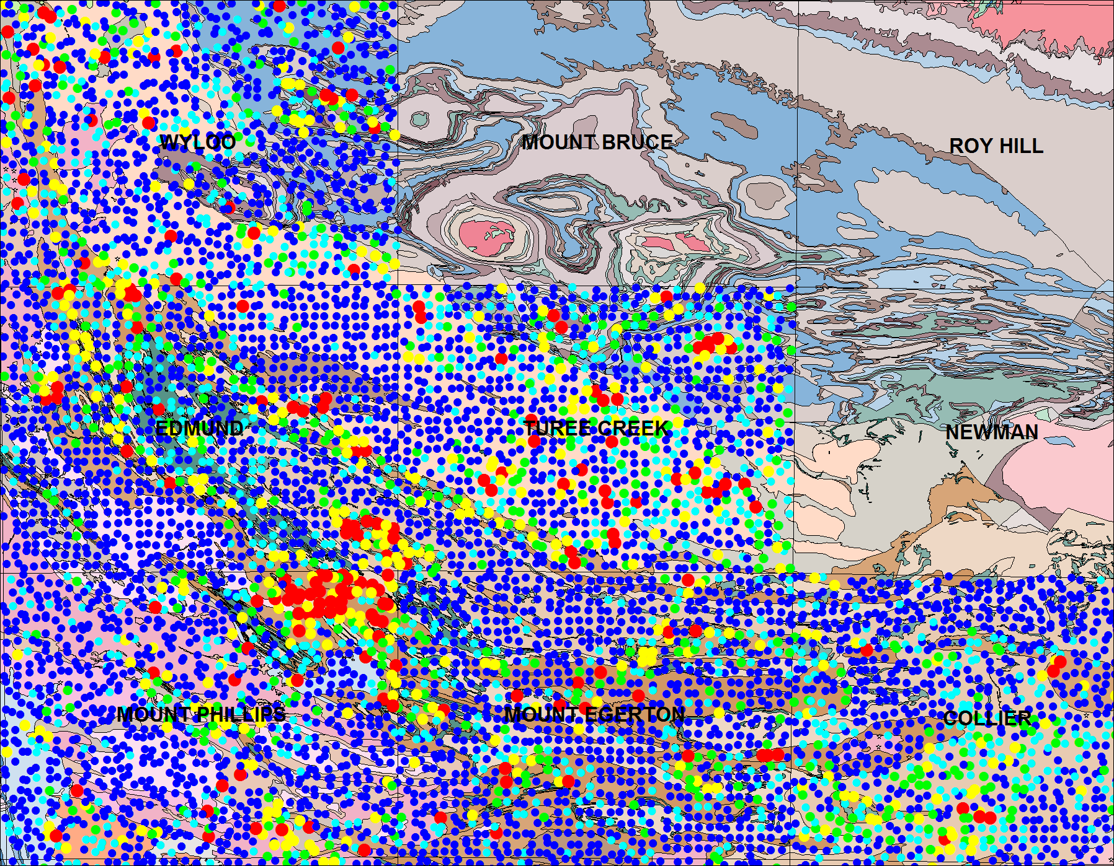
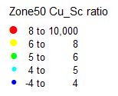
Geochemistry; Copper
Copper versus Scandium ratio
Defines samples with a sulfide contribution to total copper
Cu/Sc ratio accounts for the background silicate-hosted component of Cu in each sample.
By plotting the ratio, samples with a sulfide contribution to total copper can be identified.
Notes:
The Cu/Sc ratio highlights the real copper anomalies in a data set, particularly where the magnitude of the anomalism is not high, ie in leached saprolitic sample media or in stream sediment samples.

Slide 26
Geochemistry; Copper
Kabompo Dome
Gridded image of Copper distribution in soils.
Hypogene Copper grade at Sentinel is 0.51%. Soils over the deposit typically have 100 to 300ppm.
95% of the sulfide copper is leached out in a 20m thick saprolitic weathering profile.
Sentinel Cu mine

Slide 27
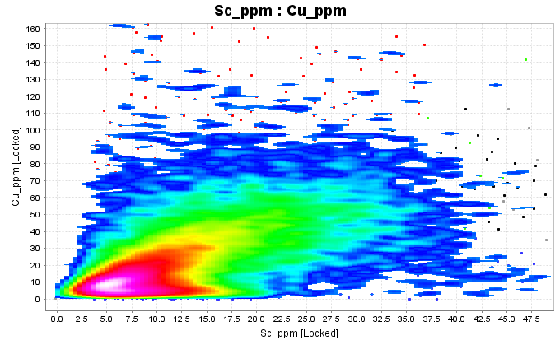
Metal Source?
Kabompo Dome soil geochem
Addition of sulfide-hosted copper
Silicate-hosted copper
Copper depletion

Slide 28
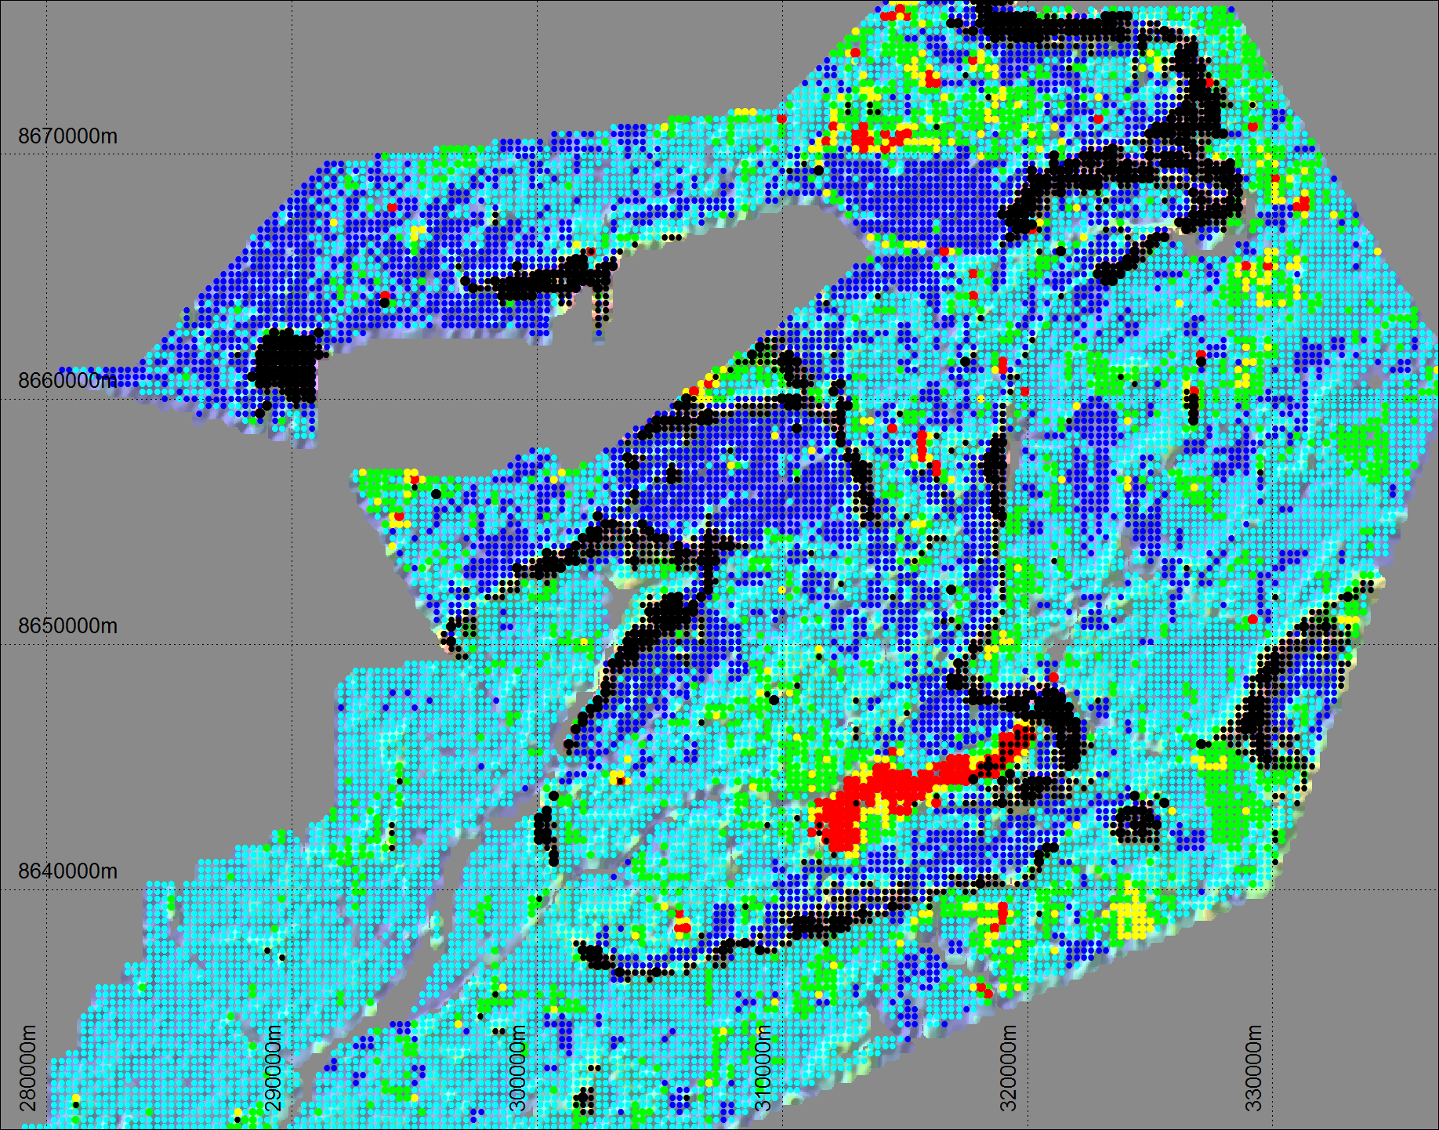
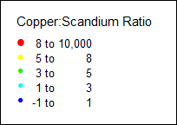
Geochemistry; Copper
Cu/Sc ratio highlights Cu-sulfide anomalies.
TALC


Slide 29
Metal Source?
Dark blue points; 50x50 km and 500m thickness at 10ppm Cu background
Easily enough Cu to form Sentinel
TALC


Slide 30
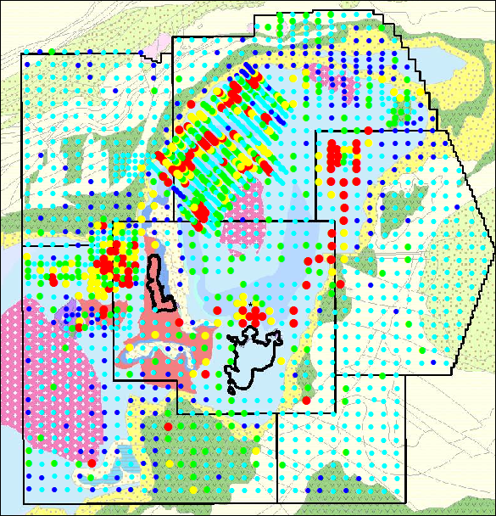
Lumwana_Sentinel_Kansanshi comparison
Cu/Sc ratio maps Cu depletion in lower Roan quartz sandstone + basement
Sentinel
300m by 300m samples
Lumwana
1km by 1km samples
Kansanshi
Deep DDH

Slide 31
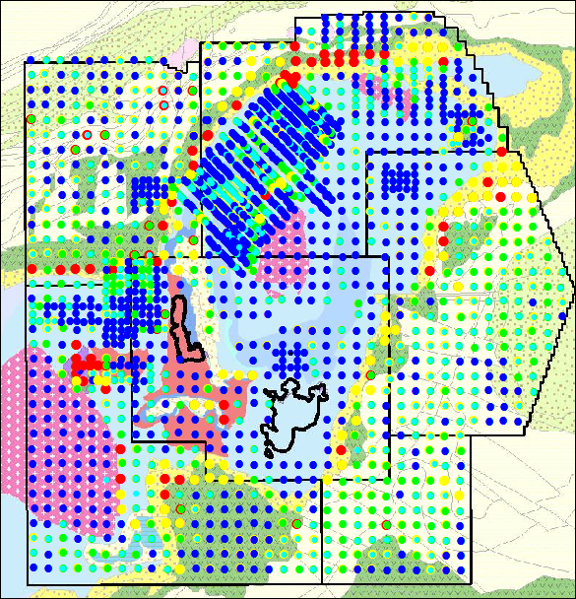
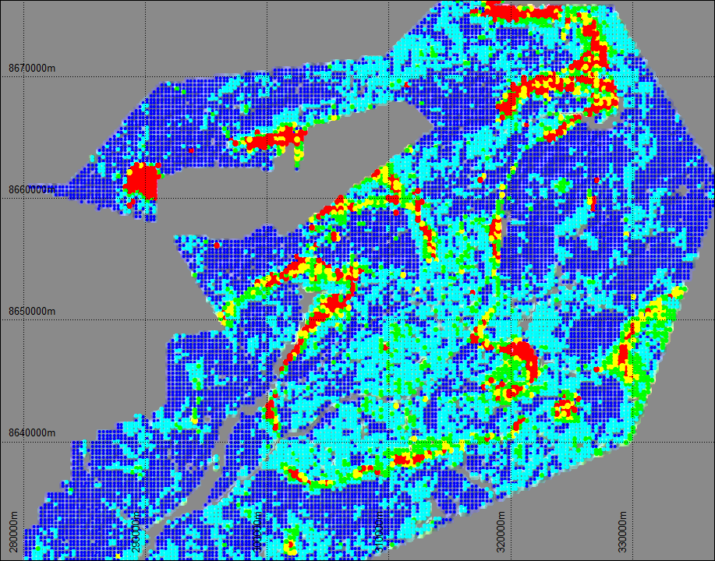
Lumwana_Sentinel_Kansanshi comparison
Ni/Sc ratio maps Ni-talc at the top of lower Roan quartz sandstone
Sentinel
300m by 300m samples
Lumwana
1km by 1km samples
Kansanshi
Deep DDH

Slide 32
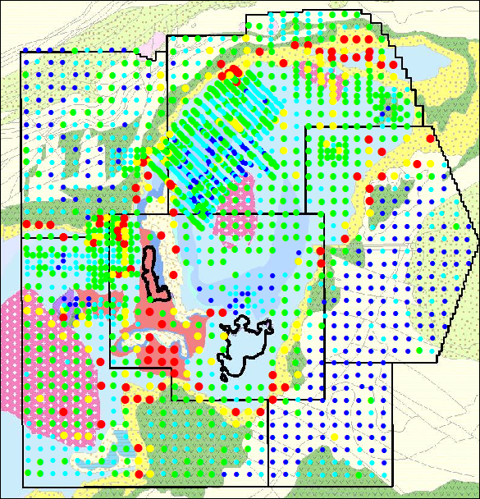
Lumwana_Sentinel_Kansanshi comparison
Cerium maps HT monazite at the top of the lower Roan quartz sandstone
Sentinel
300m by 300m samples
Lumwana
1km by 1km samples
Kansanshi
Deep DDH

Slide 33
Conclusions; What works?
Geological Mapping!!
Systematic Geochemistry
Initially broad-spaced, 4acid, low DL ICP-MS
Airmag, radiometrics, EM all contribute to mapping parts of the process.

Slide 34
Food for thought
Chemistry of the dolerites
Large volume of 780ma dolerite sills intruding Mwasha shales and evaporites!!

Slide 35
Food for thought
Chemistry of the dolerites
Zambia was underplated by basalt with MSS and ISS sulfides!!

Slide 36
Food for thought
Lumwana and Sentinel gangue mineralogy
Samples with >0.5% Cu, gangue mineralogy phlogopite-kyanite-muscovite
Phlogopite
Bulk composition always plots at the projected position of muscovite,
Therefore on the scale of an assay sample, phlogopite and kyanite always have the same proportions.
Kyanite

Slide 37
Food for thought
Lumwana and Sentinel gangue mineralogy
Hydrothermal phlogopite-kyanite, or illite-dolomite rock metamorphosed to phlogopite-kyanite-muscovite? When did Cu arrive?
Kyanite
Muscovite
Phlogopite
Quartz-muscovite-chalcopyrite schist, Lumwana
Phlogopite-kyanite-bornite schist, Lumwana

