Slide 1


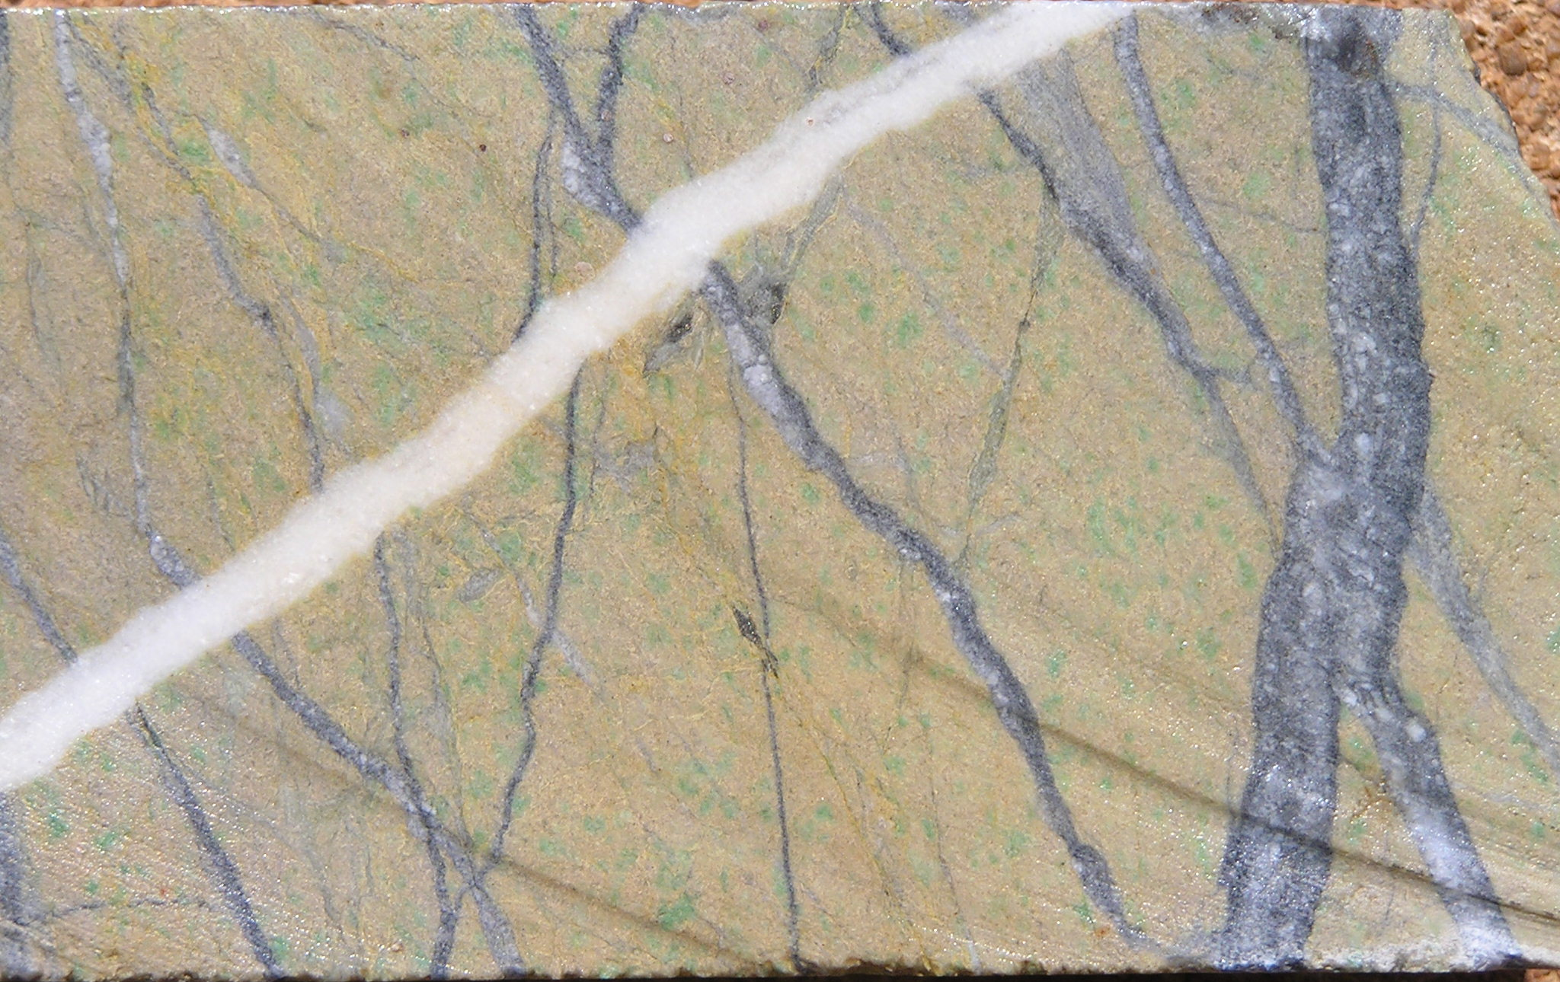
GEOCHEMICAL SIGNATURES OF ARCHEAN GOLD DEPOSITS
Scott Halley
October 3 2019
Dolomite Graphite veins in olivine Lamprophyre, Syama, Mali

Slide 2

Acknowledgements
Thanks to
Alicia for organizing the event.
Goldfields/PlacerDome/Barrick for permission to use their ME geochem and SWIR data.
Gold Fields for permission to show the St Ives pathfinder maps.
KCGM for permission to show the GMD geochem and SWIR maps.
MANY geologists from Goldfields, PlacerDome, Barrick, Northern Star, Evolution, Gold Fields, KCGM,……. For sharing their knowledge and observations and asking questions.

Slide 3
Observations (Archean and Proterozoic greenstones)
Distinct temporal evolution in basalt chemistry.
Distinct temporal evolution in granite chemistry.
Gold deposits proximal to preserved remnants of epiclastic basins.
Gold deposits proximal to “enriched” diorite intrusions.
Large footprint (10km by 10km) of pathfinder elements usually associated with low temperature hydrothermal systems.
Multiple gold events that are spatially superimposed.
Au Systems are chemically zoned at a camp scale.
Zoning pattern shows that many systems are tilted, ie the metal zoning pattern was established prior to the last deformation event.

Slide 4
Kalgoorlie Stratigraphy
Kurrawang Formation
Epiclastic conglomerate, sandstone, siltstone.
2655
2662
Gidji Lake Formation
Epiclastic conglomerate, locally volcaniclastic sandstone
White Lake Andesite
Black Flag
Andesitic volcaniclastic, locally lava
2680
Dolerite sills are either Lunnon Type or Paringa type
Dolerite Sill
Spargoville Formation
(Black Flag)
Feldspar crystal rich volcaniclastic sandstone
Paringa Basalt
Pillow basalt sequence up to 1000m thick, compositionally zoned from high Mg base to Fe-rich top
2690
2700
Devon Consols Basalt
Variolitic Pillowed Flows
Hannans Lake Serpentine
Peridotitic & Basaltic Komatiites, commonly spinifex textured
2710
Series of Massive & Pillowed, Variolitic, Amygdaloidal Flows, Flow Top Breccia
Lunnon Basalt
Notes:
The Kalgoorlie stratigraphy is constrained to the fault block bounded by the Abattoir Fault and the Boorara Shear. Within this block, the mafic stratigraphy is remarkably layer-cake; it can be tracked from the Golden Mile to the southern end of the St Ives camp. Within Archean and Proterozoic greenstones, the vast majority of basalt is chemically similar to Lunnon Basalt. Many greenstones, particularly well mineralized ones, contain basalt with a “Paringa” signature, 10 to 20my younger than the Lunnon type. Where the Paringa type occurs, it is always spatially very restricted, and occurs immediately in the vicinity of the largest gold camps. There is some very distinct process that occurs locally in the mantle directly underneath where the gold deposits will form some time later.
Another feature of the Paringa is that it is compositionally zoned; around 20% MgO at the base, gradually decreasing to 2% MgO at the top. In contrast, Lunnon basalt is the same from top to bottom. How does this happen? Eruption from a zoned magma chamber?

Slide 5
Kalgoorlie Stratigraphy
2655
Kurrawang Formation
Low Ca Granites
Mid-crustal melts
Large volume external batholiths
Peak around 2630Ma.
2662
Gidji Lake Formation
White Lake Andesite
Black Flag
2680
Dolerite Sill
Enriched Diorite
Melts from enriched under-plated basalt
Small volume plutons, internal to greenstone
Peak around 2660Ma.
Spargoville Formation
(Black Flag)
2690
Paringa Basalt
2700
Devon Consols Basalt
High Ca TTG
Melts from under-plated basalt
Large volume external batholiths
Peak around 2680Ma.
Hannans Lake Serpentine
2710
Lunnon Basalt
Notes:
Kalgoorlie, like many other well endowed archean districts has a distinct temporal evolution in granite chemistry. High Ca granites peak at around 2680Ma. These come from high pressure melting of underplated basalt. Low Ca granites peak at around 2630Ma. These are mid-crustal melts. There is a diverse range of small volume intrusions peaking at around 2660 which are somewhat like the high Ca granites, but more enriched in large ion lithophile elements and high field strength elements, and commonly very sulfur rich.

Slide 6

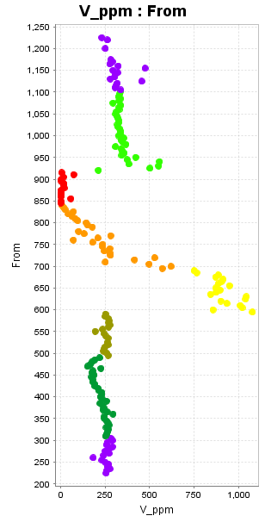
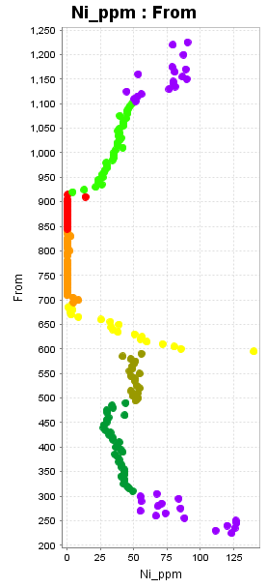
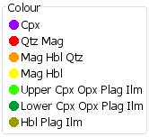
In-situ fractionation in the Golden Mile Dolerite
Vanadium
Nickel
Top of sill
Golden Mile Dolerite
Same bulk chemistry as the Lunnon Basalt
Same as 90% of Archean Basalt
Fractionates to magnetite instead of ilmentite.
Sulfur saturated at the onset of magnetite crystallization.
Magnetite
Zone
Base of sill
Notes:
Most of the dolerite sills in the Yilgarn have bulk chemistry that matches the Lunnon Basalt. The Golden mile dolerite is one of these. A few have chemistry that matches Paringa Basalt. The GMD is an example of what happens to a typical archean mafic magma when it ponds and fractionates in situ. Think of the presence of ilmenite or magnetite as an indicator of the oxidation state of a melt. All of the archean basalts are ilmenite-bearing. As it fractionates, the GMD switches from pyroxene bearing to hornblende (so it must have a significant water content), and it switches from ilmenite to magnetite. As magnetite crystallizes, it strips all the V from the melt. The GMD, like any other magma that fractionates magnetite became sulfur-saturated as it started crystallizing magnetite. Whatever Ni, Cu and presumably Au that was in the melt at the onset of magnetite crystallization ended up in immiscible sulfides at the base of the magnetite zone.
What would happen if this process happened at a much larger scale in ponded magmas at the base of the crust?

Slide 7
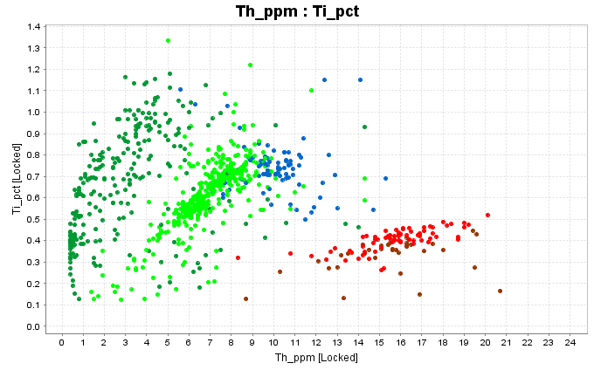
Paringa-type basalts;
Enriched in Zr, Th, La, Ce, Nb (HFSE’s)
Enriched in K, Ba, Cs (LILE’s)
Commonly show fractional crystallization of magnetite
Sulfur-saturated prior to eruption
VERY localized distribution
Lunnon-type
Paringa-type
Notes:
In a well mineralized greenstone belt like Kalgoorlie, >90% of the magmas have chemistry like Lunnon Basalt and less than 10% are like Paringa Basalt.
This variation from Lunnon to Paringa is not restricted to Kalgoolie; there are localized Paringa-type magmas in many greenstones such as Abitibi (Timmins, Red Lake), West Africa archean and Proterozoic and Lake Victoria (east Africa).
Paringa-type basalts;
Enriched in Zr, Th, La, Ce, Nb (HFSE’s)
Enriched in K, Ba, Cs (LILE’s)
Commonly show fractional crystallization of magnetite
Sulfur-saturated prior to eruption
VERY localized distribution

Slide 8
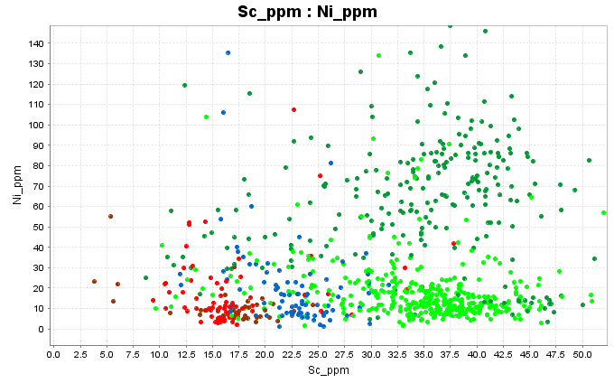
Paringa-type basalts;
Enriched in Zr, Th, La, Ce, Nb (HFSE’s)
Enriched in K, Ba, Cs (LILE’s)
Commonly show fractional crystallization of magnetite
Sulfur-saturated prior to eruption
Normal Ni content relative to Sc = Ni hosted in silicates
Ni depleted,
Ni and Cu left behind as MSS and ISS in magma chamber
Notes:
In ilmenite-bearing basalts, the ratio of Ni to Sc is always around 1.5 to 1, and the ratio of Cu to Sc is always around 2.5 to 1. Any of the basalts that have seen fractional crystallization of magnetite have become sulfur saturated. The effect of this can be seen by plotting Ni against Sc.
The Paringa Basalts are erupted as pillow lavas, but this shows that they must have had residence time in a magma chamber, presumably near the base of the crust before being erupted. A consequence of this is that there must be a cumulate zone left behind with abundant sulfur, nickel, copper and gold.
Could this be a pre-conditioning event forming a gold-enriched reservoir directly beneath the Golden Mile, Timmins, Red Lake, etc?

Slide 9
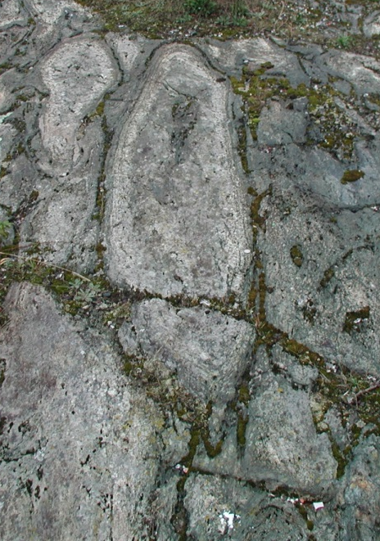
Fertile Archean and Proterozoic terranes show a common temporal evolution in basalt chemistry,
Fractionation in a deep magma chamber, or crustal contamination?
Vipond Formation basalt, Timmins, Canada
MacDonald, P.J. and Piercey, S.J., 2018. Geology, lithogeochemistry, and significance of porphyry intrusions associated with gold mineralization within the Timmins–Porcupine gold camp, Canada. Canadian Journal of Earth Sciences, 56(4), pp.399-418.
Notes:
At Timmins, the paringa-type basalt is called the Vipond. It occurs JUST between the Porcupine Destor fault and the Pamor Fault, just within the vicinity of Timmins, but not very far along strike. These are pillow basalts, that trend from Mg rich at the base, to Fe rich at the top of the pile, with progressively increasing degree of magnetite fractionation and S saturation. There must have been an accumulation of magmatic sulfides near the base of the crust immediately beneath Timmins!

Slide 10
Significance of Basalt chemistry
Fractionation of mantle plume (or crustal contamination) creates underplated basalt enriched in water, CO2, alkali elements AND with immiscible sulfides, Au, As, Sb etc.
Source region that has significantly enriched metals, sulfur and volatiles.

Slide 11
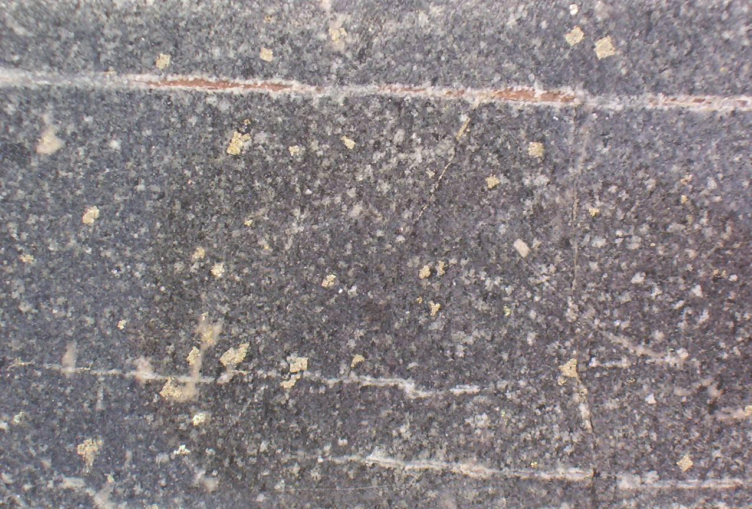
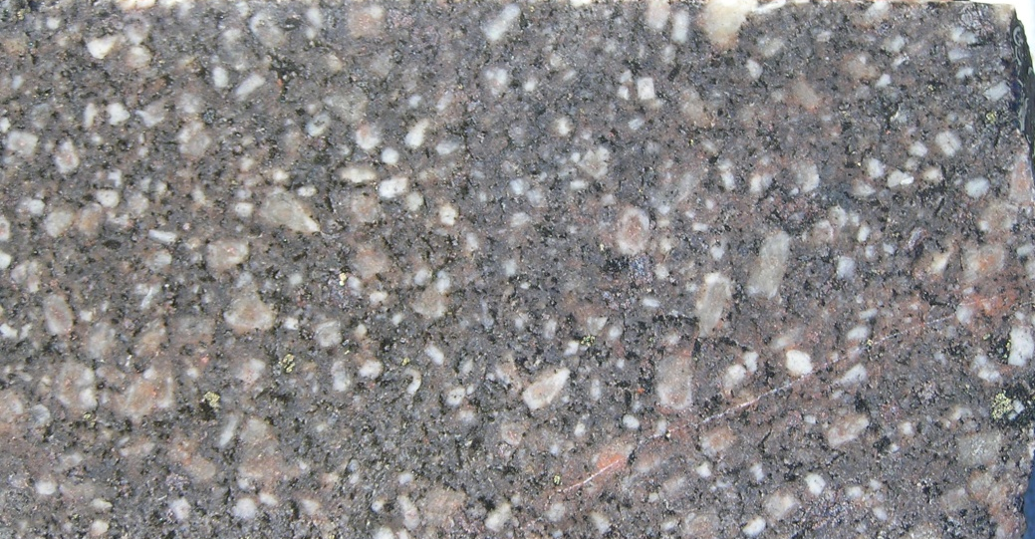
Eastern Goldfields; >20 diorite intrusions with 1moz to 40moz Au at grades of 0.2 to 0.5ppm.
Very sulfur-rich!!
Intrinsically Au-rich
Distinct trace element signatures
High Th, La, Ce, Ba, Sr
Partial melts of metasomatised mantle,
Beta Porphyry, Kambalda. Pyrite +/- anhydrite.
Mean gold grade 0.37ppm Au
Santa Anna Trondhjemite, Kambalda..
Mean gold grade 0.5ppm Au
Notes:
There is a large number of diorite intrusions in the eastern goldfields that contain pervasive enrichment of gold, typically around 0.1 to 0.2ppm levels, sometimes as high as 0.5ppm. The gold grades in these are so consistent that it appears the metal was introduced with the melt rather than via a hydrothermal overprint. These gold-bearing porphyries are also very sulfur rich, commonly very oxidized, eg anhydrite-bearing, and have the highest degree of enrichment of P, Th, Ce, Ba, Sr etc of any of the porphyries.

Slide 12

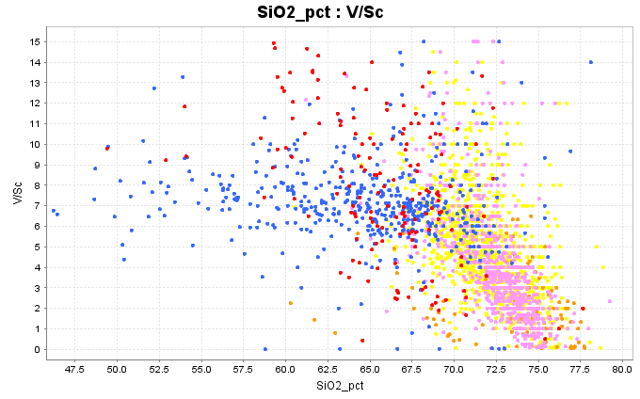
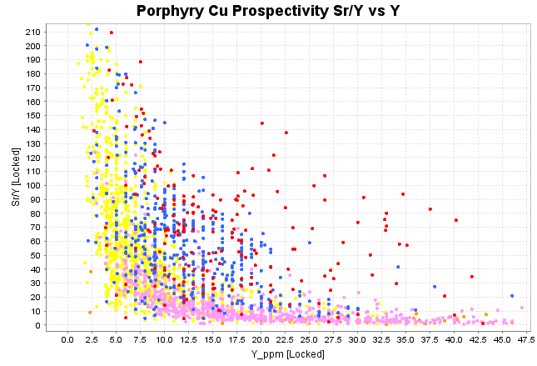
Intrinsically Au-rich diorite intrusions in the Eastern Goldfields
Distinct trace element signatures
High Sr/Y
No depletion of V
High Ba
High Th, La, Ce, P
No Eu anomaly
LOTS of Sulfur
Fractional Crystallization of Fe-silicates
High pressure melting of under-plated basalt
Mid-crustal melting
Fractional Crystallization of Magnetite
AMIRA P482 database.
Notes:
These plots are based on the AMIRA P482 data.
These 2 diagrams are commonly used in porphyry Cu exploration, but are also very applicable to archean granites.
In magnetite-bearing melts, as magnetite crystallizes and fractionates, melts evolve to lower V/Sc. Most melts follow this trajectory. There is a window in P-T-H2O space where hornblende crystallizes before magnetite; these melts evolve to higher V/Sc ratios with fractionation of hornblende. The more oxidized the melt, the higher the ratio goes. This is a favourable trend.
All of these melts plot on a spectrum from high Sr-low Y to low Sr – high Y. This maps a transition from high Pressure melting where garnet is stable in the source region and all of the plagioclase melts, to low pressure melting where plagioclase is fractionating.
Fertile diorites have high Sr/Y, high V/Sc, Ba>1000ppm, high P, Th, La, Ce and LOTS of sulfur.

Slide 13
Significance of Enriched Diorites
Homogenously enriched in Au and Sulfur; these are low-grade Porphyry Gold systems
Partial melts of under-plated enriched basalts (Paringa-type)?
Generate alteration cells with physical dimensions similar to modern porphyry Cu systems.
Create a shallow crustal volume of rock with significant enrichment of metals, sulfur, water and CO2.

Slide 14
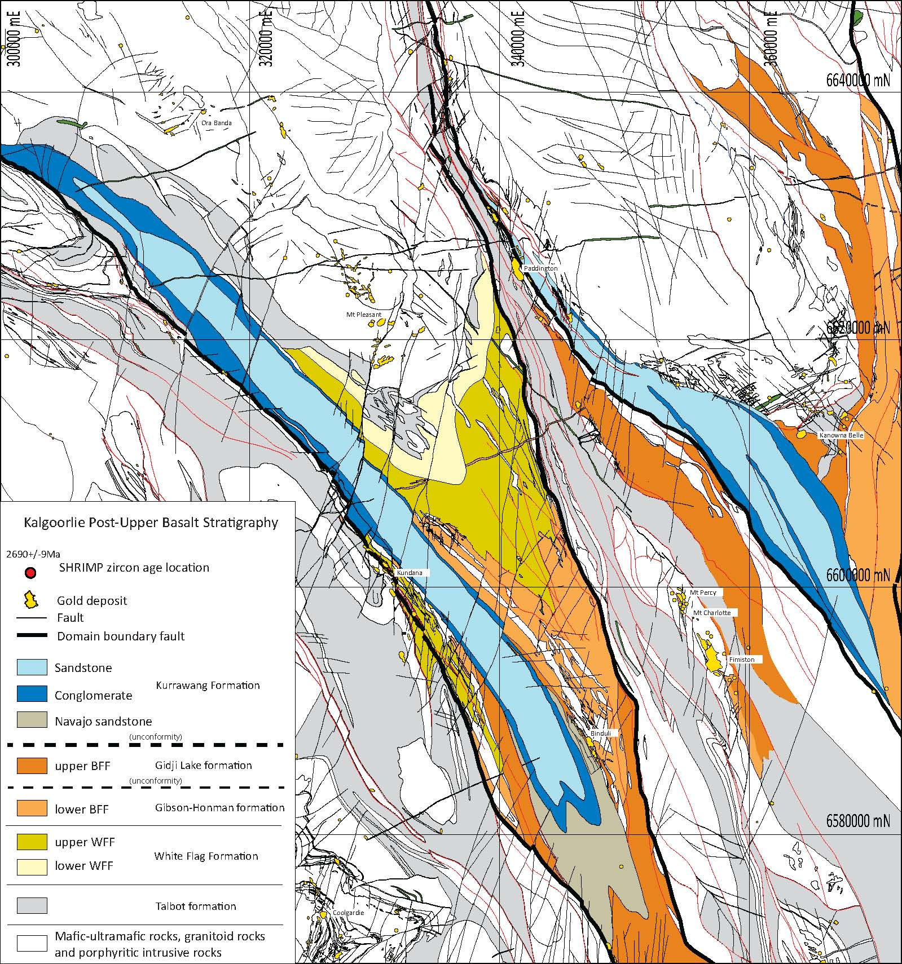
Preservation of Epiclastic Basins
Early gold event synchronous with volcanism ~2660 Ma
Spatial association of unconformity potential indicator of syn-volcanic faults
Indicator of shallow crustal level
Map from Gerard Tripp
Notes:
It is widely recognized that there is a spatial association between polymict epiclastic basins and gold mineralization. Gerard Tripp recognized 2 stages of
late basins”. Time wise, he related Fimiston Lodes, Kanowna Belle and Binduli to the first epiclastic sequence, the Gidji Lake Formation

Slide 15
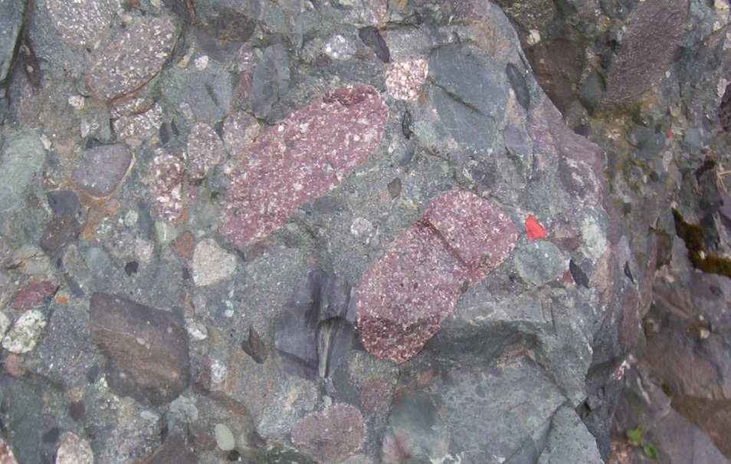
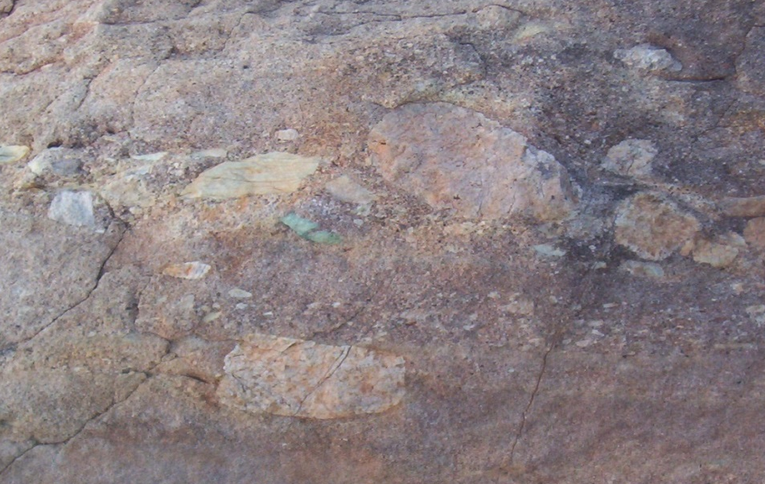
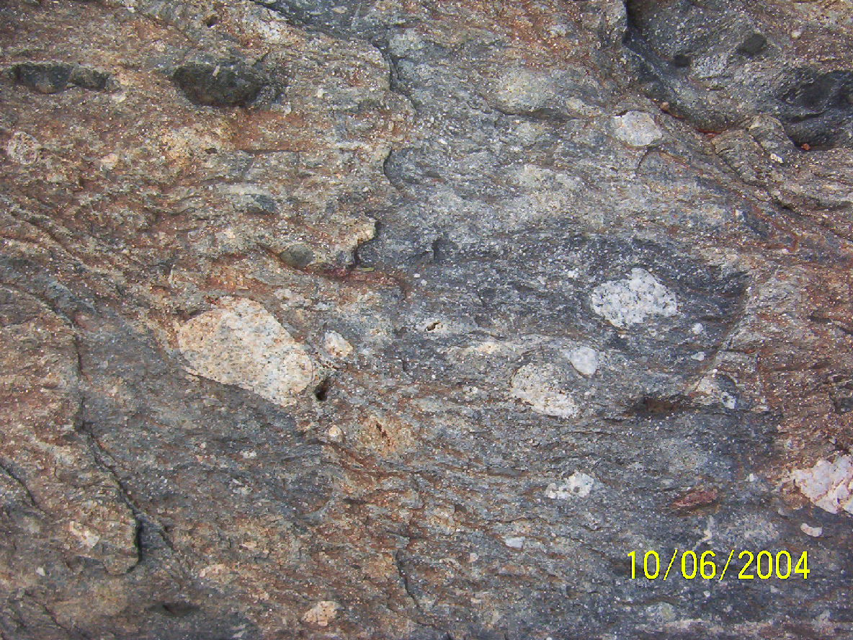
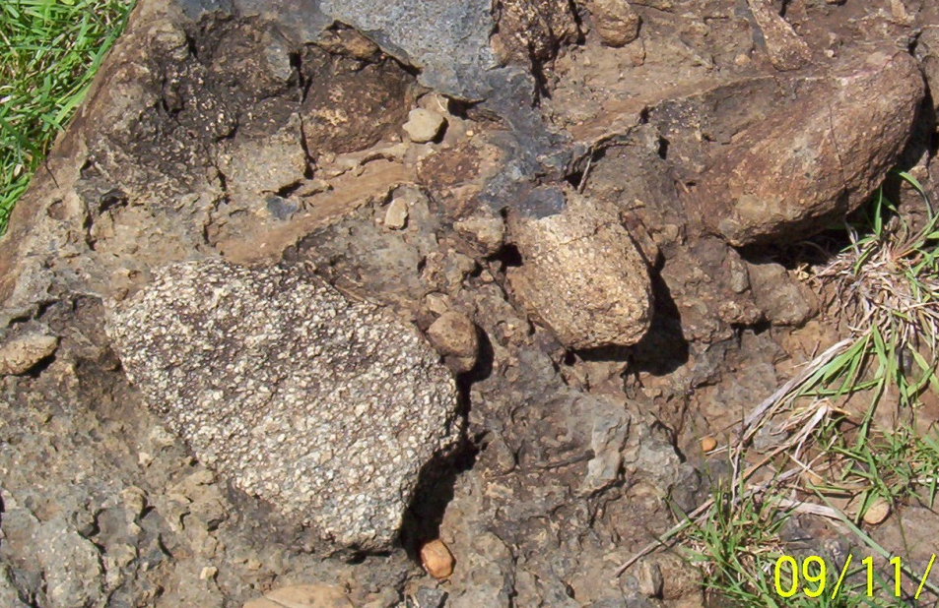
Proximity to Epiclastic Basins
Kirkland Lake
Kalgoorlie
Kolar
Lake Victoria
Notes:
Examples of polymict conglomerates from premier gold provinces. The same association is also seen in the Proterozoic Birimian in west Africa.

Slide 16
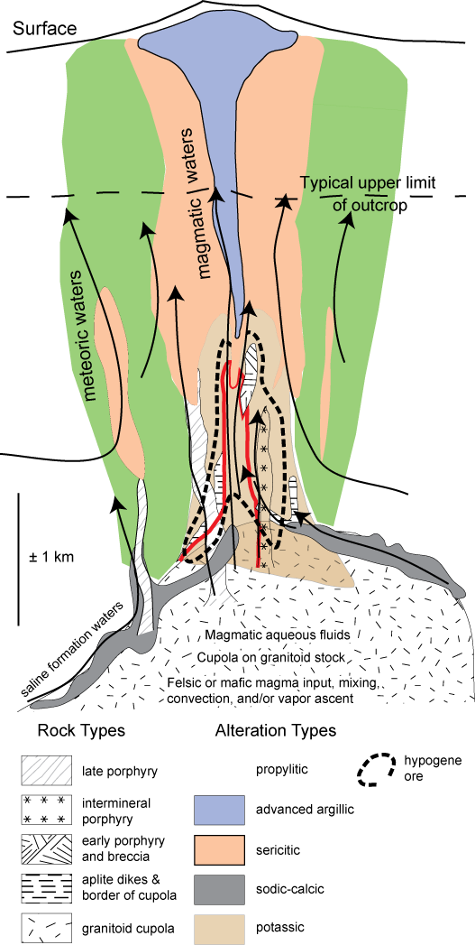
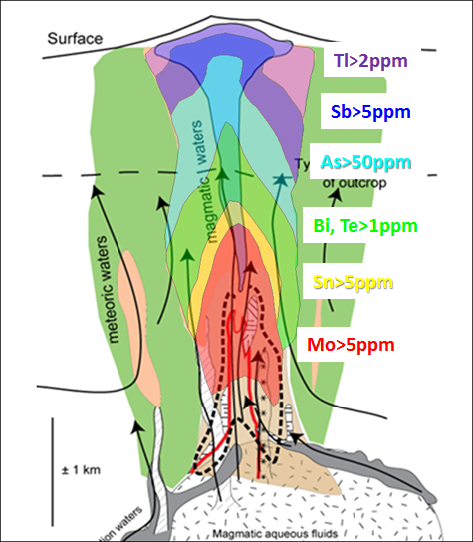
Pathfinder zoning patterns in hydrothermal systems
Mo-Se-Sn-Te-Bi-As-Sb substitute into the lattice of pyrite and are precipitated in sulfidic alteration sequentially down-temperature in any kind of hydrothermal system, regardless of the type of system. The zoning pattern primarily reflects a temperature gradient.

Slide 17
Modern Geothermal system
Elevated Sb-Hg-Cs-Li occur at shallow levels in association with pervasive smectite alteration
Kaolinite
Smectite Zone
Chlorite Zone
Muscovite
Illite Zone
Epidote Zone
Chambefort, I., Lewis, B., Simpson, M.P., Bignall, G., Rae, A.J. and Ganefanto, N., 2017. Ngatamariki geothermal system: Magmatic to epithermal transition in the Taupo volcanic zone, New Zealand. Economic Geology, 112(2), pp.319-346.
Notes:
In modern geothermal systems and in low sulfidation epithermals, Sb, Hg, Cs and Li are significantly enriched within 1km of the palaeosurface. Within that temperature window, alteration mineralogy is dominated by smectite. This is below the stability range of white mica.

Slide 18
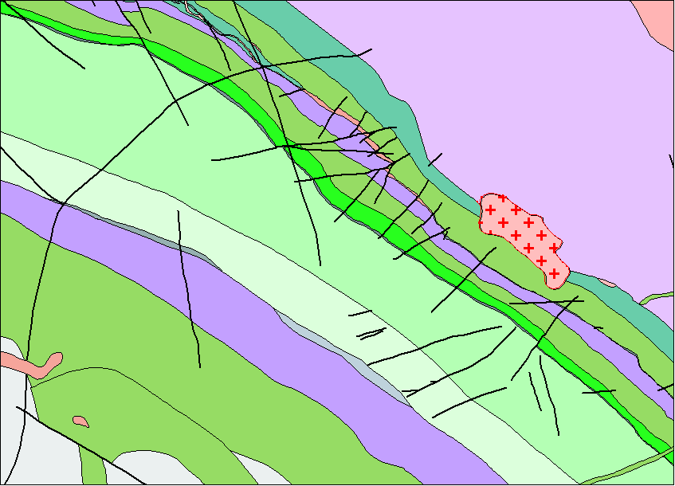
Ora Banda Geology
Komatiite
High-Mg Basalt
Enterprise Dolerite
Mt Pleasant Dolerite
Porphyry
Bent Tree Basalt
Victorious Basalt
Enterprise
Ora Banda Sill
Orinda Sill
Gimlet South
Notes:
Geology map of the Ora Banda area. Note the location of the outcropping porphyry.
All the geology dips at about 30degrees to the SW.

Slide 19
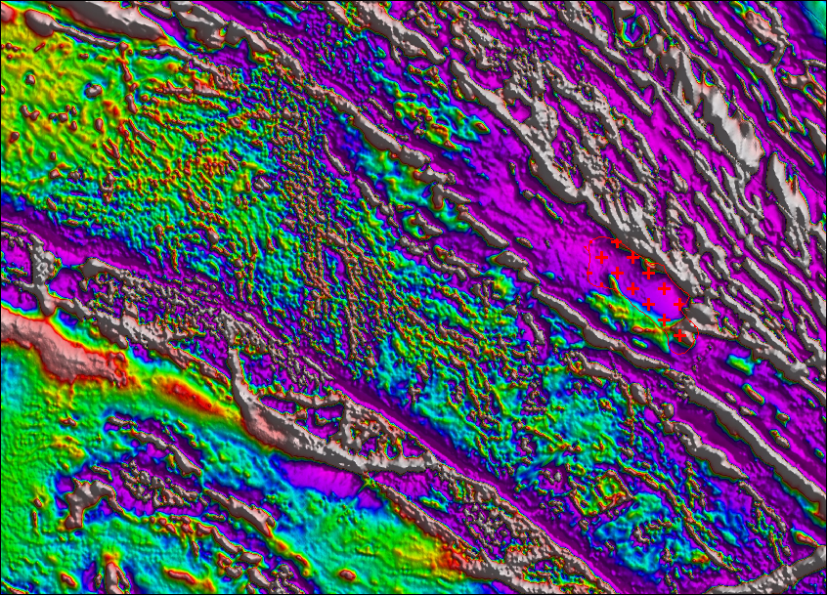
Ora Banda RTP_1VD
Enterprise
Gimlet South
Notes:
Magnetic Image; same field of view. Note the location of the outcropping porphyry.
Observe the strong linear magnetic unit on the southern side of the porphyry outcrop. This is the pyroxene cumulate at the base of the Mt Pleasant Sill. Note that where it passes by the porphyry, there are 10 or so breaks in the magnetic unit; these are demagnetised zones around W to WSW-trending faults. This set of faults is just developed in the hangingwall of the porphyry.

Slide 20
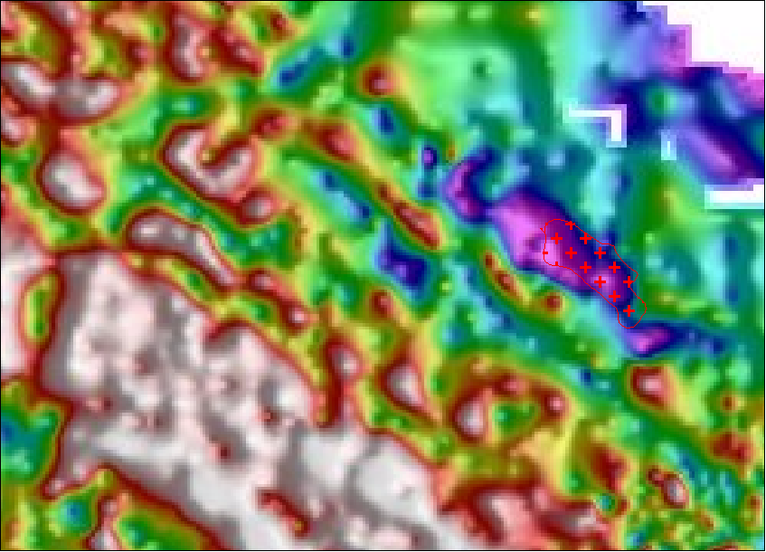
Ora Banda Gravity
Enterprise
Gimlet South
Notes:
Gravity Image; same field of view. Note the size of the gravity low relative to the outcropping porphyry. The zone of W to WSW-trending faults is just developed in the hangingwall of the shallowly buried porphyry.

Slide 21
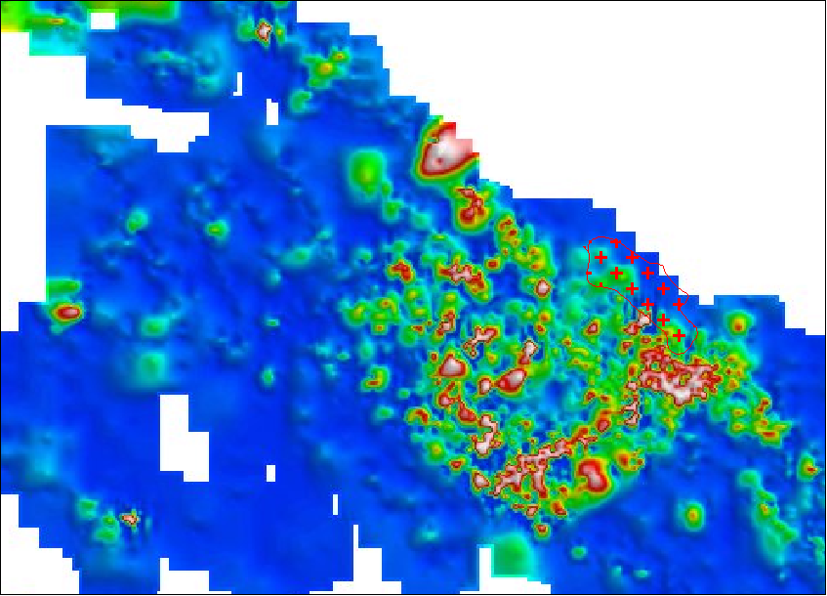
Ora Banda Gridded Au assays from all de-surveyed points
Enterprise
Gimlet South
Notes:
Image of gold geochemistry. This was generated from all gold assays from all RAB, aircore, RC and diamond drilling. The anomalous gold sits above the porphyry; both the outcropping porphyry and the hidden porphyry seen in the gravity.

Slide 22
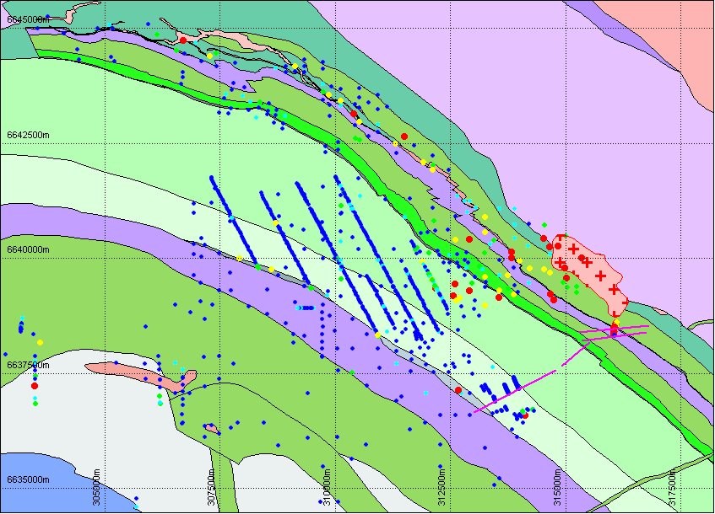
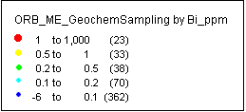
Ora Banda Bismuth assays
Bi
Enterprise
Gimlet South
Notes:
Note the high Bi (= Mo and Te) in the Lone Hand Monzongranite and its altered carapace, including the Enterprise deposit.

Slide 23
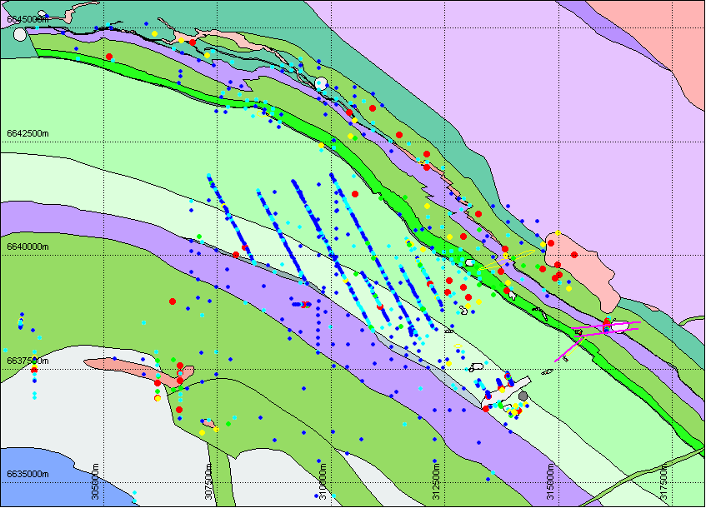
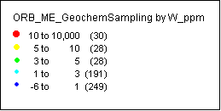
Ora Banda Tungsten assays
W
Enterprise
Gimlet South
Notes:
Tungsten geochem on gravity. Note the tungsten halo around the gravity low, and look at the leakage in on orientation parallel to the Gimlet structure.

Slide 24
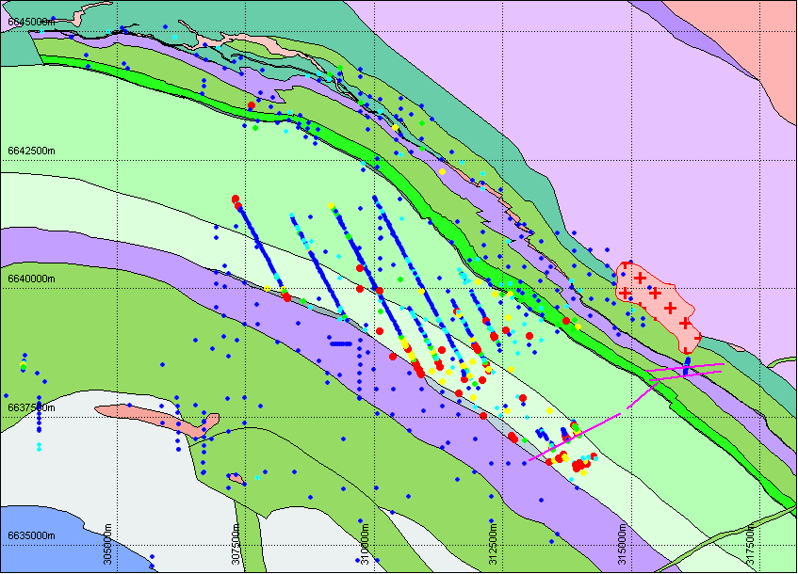
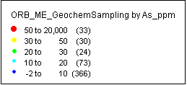
Ora Banda Arsenic assays
As
Enterprise
Gimlet South
Notes:
Arsenic is very low in the Lone Hand Monzongranite and adjacent altered rocks, but is enriched in Gimlet and Perimeter prospect.

Slide 25
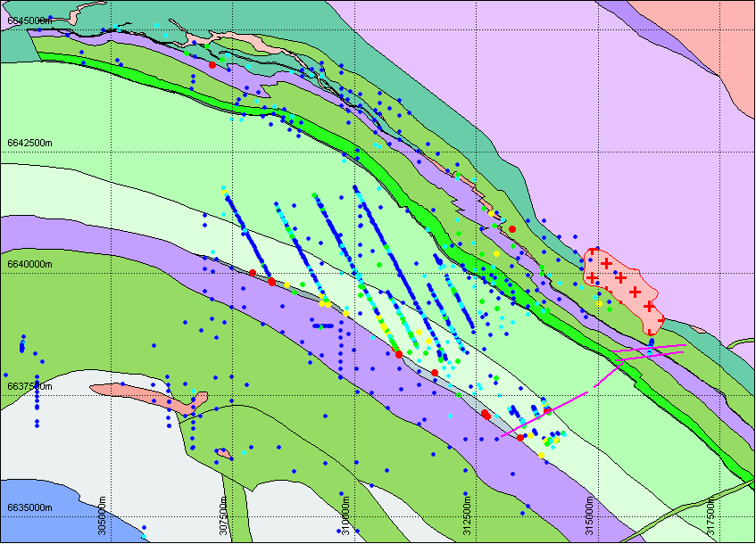
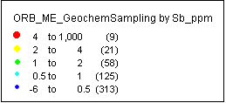
Ora Banda Antimony assays
Sb
Enterprise
Gimlet South
Notes:
Antimony is located much further outboard, mostly in the centenary shale, with the Ora Banda Sill acting as an aquiclude.

Slide 26
Ora Banda Long Section in the plane of Gimlet South
Anomaly One
Laterite Pit
Gimlet South Mine
~ 1Mozs
Enterprise Mine
~ 1.3Mozs
Looking NNW
2km
Notes:
If we consider gold deposits on the scale of a Camp rather than individual deposits, the camps are chemically zoned. They contain a diversity of deposits with distinctive metal associations, which amongst other things reflect a temperature variation.

Slide 27

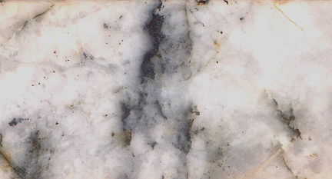
Ora Banda Long Section in the plane of Gimlet South
Metals show a temperature zoning away from the Lone Hand Monzogranite.
The age and metal zoning suggests that the Ora Banda system was tilted after formation.
Sb
As
W
Bi
Mo
Gimlet South Mine
~ 1Mozs
Anomaly One
Laterite Pit
Enterprise Mine
~ 1.3Mozs
Enterprise quartz-moly veins; Rh-Os age 2670 Ma
2km
Notes:
Ora Banda is a gold system that was tilted after the formation of these deposits. Around the Lone Hand Monzograntite, the mineralogy of the system is biotite-feldspar-pyrite +/- white mica, with a strong Mo-Bi-Te signature. This is mineralization that formed at maybe 350 to 400 degrees, at a depth of 3 to 4km. The top of the system is Sb rich, formed at maybe 200 degrees and a depth of perhaps 1km. Many Yilgarn gold camps are zoned in this way, and have been subsequently deformed and tilted. When you are exploring in a gold camp, consider the diversity of deposit styles that may be present. Try to recognize where you are within a system; think about the facing directions, and consider what the gold deposits might look like at deeper or shallower palaeolevels.

Slide 28
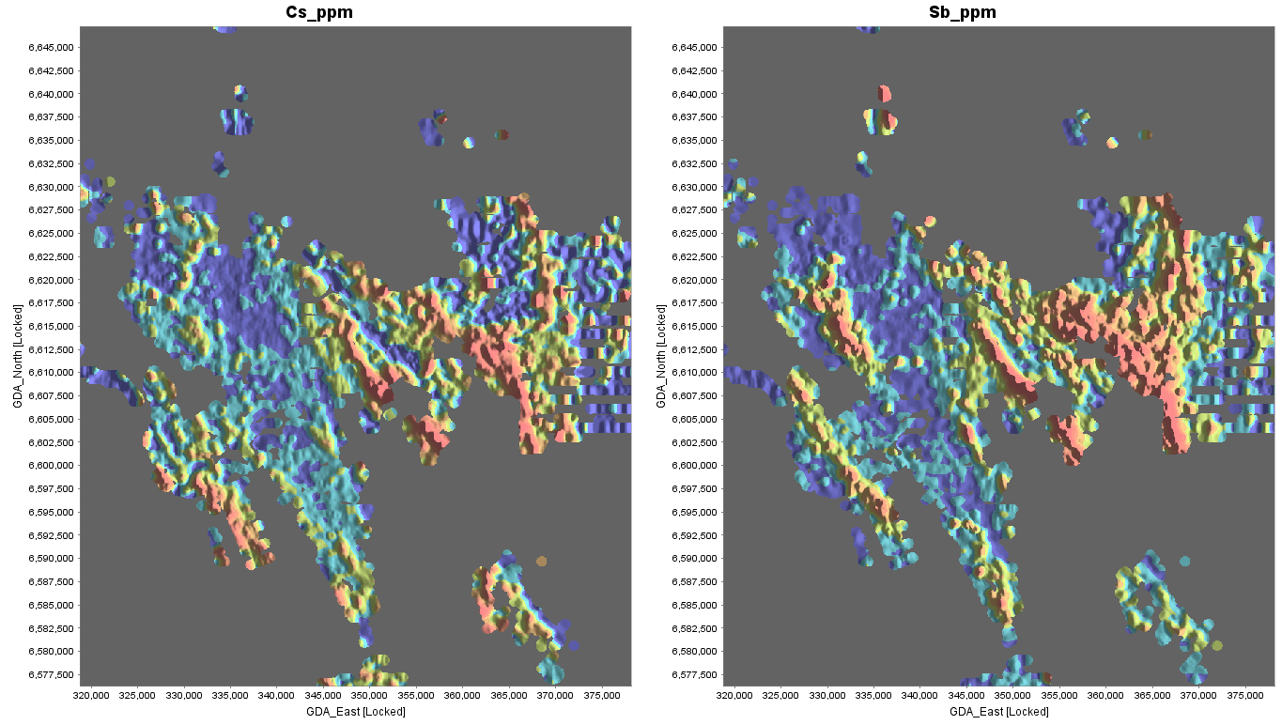


Orogenic gold deposits are located within the footprints of low temperature, pre-metamorphic alteration cells.
Cs is a proxy for low Temp clay alteration. Sb accommodated in low Temp pyrite.
Cesium
Antimony
Mt Pleasant
Mt Pleasant
KB
KB
Kundana
Kundana
Notes:
Now step out a scale. A characteristic of the Kalgoorlie district is that it contains large cells of anomalous pathfinder geochem that we would consider to be indicative of shallow levels (low temperatures) in modern environments. The levels of caesium and antimony shown here are comparable with the top 1km of NZ geothermal systems or the outflow zones from low sulfidation epithermal deposits. The major orogenic gold camps are located with these footprints of low temperature pathfinders. If these were indeed low temperature hydrothermal cells, then they would have been in a temperature range where smectites were the dominant hydrothermal minerals.

Slide 29
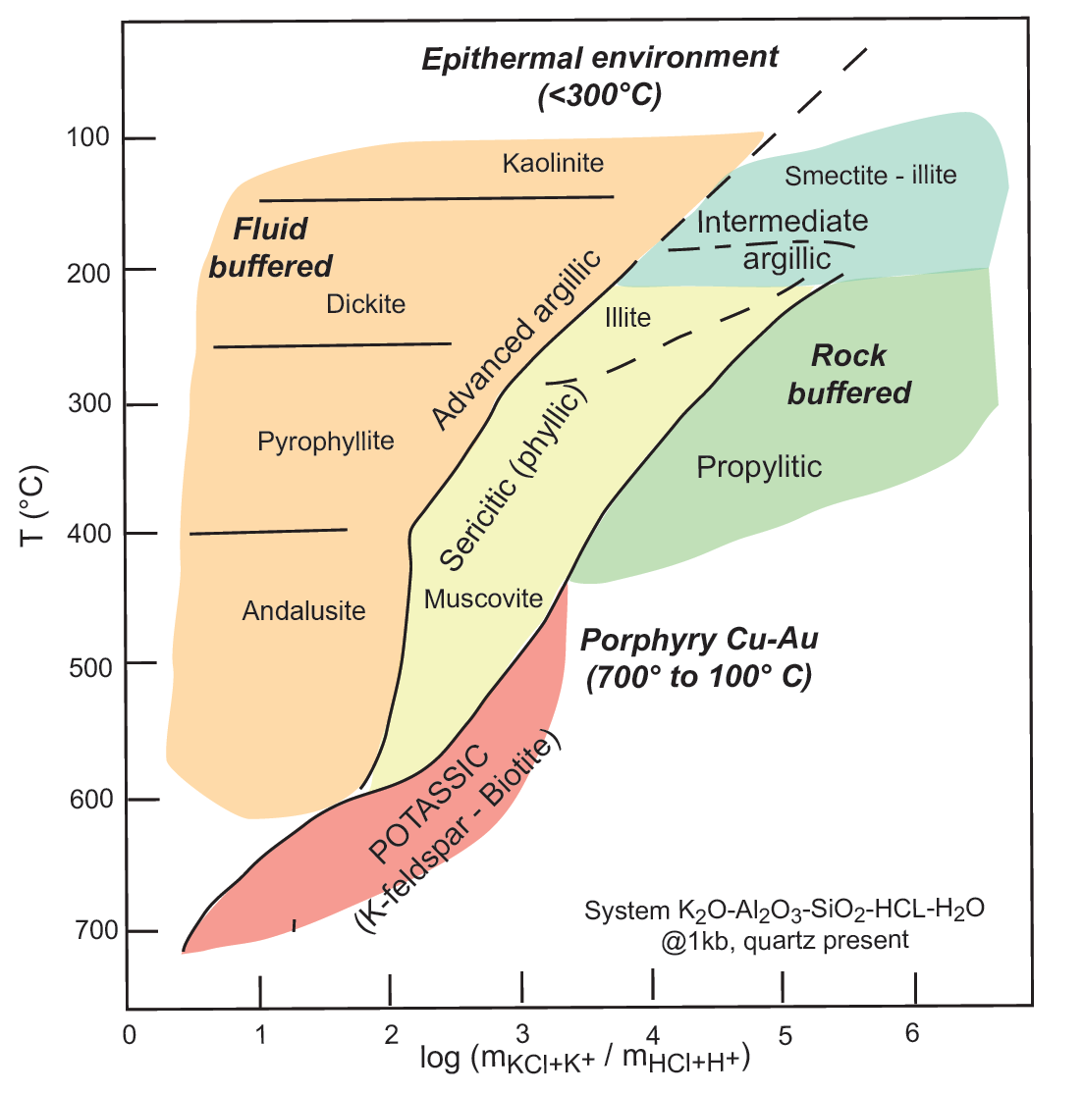
2670 to 2660Ma shallow level alteration.
Clay alteration in mafic rocks is metamorphosed to paragonite-Fe chlorite-chloritoid at middle greenschist, clinozoisite-albite at upper greenschist
Smectite
Illite-Smectite
Chlorite-Smectite
Paragonite-Fe chlorite +/- Chloritoid
Illite-Chlorite
Middle greenschist
Illite
Chlorite
Biotite
Clinozoisite -Albite
Upper greenschist
Notes:
Smectites are not stable above 200 degrees. If there were Fimiston-age syn-intrusion hydrothermal systems formed within the top 4km of crust, they would be vertically zoned from biotite-feldspar to sericite-chlorite to illite-smectite-chlorite to smectite. The biotite-feldspar and sericite-chlorite would survive middle greenschist metamorphism, but the interlayered smectite-chlorite-illite would be converted to paragonite-Fe chlorite.This reaction would produce enormous volumes of metamorphic fluid even at quite low metamorphic grades.
It is also important to note that in upper greenschist conditions, carbonates react with phyllosilicates to form metamorphic feldspars. Ca from ankerite is incorporated in feldspars, but the left over Fe makes metamorphic magnetite.

Slide 30
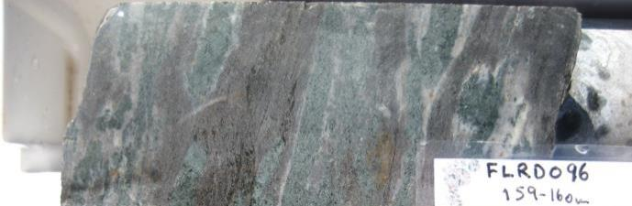
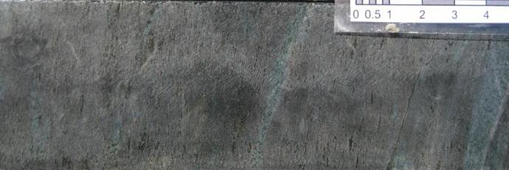
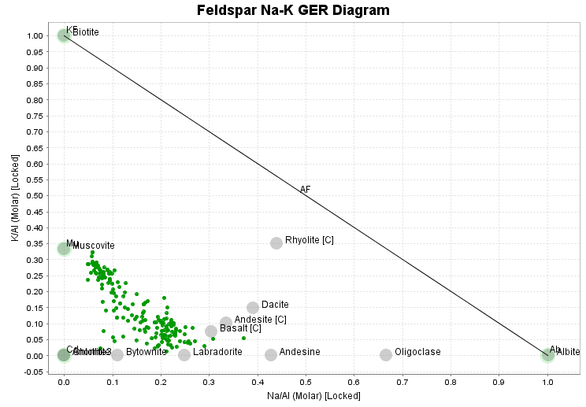
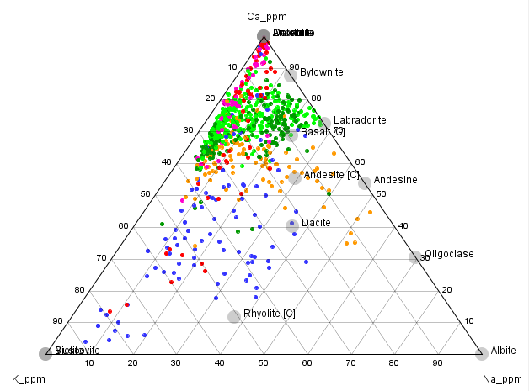
Anomalous mineral assemblages formed from metamorphism of altered protoliths
Major elements indicative of sericite-chlorite-carbonate alteration in rocks that are now biotite-actinolite-anorthite.
Least-altered basalt
Trend of increasing alteration intensity
Trend of increasing alteration intensity
Least-altered basalt
Notes:
K/Al vs Na/Al molar ratio plot. These plots are a really good way to visualise changes in bulk composition during alteration. Alteration in the basalt lies on a trajectory heading towards the composition of muscovite. Alteration has removed Na from the rock, but the Ca-K-Na ternary plot shows that Ca has been retained. This is a really typical pattern in rocks with sericite-chlorite-carbonate alteration. However in the example shown here, the mineralogy of these rocks is biotite-actinolite-anorthite. The most altered (and mineralized) rocks have a molar K/Al ratio of 1:3 as we would see in white mica, but in these rocks all the K is in biotite, with K/Al = 1:1. That means that on the scale of an assay interval, biotite and anorthite are always present in the same ratio. This cannot be a hydrothermal process. This must be a metamorphic overprint of a hydrothermally altered rock!

Slide 31
Significance of low temperature pathfinder footprints
Temperature-related zoning patterns, commonly tilted.
Large synvolcanic alteration systems, dominantly clay-rich alteration with carbonates and abundant metal-bearing pyrite.
Metamorphism of pre-existing alteration cells even under quite low metamorphic grades will make very large volumes of H2O-CO2-Au-S fluid.
Proximity to late basin = shallow crustal level = more hydrous alteration minerals = greater volume of metamorphic fluid

Slide 32
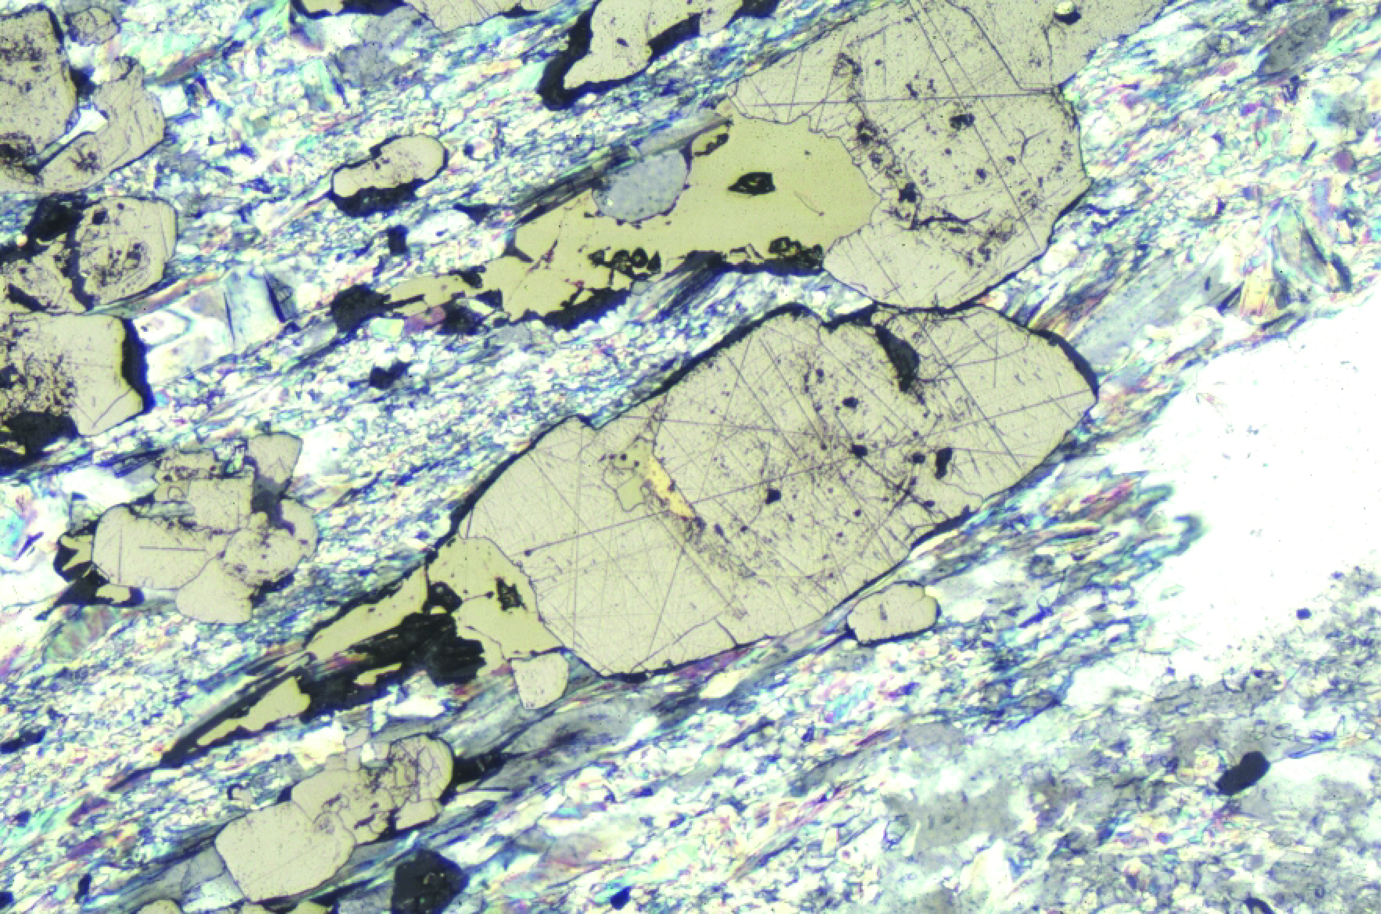
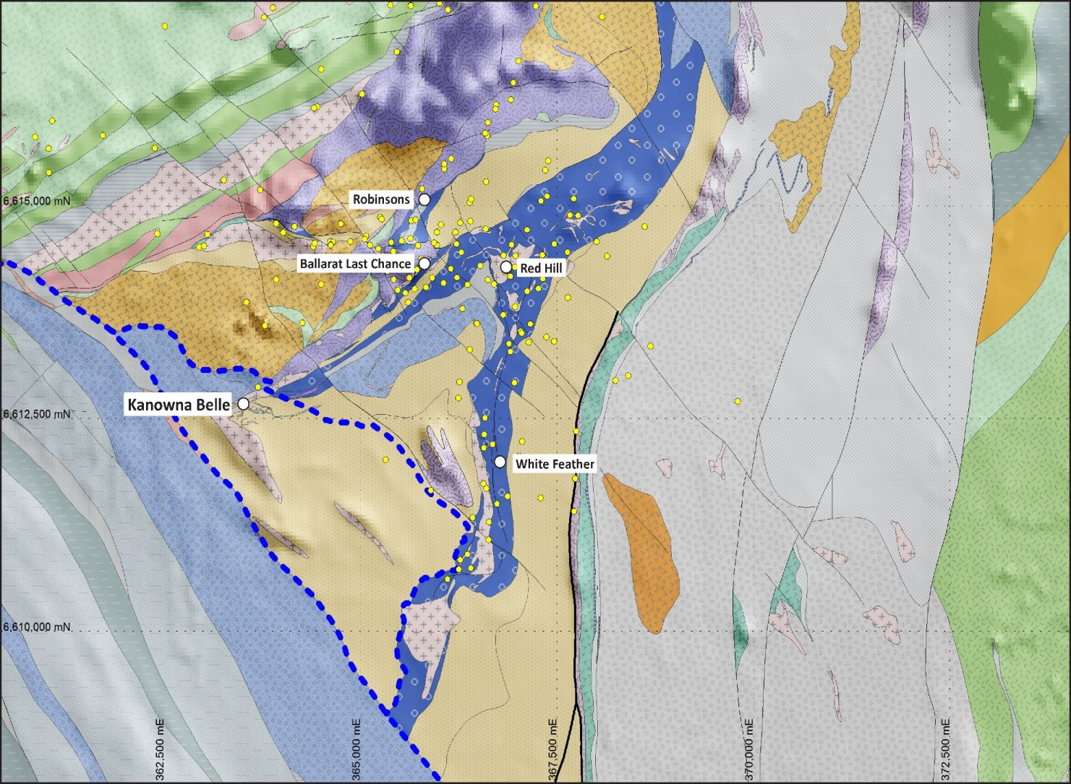
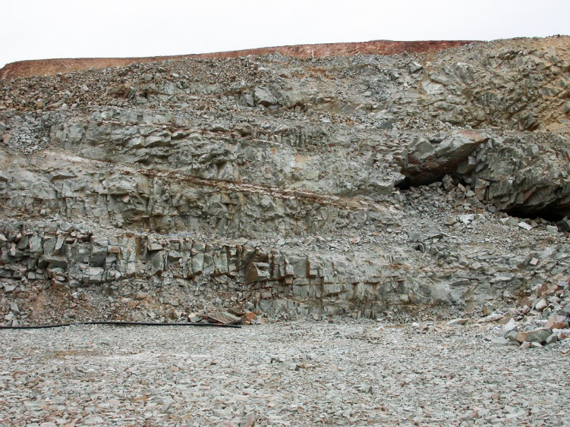
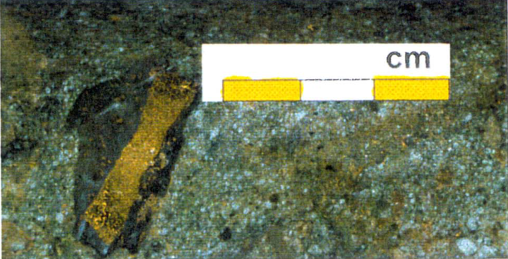
Kanowna Belle Camp – At least 3 different ages of mineralization.
Multiple intrusion-related events AND a metamorphic overprint
Qtz-Mo-Au in apophyses of Scotia-Kanowna dome (2668, Re-Os)
Deformed ore-stage pyrite at KB
Post-foliation veins at Red Hill
(from Gerard Tripp)
Kanowna Belle Pyrite
Red Hill
Post foliation orogenic flat veins
Notes:
An obvious reason for the apparent “multiple gold events” is that there are early intrusion-related hydrothermal systems, that are subsequently metamorphosed. Dehydration and decarbonatization reacts from the low temperature phyllosilicates and carbonates generate large volumes of metamorphic fluid that locally redistribute metals and sulfides into shear zones and brittle fault arrays.

Slide 33
Geology
Epiclastic
Basin
Unconformity
Upper Basalt;
Paringa-type
Lower Basalt;
Lunnon-type
Black Flag Beds
Ultramafic
Enriched porphyry;
Partial melt from a metasomatised mantle source, or
Highly fractionated, or
Hybrid magma – mixed TTG + lamprophyre composition
Syn-volcanic, pre-metamorphic emplacement at a shallow crustal level.

Slide 34
Metal Zoning
Epiclastic
Basin
Sb
As
Black Flag Beds
Mo
Bi-Te
Upper Basalt;
Paringa-type
Lower Basalt;
Lunnon-type
Ultramafic

Slide 35
Early (pre-metamorphic) alteration zoning
Smectite-Pyrite-Ankerite
Illite chlorite pyrite ankerite
Feldspar muscovite
Biotite magnetite
This is the expected mineral zoning pattern in near surface (0 to 3km) environments.

Slide 36
Low temperature indicators
Sb
Cs
Li
As well as high Sb levels (commonly with Sb de-coupled from As) there are other low temp signatures;
Low temperature interlayered smectite-chlorite is a repository for Lithium (in mafic rocks)
Low temperature smectite is a repository for Cesium (in intermediate to felsic rocks)

Slide 37
Metamorphic (middle greenschist) mineral zoning
Paragonite-Fe chlorite
(magnetite)
Muscovite chlorite pyrite ankerite
Feldspar phengite
Biotite magnetite

Slide 38
Conclusions
Giant gold systems are the cumulative result of several “pre-conditioning events”.
Fractionating mantle plumes create an enriched mantle source.
Partial melting of the enriched mantle creates Au-S enriched dioritic magmas.
Emplacement of the enriched diorites at shallow crustal levels creates hydrothermal cells with high water, CO2, Au, S plus zoned pathfinder chemistry. Some orebodies are formed at this stage.
Ore fluids in orogenic gold systems are locally derived from metamorphic reactions within the early-formed alteration systems.
The alteration systems may be tilted by later events; need to understand the zoning pattern to improve targeting.

Slide 39
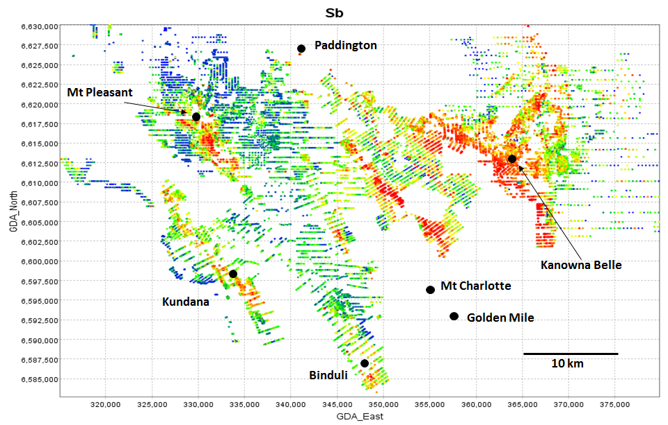
Exploration for Orogenic Au systems
Camp scale
GEOLOGY MAP!!!
Gravity to map the intrusions
Magnetics + Mo-Bi-Te to map alteration around intrusions
Sb-Cs-Li to map outflow zones
Metamorphic magnetite after ankerite
Structural targeting INSIDE to footprint of hydrothermal cells

