Slide 1
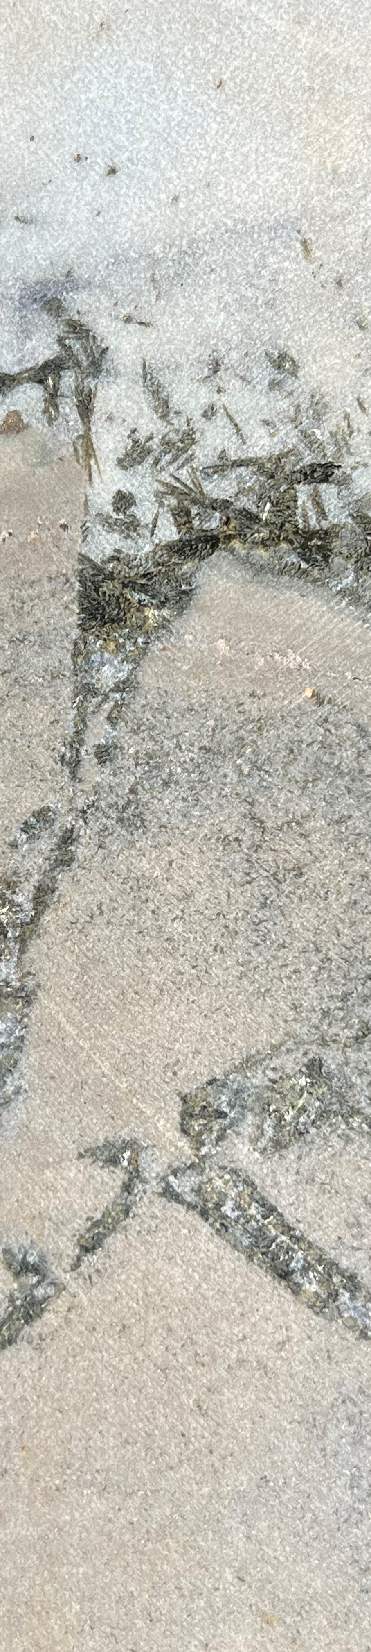
Mineralogy Models from drill hole data
Visual logging is subjective. Every geologist will log differently. The same geologist will log differently on a Tuesday morning compared to a Friday afternoon. For most mineral deposits it is almost impossible to create a meaningful and useful alteration model from visual logging data.
Without a reliable mineralogy model, metallurgists select test samples based on low, medium, high grade, but they don’t sample to test variations in gangue mineralogy. (What could possibly go wrong?)
This case study is a sediment-hosted Cu system in rocks metamorphosed to amphibolite grade. It has been drilled by several different companies over a period of 30 years.
The data presented here shows inconsistency of visual logging. Whole rock chemistry (4AD ICP-OES) is a quantitative data set from which mineral abundances can be calculated with a mass balance algorithm. The mineralogy in this system is dominantly albite (oligoclase)-calcite-biotite-quartz. The fine-grained hydrothermal feldpars were usually logged as “silicification”.
Mineralogy estimated from assays is more reliable than alteration categories assigned from visual logging. Spectral systems report “spectral contributions” of minerals that are active in various wavelength ranges, but SWIR for example, doesn’t respond to quartz, feldspars or sulfides.
We do not need perfection, but we do need a useful model. We are not trying to do a Ph.D. We are trying to map and model variability in a mineral system.

Slide 2
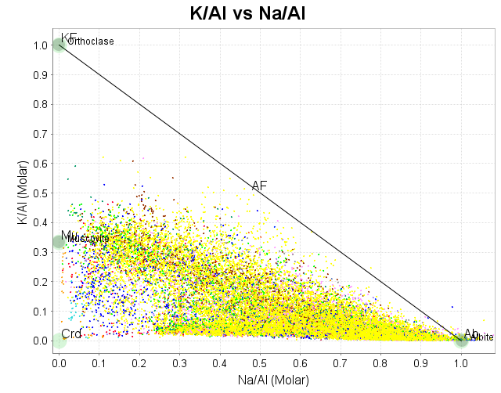
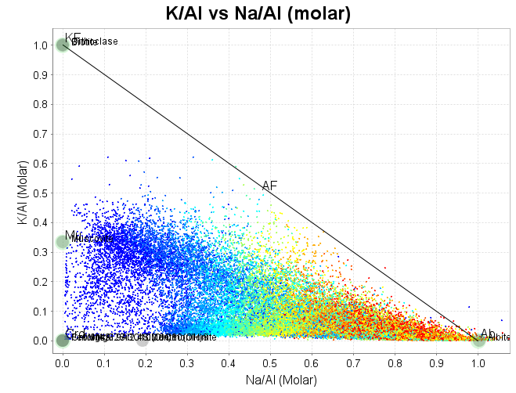
K/Al vs Na/Al (molar)
In this figure, there are 32,000 data points (assay intervals) with 30 different codes for the dominant alteration mineral.
Logged Alteration
Albite_%
Silica
to 10.37
Albite
to 16.9
Chlorite
to 21.91
Biotite
to 25.78
Clinopyroxene
to 29.52
Hematite
to 33.23
Carbonate
to 37.22
silica
to 41.95
Diopside
to 48.33
Sericite
to 80.73

Slide 3
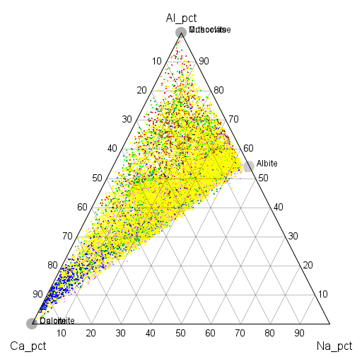
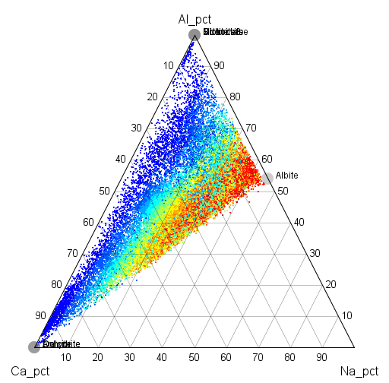
Al-Ca-Na ternary
This plot shows a very sharp boundary to the data cloud between the albite node and the Ca apex. This is a feldspar-calcite control.
Logged Alteration
Albite_%
Silica
to 10.37
Albite
to 16.9
Chlorite
to 21.91
Biotite
to 25.78
Clinopyroxene
to 29.52
Hematite
to 33.23
Carbonate
to 37.22
silica
to 41.95
Diopside
to 48.33
Sericite
to 80.73

Slide 4
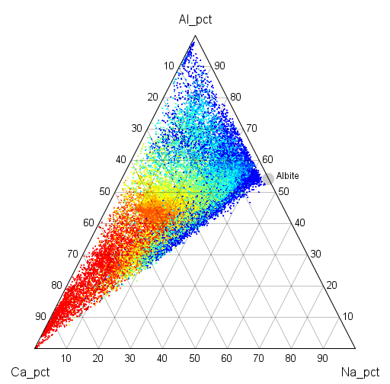
Al-Ca-Na ternary
This plot shows a very sharp boundary to the data cloud between the albite node and the Ca apex. This is a feldspar-calcite control.
Logged Alteration
Calcite_%
Silica
to 0
Albite
to 0.65
Chlorite
to 1.69
Biotite
to 2.71
Clinopyroxene
to 4.3
Hematite
to 7.07
Carbonate
to 10.26
silica
to 12.37
Diopside
to 16.61
Sericite
to 86.84

Slide 5
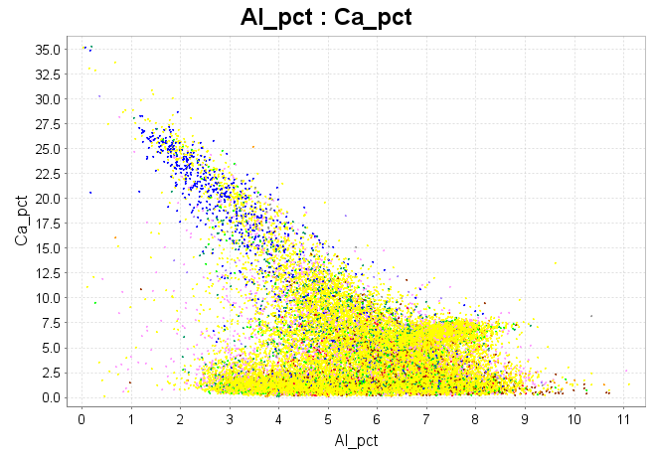
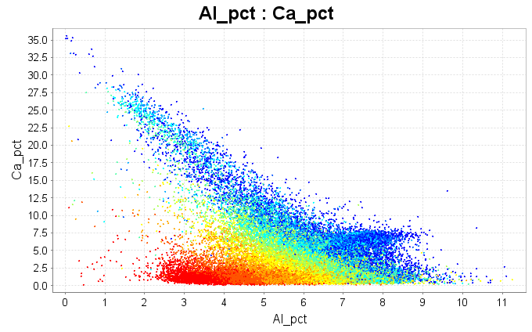
Al vs Ca
The sediments include alternating sand and silt bands. There are more phyllosilicates (with high Al) in the silt, and the sandy layers contain more quartz (Al deceases as quartz increases). Even though SiO2 was not analyzed, the estimates of quarzt_pct are surprisingly accurate.
Logged Alteration
Quartz_pct
Silica
to 8.61
Albite
to 11.3
Chlorite
to 13.76
Biotite
to 16.73
Clinopyroxene
to 21.3
Hematite
to 28.39
Carbonate
to 36.69
silica
to 47.21
Diopside
to 57.5
Sericite
to 94.62

Slide 6
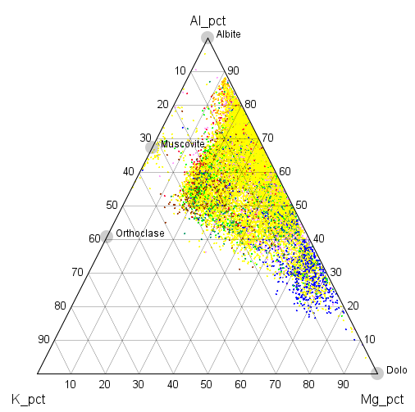
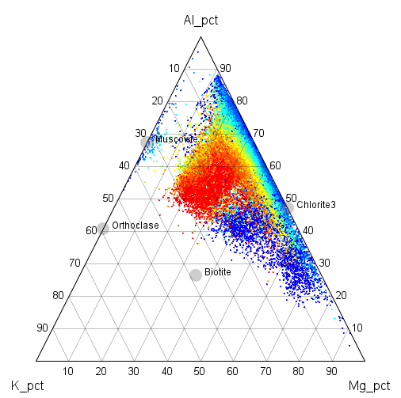
Al-K-Mg ternary
We write the composition of biotite as K(Fe,Mg)3AlSi3O10(OH)2, ie K:Al = 1, but the Al atoms per formula unit in hydrothermal biotite is always more than 1 (usually more like 1.4). The data cloud in this plot shows a biotite control. Biotite>Muscovite is consistent with temperatures >350 degrees, along with oligoclase rather than albite.
Logged Alteration
Biotite_%
Silica
to 0.35
Albite
to 1.38
Chlorite
to 2.63
Biotite
to 3.9
Clinopyroxene
to 5.28
Hematite
to 6.81
Carbonate
to 9.03
silica
to 12.37
Diopside
to 18.44
Sericite
to 49.94

